Slide 1
Key Enquiry:
Does the UK’s decision to leave the EU (Brexit) justify a second independence referendum?
What type of source is this?
Who made it? Does this influence you in any way?
Who is the target audience?
What is the tone?
What message does this source give its audience?

Slide 2
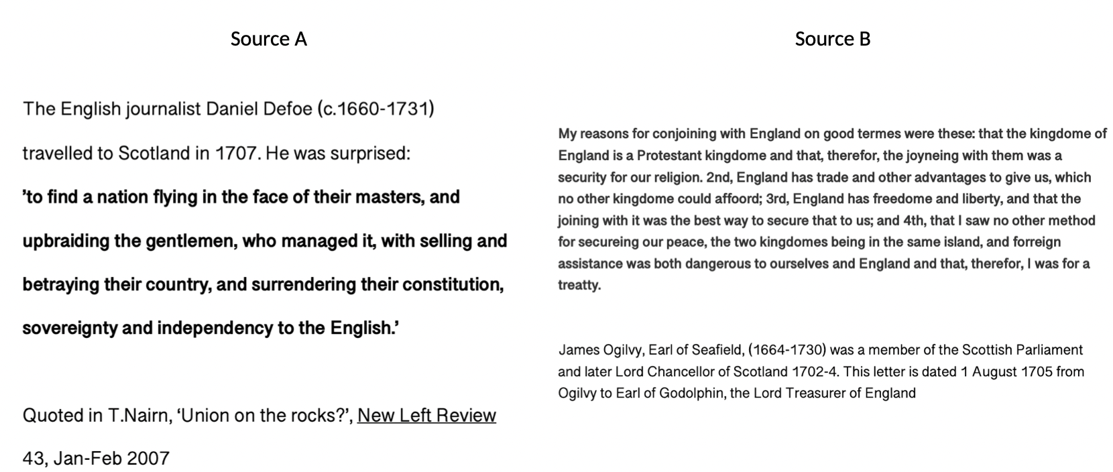
Activity
The passing of the Act of Union
Give students paired source questions related to the question of benefit from the Union.
Discuss responses in class or set as written work
How useful is Source A in helping us understand Scottish responses to the Act of Union of 1707?
How fully does source B explain why Scots thought the Act of Union was necessary for the protection of Scottish identity?
What does a comparison of these two sources tell you about Scottish attitudes to the Act of Union?

Slide 3
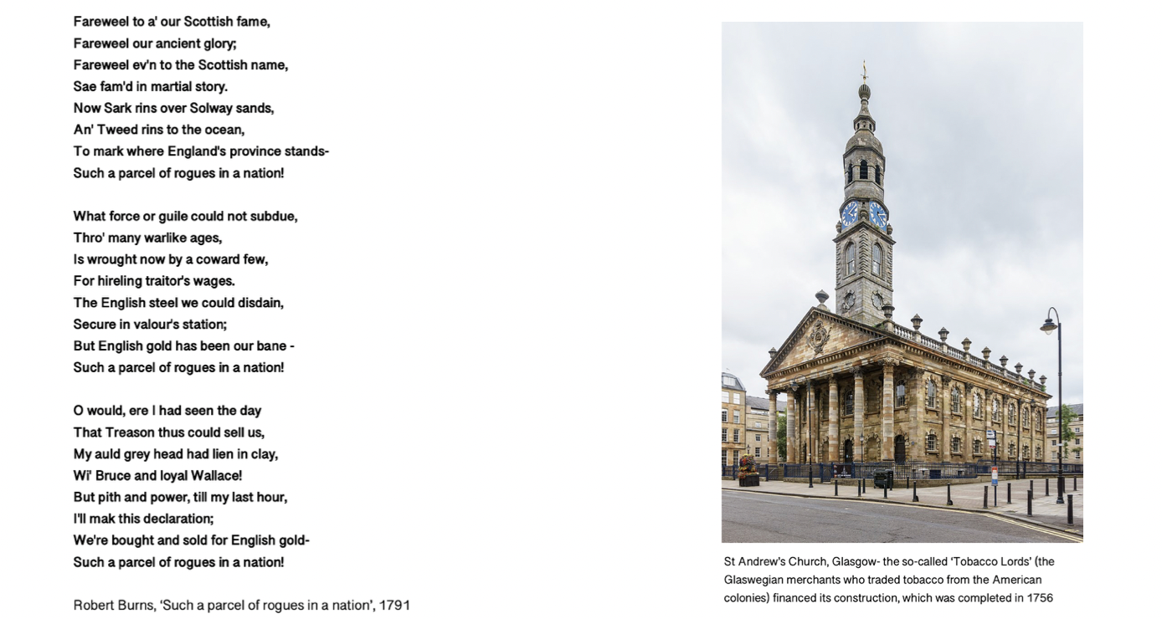
Activity
The impact of the Act of Union
Give students paired source questions related to the question of benefit from the Union.
Discuss responses in class or set as written work
How fully does Source A explain Scottish responses to the impact of Union ?
How useful is source B in helping us understand the impact of Union on Scottish economy and society?
What does a comparison of these two sources tell you about the impact of the Union on Scottish identity?

Slide 4
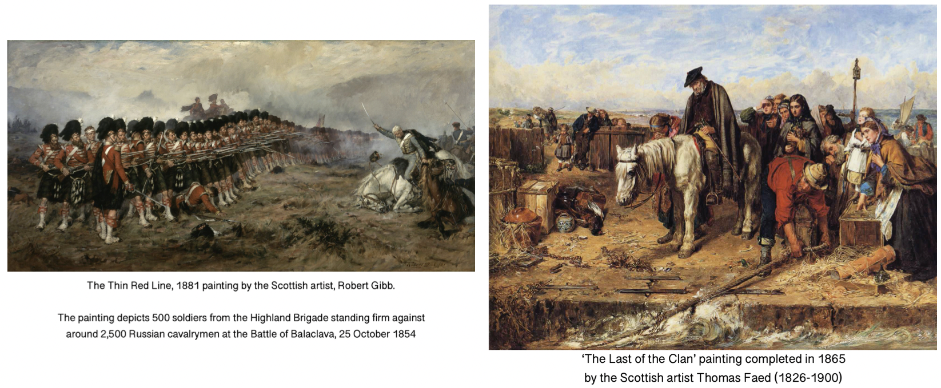
Activity
Migration and Empire
Give students paired source questions related to the question of benefit from the Union.
Discuss responses in class or set as written work
How useful is painting A in helping us understand the reasons for Scottish support of Union and empire?
How fully does painting B explain the push factors in migration of Scots?
What does a comparison of these two sources tell you about the impact of empire on Scottish identity?

Slide 5
Activity
Migration and Empire
Give students paired source questions related to the question of benefit from the Union.
Discuss responses in class or set as written work
How useful is source A in helping us understand the reasons for Scottish emigration?
How fully does source B explain why Scots did not migrate from the UK?
What does a comparison of these two sources tell you about the impact of empire on Scottish identity?

Slide 6
Activity
Impact of the Great War
Give students paired source questions related to the question of benefit from the Union.
Discuss responses in class or set as written work
How useful is source A in helping us understand the reasons for continued Scottish support for the Union after the Great War?
How fully does source B explain post-war migration?
What does a comparison of these two sources tell you about the impact of the Great War on Scottish identity?

Slide 7
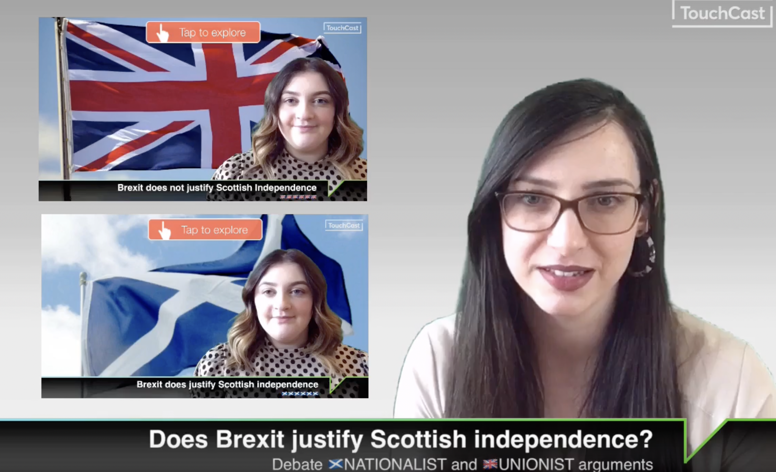
Activity
Building the narrative
Put students in groups:
Group 1: Brexit does not justify Scottish independence
Group 2: Brexit does justify Scottish independence
What are the lines of argument made?
https://me.touchcast.com/s/cbixxbw3f9

Slide 8
Stage 1: Divide yourselves into two teams
Team 1: Brexit does not justify Scottish independence
Team 2: Brexit does justify Scottish independence
Activity
Prepare, Debate and Reflect
Create teams of 4
Provide each group with the source booklet
Students are to explore the sources and use them as evidence to support their arguments.
Discussion findings as a class before starting stage 4.
They are then to write a 60 second speech to use in a debate.
Stage 2: Your team’s arguments
From the video, agree as a team what four arguments you will use in a debate.
Stage 4: Writing your speech
Write a 60 second speech for your debate. You can use this format to help you:
S – State your argument
E – Evidence from the source
E - Factual Evidence
L – Link
Stage 3: Explore the sources
In groups explore all the sources:
Make inferences
Question its reliability
Question its utility
As a team choose the best source that would strengthen each argument
Class discussion: Are some sources stronger than others, and why?

Slide 9
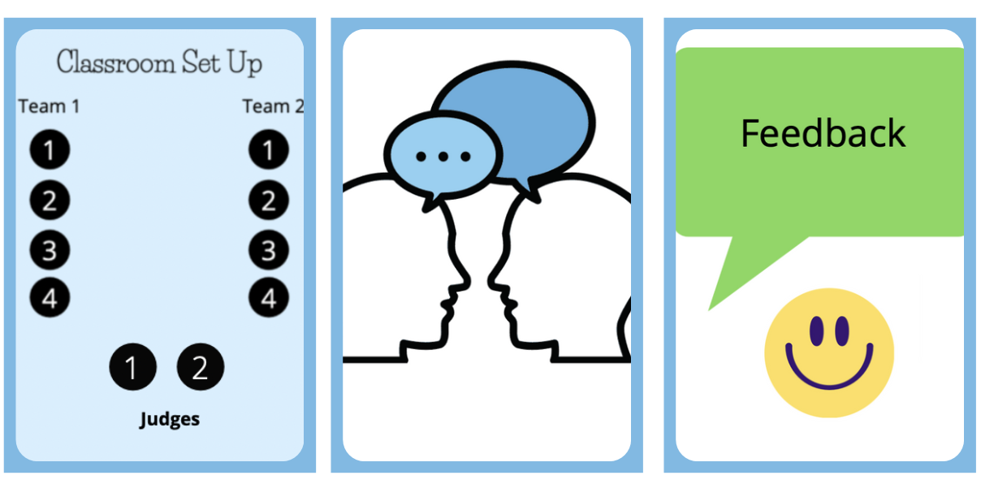
Activity
Prepare, Debate and Reflect
Run debates in groups of ten (two teams of four and two judges)
See guidance on debates and on how to judge debates.
The debates will run for 20 mins
Reflection for 5 mins

