Slide 1
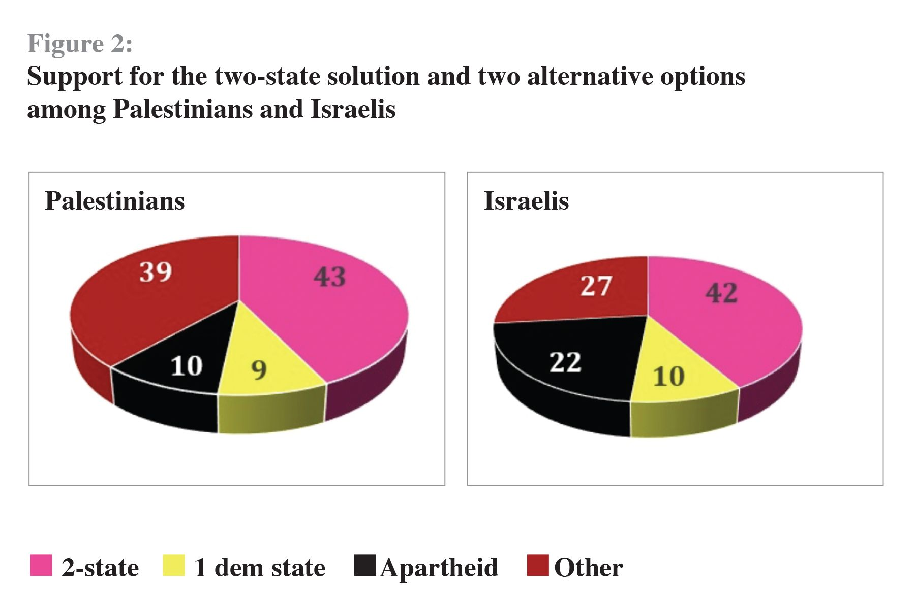
Key Enquiry:
Would a one State or a Two State outcome be better for Israelis and Palestinians?
How reliable is this source for an enquiry into a One-State or a Two-State solution?

Slide 2
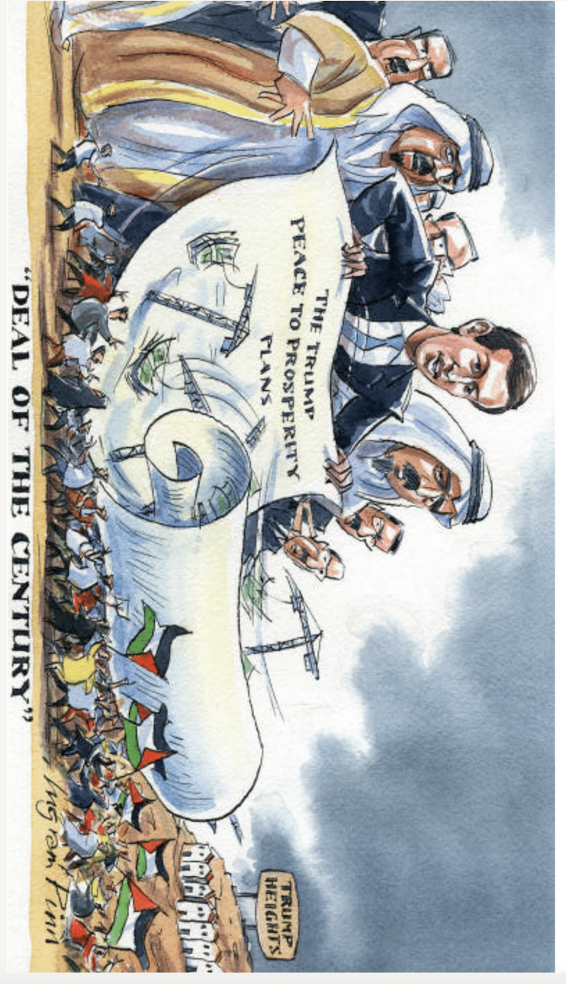
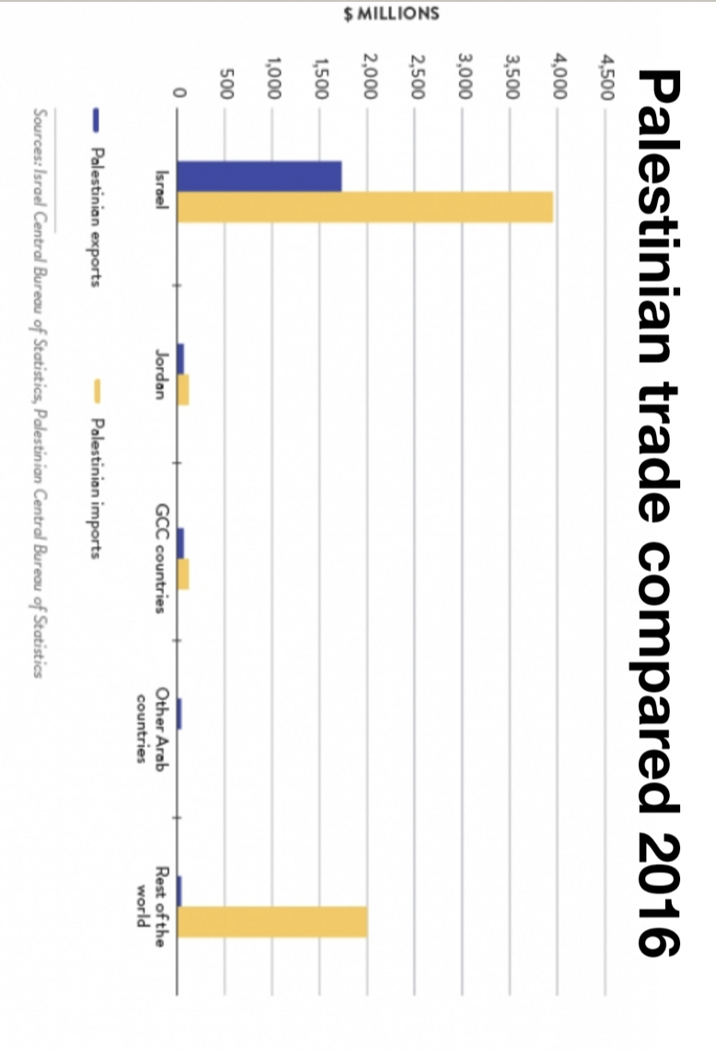
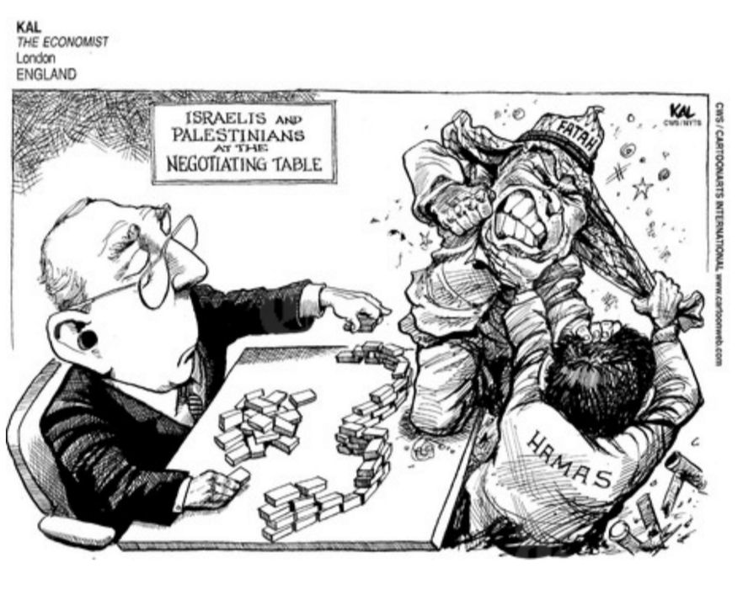
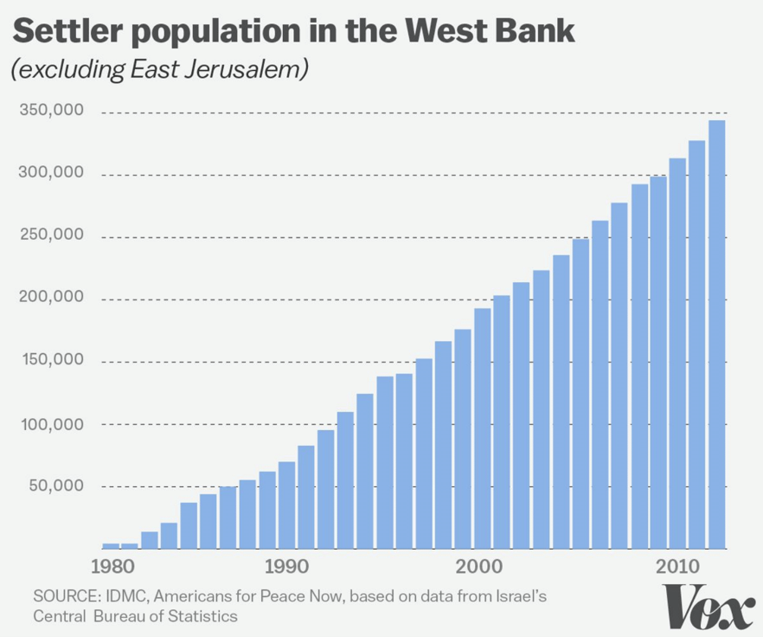
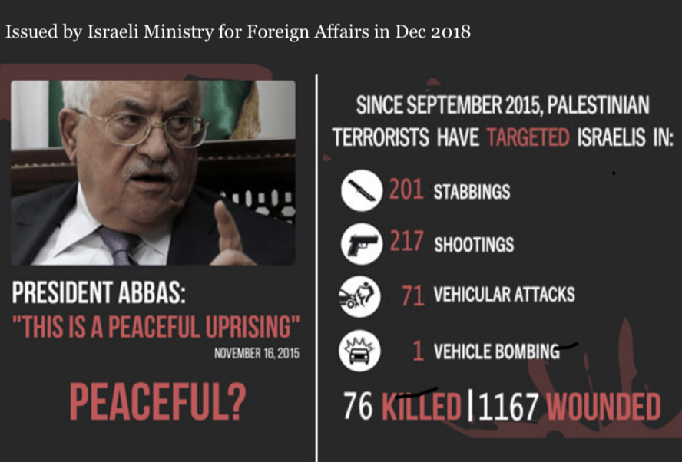
Activity 1:
Using sources as evidence
In groups of 4 explore all the sources:
Make inferences
Question its reliability
Question its utility
Discuss: how do these sources help you answer the key question?

Slide 3
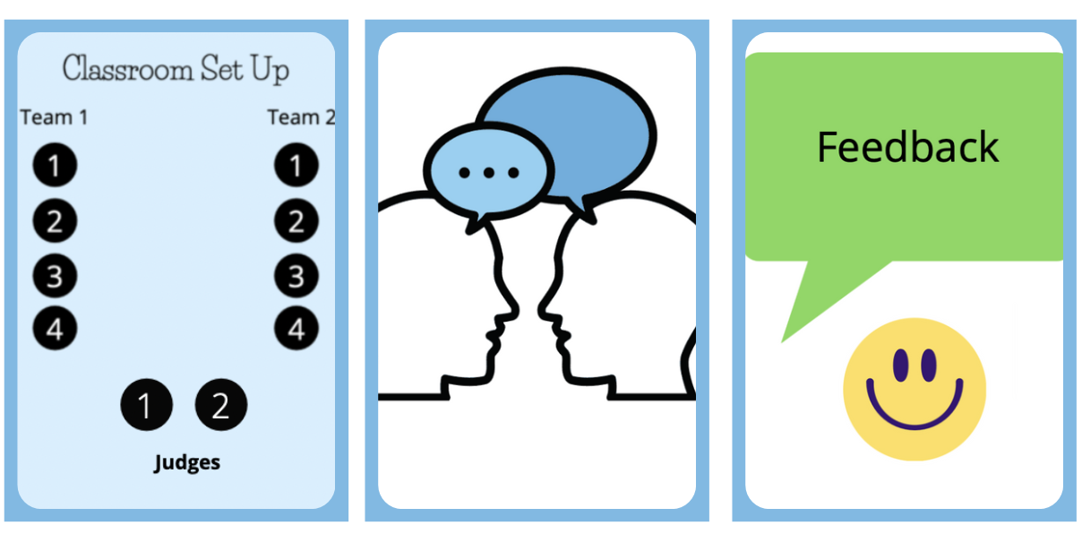
Activity 2:
Prepare, Debate and Reflect
In groups of four prepare arguments for either a ‘one state solution would be better’ or ‘ a two-state solution would be better’.
Each student picks sources to support his/her argument.
Challenge students to look beyond a source’s content and make comments on a source’s provenance.
Students should have to speak for 90s-2mins.
Then run debates in groups of ten (two teams of four and two judges)
Reflection

