Slide 1
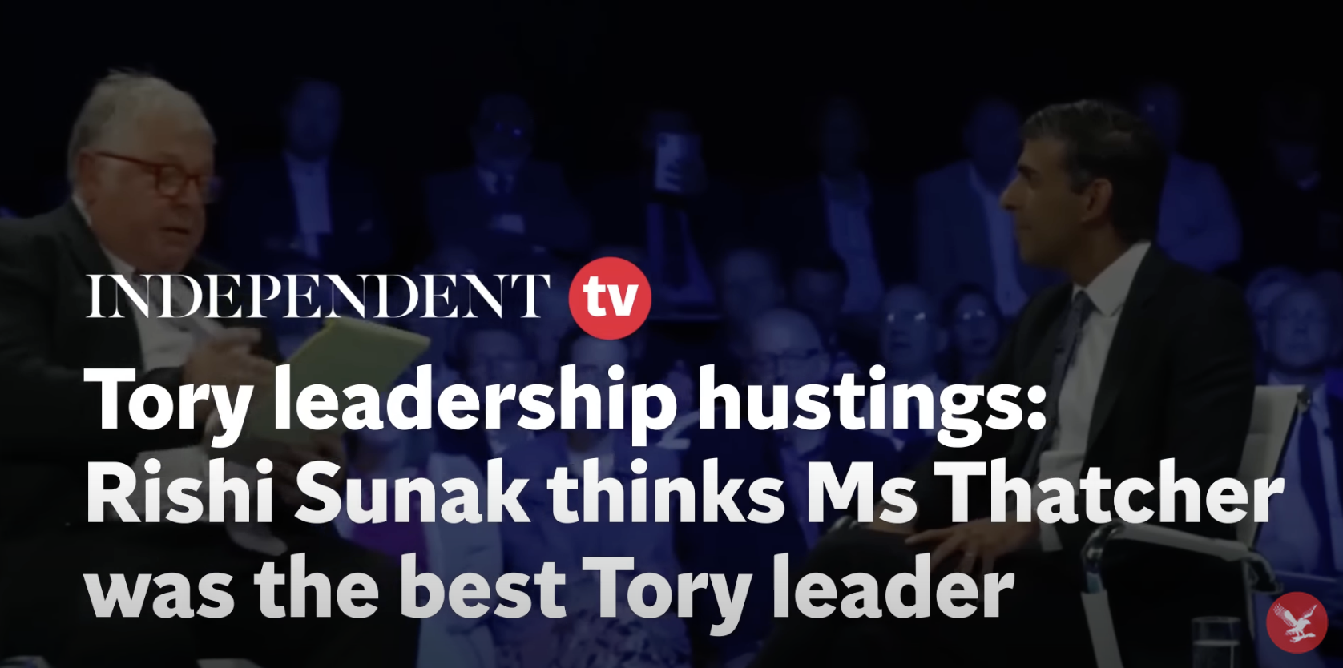
Starter: Margaret Thatcher today
Watch the interview from the Independent and think about what Rishi Sunak says about Thatcher. Is it a complete view of her leadership?
Questions: Rishi Sunak stated that “Margaret Thatcher was the best ever leader of the Conservative party”. What reasons did he give to support his view?
What impression does Sunak’s interview give you about Margaret Thatcher’s legacy?

Slide 2
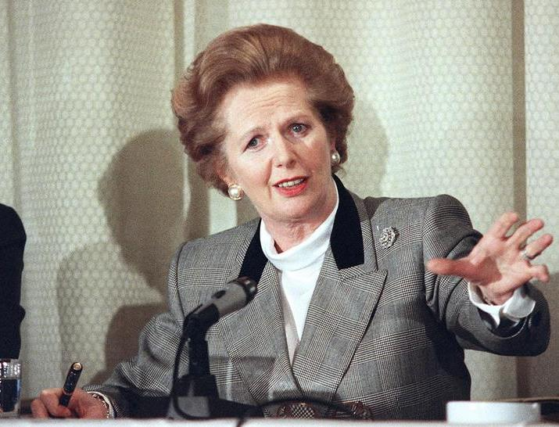
Was Margaret Thatcher good for Britain?

Slide 3
New information:
Watch the video on Thatcher and answer the questions
When did Margaret Thatcher become Prime Minister?
What Party was Margaret Thatcher leader of?
Write down two arguments that suggest that Margaret Thatcher was not good for Britain?
Write down two arguments that suggest that Margaret Thatcher was good for Britain.

Slide 4
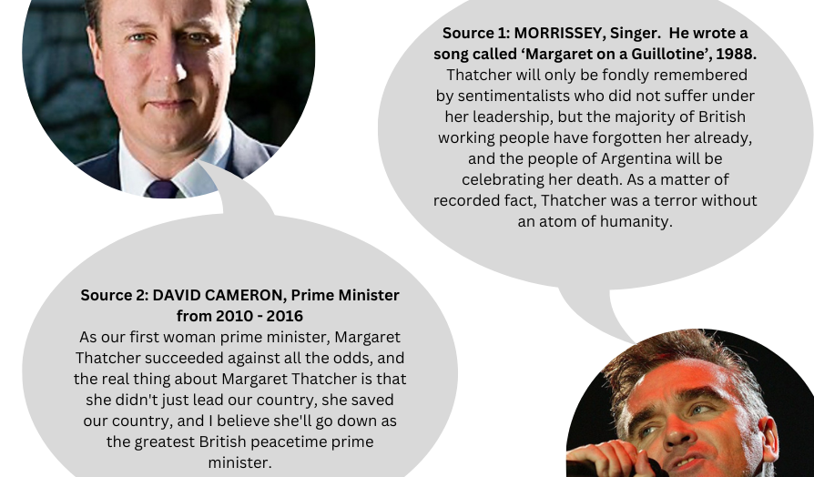
Develop your knowledge: In 1979 Margaret Thatcher became Britain’s first ever female Prime Minister. During her role as PM, she became a very controversial figure, but why does Margaret Thatcher divide opinion?
Task: In pairs discuss how these opinions are different and why they are different

Slide 5
Was Margaret Thatcher good for Britain?
Preparing for a debate on Thatcher
From the previous activity, you can see that people hold different opinions of Margaret Thatcher. Now it is over to you. Was Margaret Thatcher good for Britain?
Split the class into teams of 4 and assign each team a position:
EITHER YES, Margaret Thatcher was good for Britain
OR No, Margaret Thatcher was not good for Britain
Each team should:
Decide on 4 arguments to use in their debate
Choose sources to support each argument
Analyse each source and comment on:
What does the source tell you?
Who is the author of the source?
Why do you think this source has been produced?
In what ways is the source credible?
Write a 1–2-minute speech. Don’t forget you need to persuade your opposition that your argument is convincing.

Slide 6
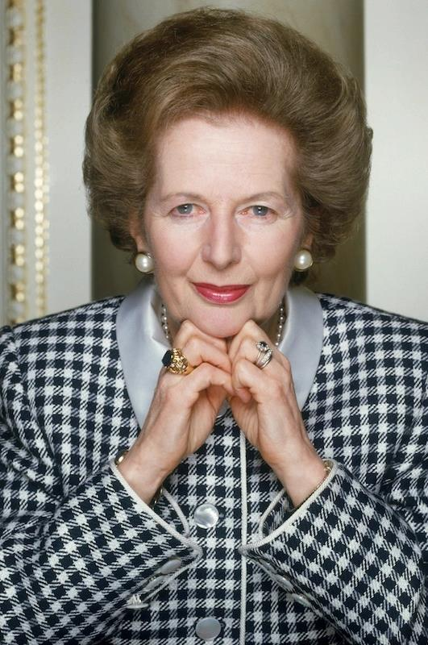
Let the debates begin!
Classroom set up:
Create groups of 10
Team 1 (4 students) – YES argument
Team 2 (4 students) – NO argument
2 students will act as judges. They will give feedback to each speaker
Rules:
You have 2 minutes maximum to deliver your speech
After all speeches have been delivered, allow 5-10-minutes for rebuttals.
At the end, each speaker will deliver their feedback. The feedback should contain What was good about the speech and what could be improved.

