Slide 1
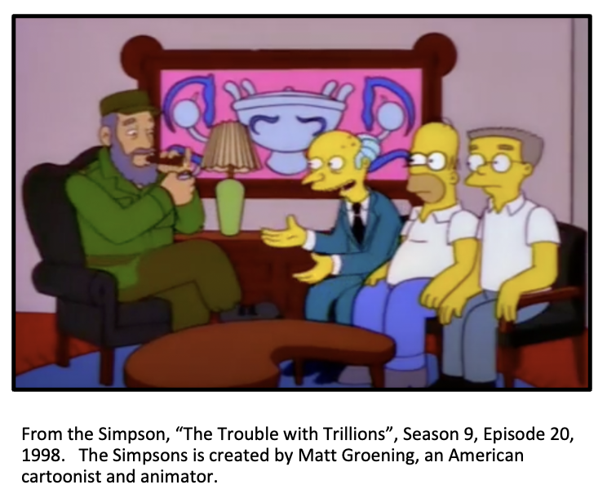
Starter: The Simpson’s take on Fidel Castro
Cartoons offer an insight into public opinion on events or individuals but they too could exaggerate or oversimplify the past for a particular purpose.
Watch this clip from The Simpsons and put your source analysis skills to the test.

Slide 2
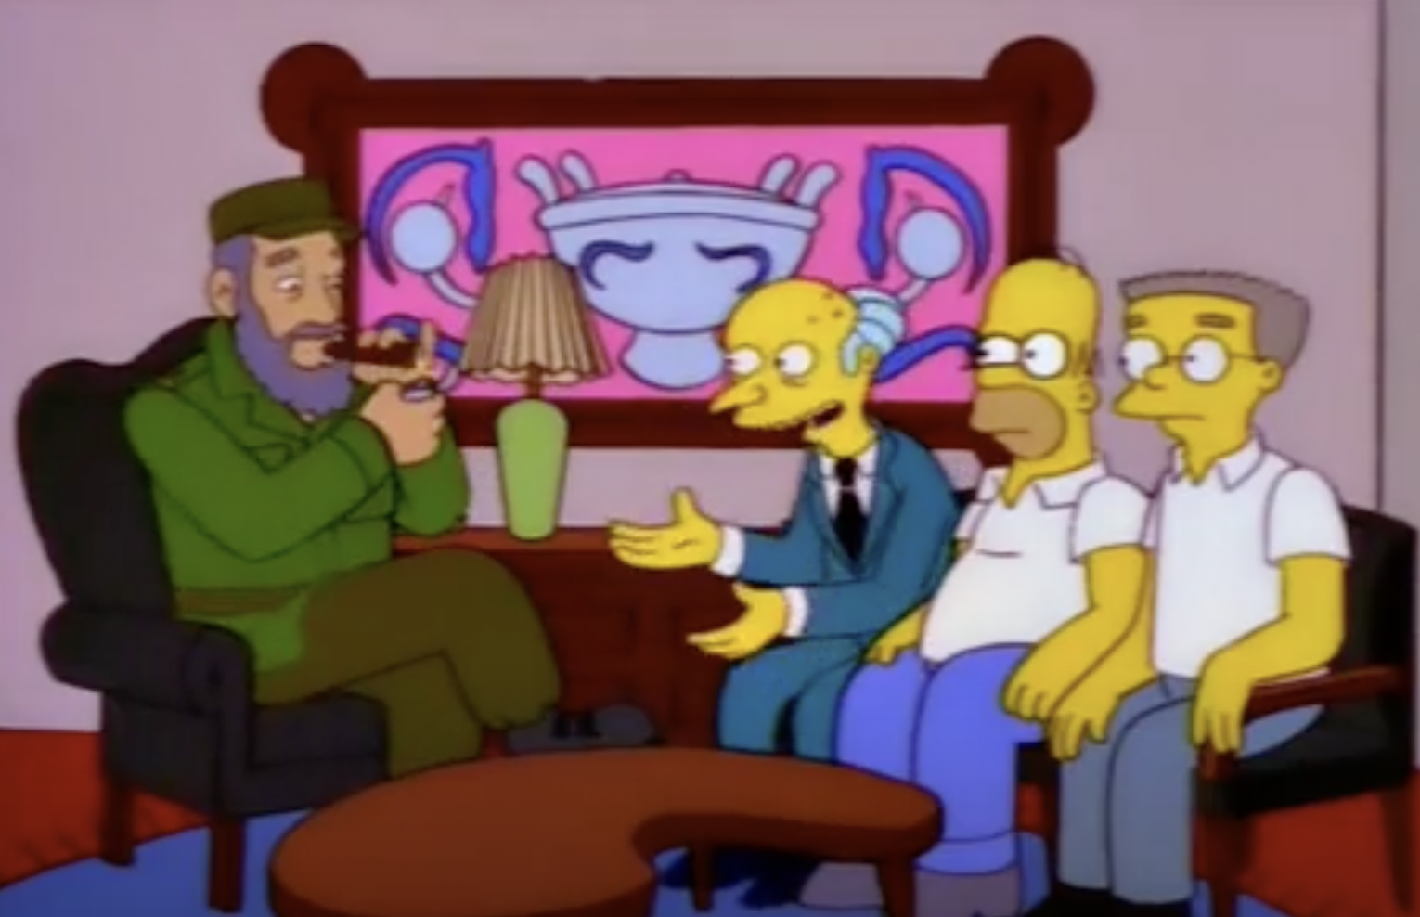
Step 2: How is Fidel Castro being presented?
Step 4: Watch the cartoon clip again. Review your list and comment on what they could stand for e.g., posters, people, things they they say
From the Simpson, “The Trouble with Trillions”, Season 9, Episode 20, 1998. The Simpsons is created by Matt Groening, an American cartoonist and animator.
Step 3: Now consider who made the cartoon. Where do they come from? What is their motive? What are they trying to say?
Step 1: Watch this video clip from the Simpsons. Make a list of the things you see that are in the cartoon.
Step 5: What is the message of the cartoon?

Slide 3
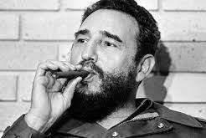
Was Fidel Castro a Great Leader?

Slide 4
New information:
Watch the video on Fidel Castro and answer the questions
When did Fidel Castro take power?
List 3 things Fidel Castro did when he came to power?
What crisis did Fidel Castro play a key role in?
Who was Fidel Castro allied with during this crisis?
Write down two arguments that suggest that Fidel Castro was a great leader.
Write down two arguments that suggest that Fidel Castro was not a great leader.
Extension: Using the video, create a dual narrative timeline on Fidel Castro

Slide 5
He raised the international profile of Cuba
He resisted the USA’s efforts to turn Cuba into a colony
Castro brought the world to the brink of nuclear destruction by inviting the Soviets to place missiles in Cuba in 1962. Only the statesmanship of American and Soviet officials – not Castro – prevented nuclear war.
Against the odds, he put an end to a criminal regime in Cuba that was backed by the USA.
He presided over a stagnating, poor economy that never manage to develop to the level of capitalist, democratic countries.
Castro had homosexuals rounded up, put into camps, and killed.
He made sure that the Cuban government provided healthcare, education and other social services for the whole population
Cubans’ dissatisfaction with his rule is demonstrated by mass emigration
Cuba’s economic problems were a result of the USA’s unprecedented, long, trade embargo – not Castro’s policies.
Castro was an authoritarian dictator
Match the source to the argument.
In groups of four organise the arguments into PRO and ANTI Fidel Castro
Using the source booklet, match each source to an argument (2 sources per argument)
Compare the two sources and select the strongest source for each argument.
Explain why you’ve selected each source.

Slide 6
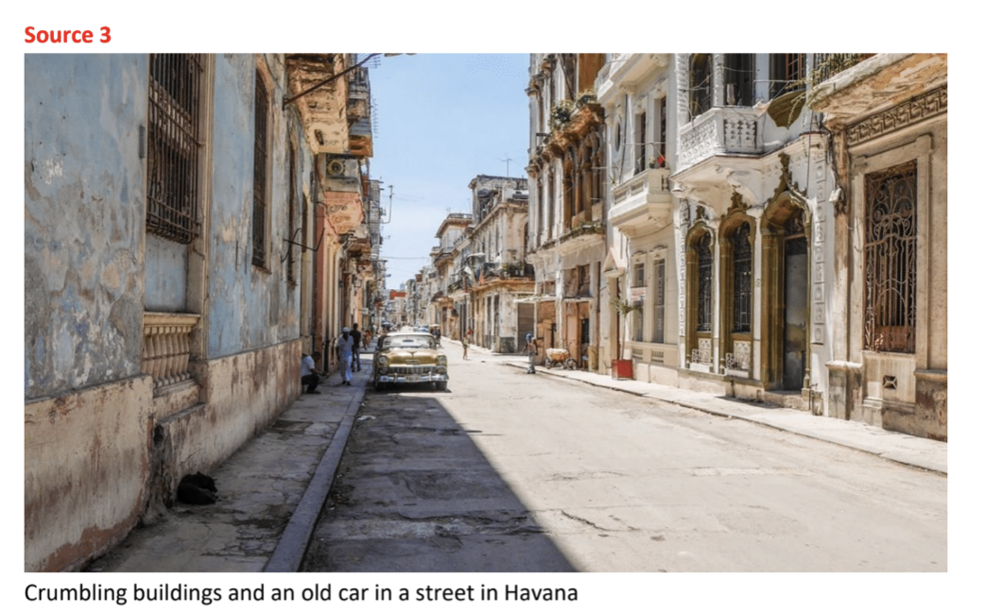
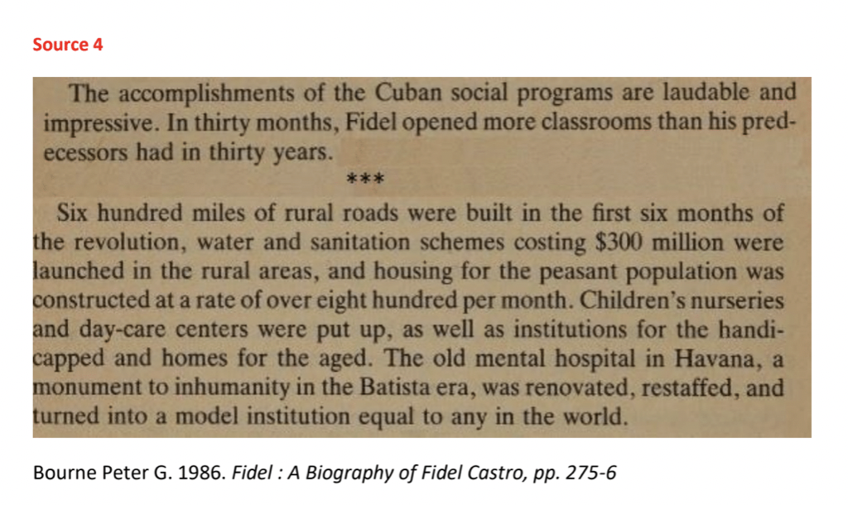
In pairs examine each source below and discuss the following questions:
What theme do both sources focus on?
Take a closer look at Source 3. What is the main subject of the photograph?
Why do you think the photographer has taken the photograph in this way?
Take a closer look at Source 4. Discuss the strengths and weaknesses of the source being a biography of Fidel Castro.
What does the content tell you about Fidel Castro’s leadership?
What does each source suggest about Fidel Castro’s leadership?
Exploring sources in depth
In order to assess Fidel Castro’s leadership, compare these sources.

Slide 7
Was Fidel Castro a Great Leader?
Preparing for a debate on Fidel Castro
From the previous activity, you can see that different sources reveal different views on Fidel Castro’s leadership . Now it is over to you. Was Fidel Castro a Great Leader?
Split the class into teams of 4 and assign each team a position:
EITHER Yes, Fidel Castro was a great leader
OR No, Fidel Castro was not a great leader
Each team should:
Decide on 4 arguments to use in their debate
Choose sources to support each argument
Analyse each source and comment on:
What does the source tell you?
Who is the author of the source?
Why do you think this source has been produced?
In what ways is the source credible?
Write a 1–2-minute speech. Don’t forget you need to persuade your opposition that your argument is convincing.

Slide 8
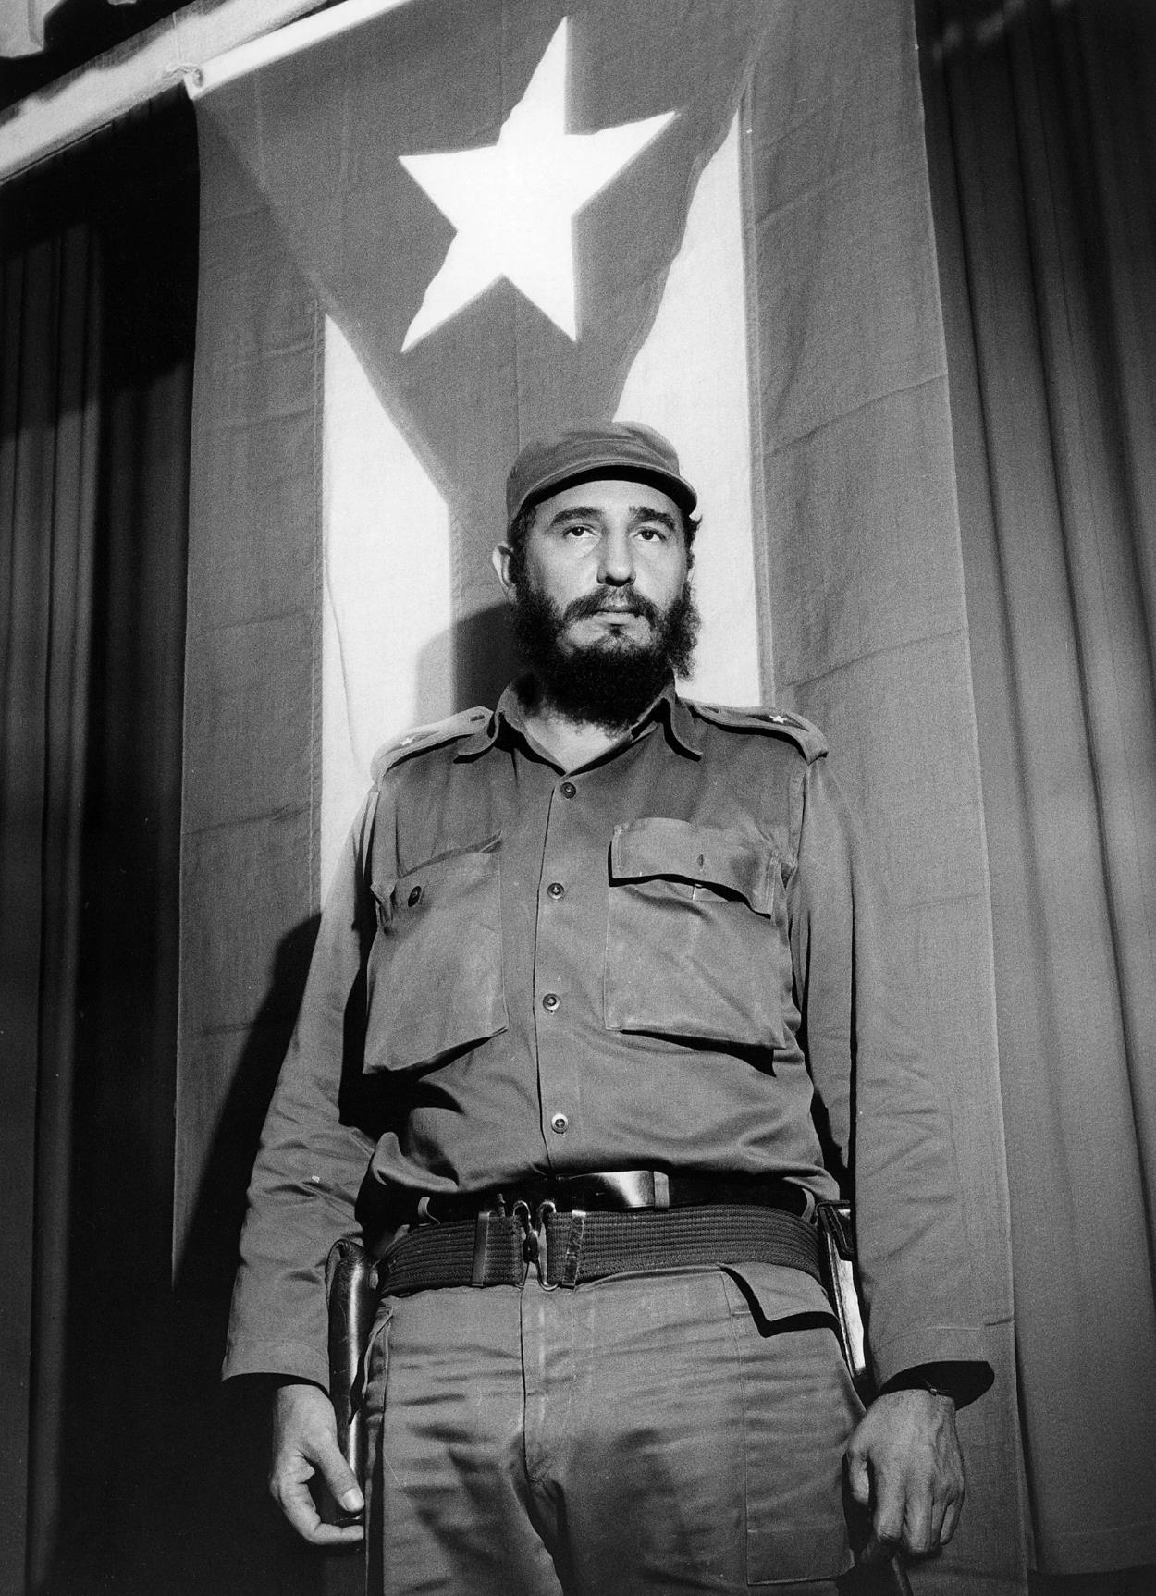
Let the debates begin!
Classroom set up:
Create groups of 10
Team 1 (4 students) – YES argument
Team 2 (4 students) – NO argument
2 students will act as judges. They will give feedback to each speaker
Rules:
You have 2 minutes maximum to deliver your speech
After all speeches have been delivered, allow 5-10-minutes for rebuttals.
At the end, each speaker will deliver their feedback. The feedback should contain What was good about the speech and what could be improved.

