Slide 1
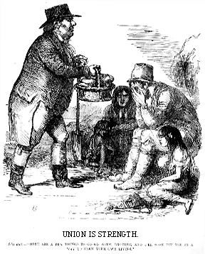
Starter: Source analysis
What can you learn from this source about the Great Famine?
To what extent are cartoons useful pieces of evidence?
A British cartoon from 1846 showing John Bull (John Bull was used to symbolise English people) feeding the poor Irish people.
The source says,
Union is Strength. John Bull - "Here are a few things to go on with, brother, and I'll soon put you in a way to earn your own living.".

Slide 2
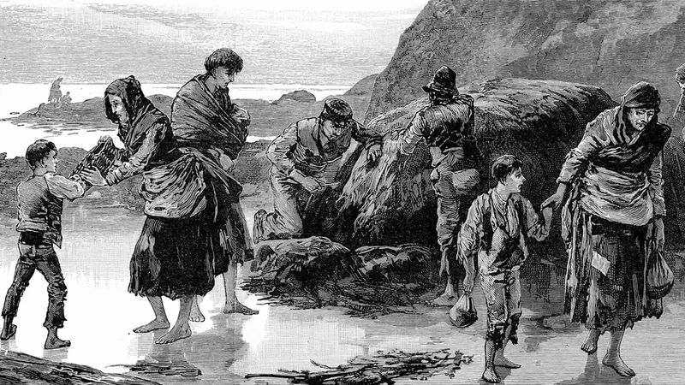
Key Enquiry:
Is the British Government responsible for the impact of the Famine?

Slide 3
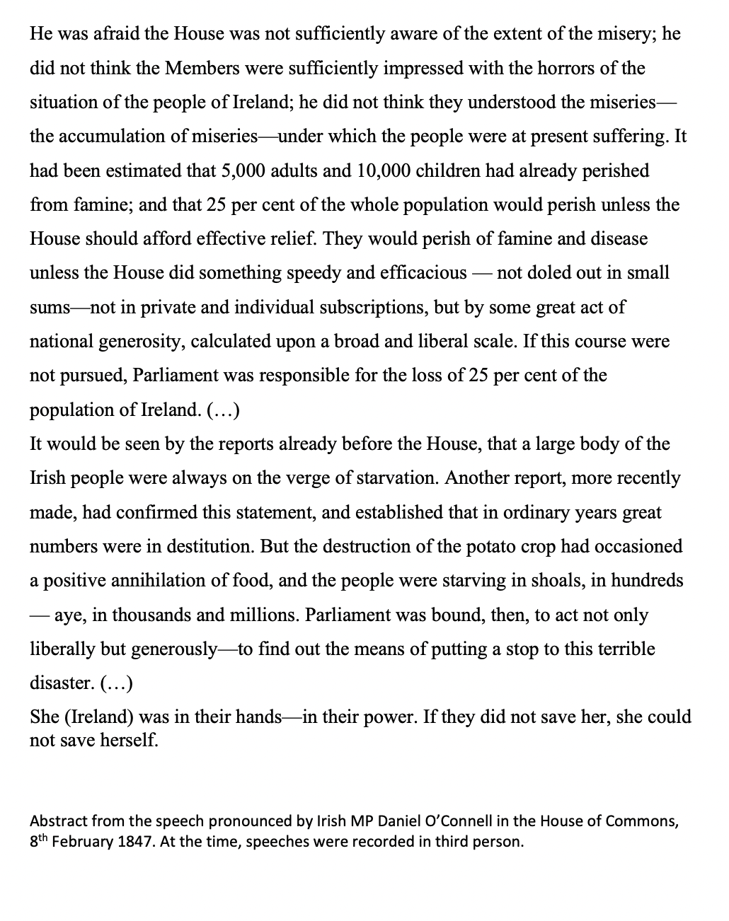
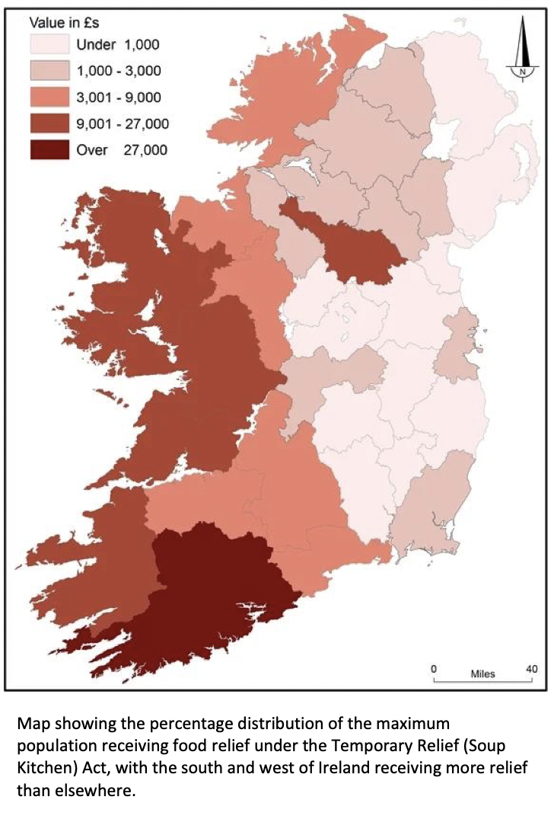
Activity
Compare and Contrast
Ask students to analyse Daniel O’Connor speech and the article in the Southern Reporter, or (less challenging) the cartoon ‘English Labourer’s Burden’ and the map of Location of Relief Committees and list the ways they are different and the same.
Compare and contrast the following aspects:
Content and Message
Timing
Media
Tone of Voice
Audience and Purpose

Slide 4
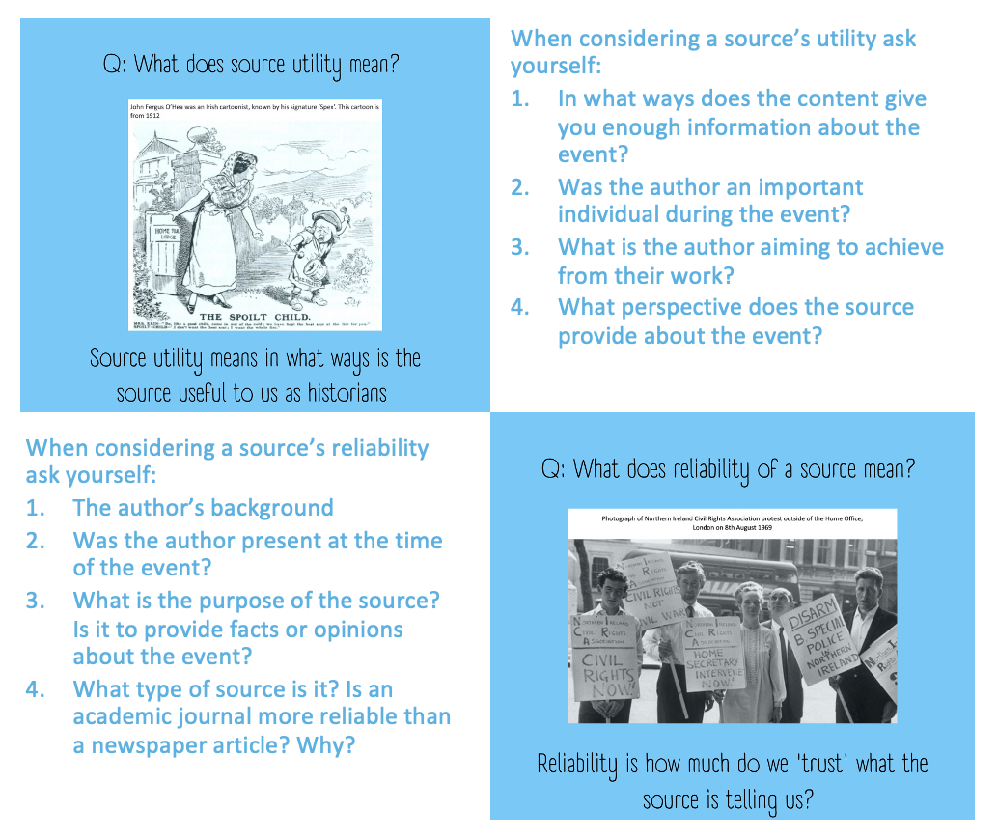
Activity
Source analysis
In either pairs or groups
Provide each group with a selection of sources from the source pack.
Ensure that students look beyond the content and make comments on utility and reliability of each source.
Ask groups to work out the arguments for their ‘side’ they could make from the sources.

Slide 5
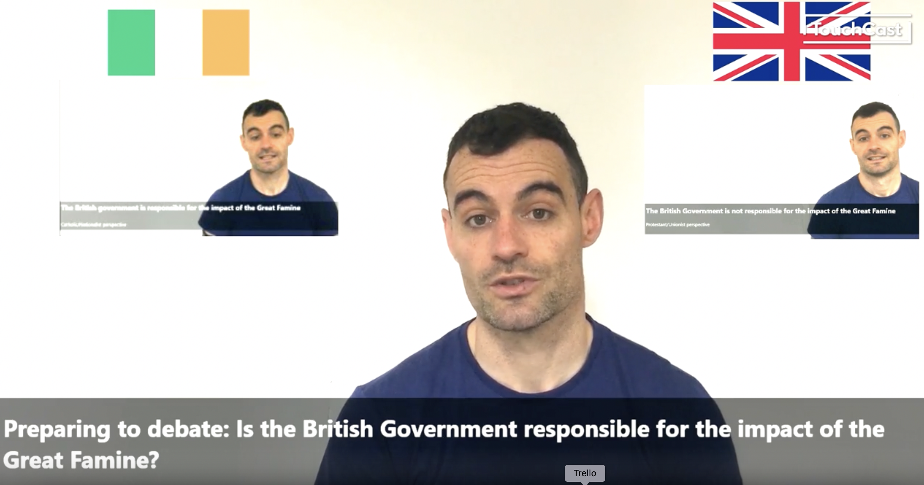
Homework or next activity
Split the class into two groups
Group 1 watch the ‘Britain is responsible’ side
Group 2: watch the ‘Britain is not responsible’ side
Make a note of some possible lines of argument you can use.
https://me.touchcast.com/s/frh41zpxhs

Slide 6
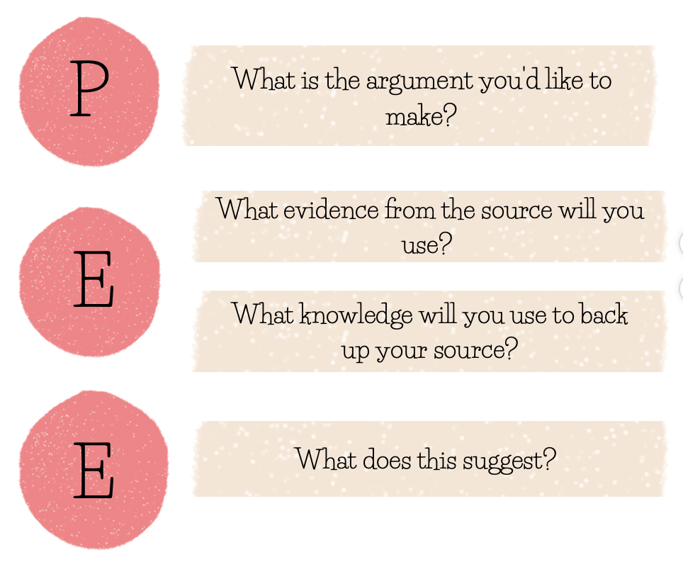
Activity
Preparing for a debate
In groups of 10:
Team 1: Responsible (5 students)
Team 2 : Not Responsible (5 students)
Each student prepares an argument using 1 source to support his/her own argument.
You can use the structure to support your students or provide one of your own.

Slide 7
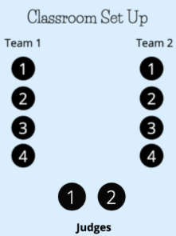
Activity
Run a debate, feedback and reflect
Run debates in groups of ten (two teams of four and two judges)
Each speaker has 90 seconds to deliver their speeches.
The judges will time the debates and provide feedback to each speaker.
Each student to write down their feedback in their debate logs or on their speeches

