Slide 1
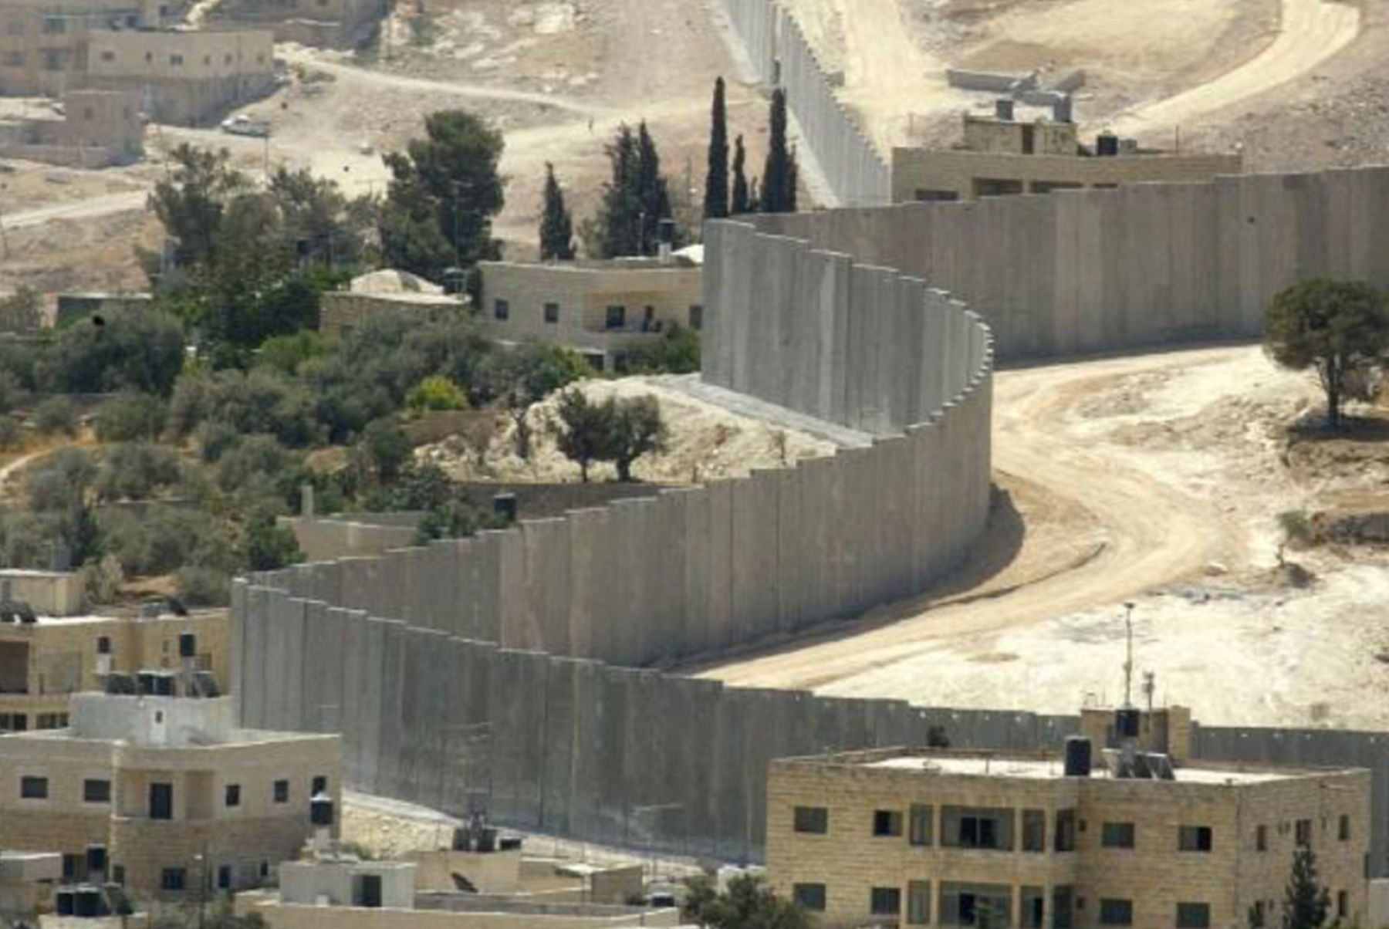
Key Enquiry:
Has the Israeli Government been justified in building the security barrier/separation wall?

Slide 2
Activity 1:
Using sources as evidence
In groups of 4 explore all the sources:
Make inferences
Question its reliability
Question its utility
Discuss: how do these sources help you answer the key question?

Slide 3
Homework
In groups of 10:
Team 1: watch ‘The Israeli Government has been justified’ side
Team 2: watch ‘The Israeli Government has not been justified’ side
Make a note of some possible lines of argument you can use.
https://me.touchcast.com/s/8uxpkrrhix

Slide 4
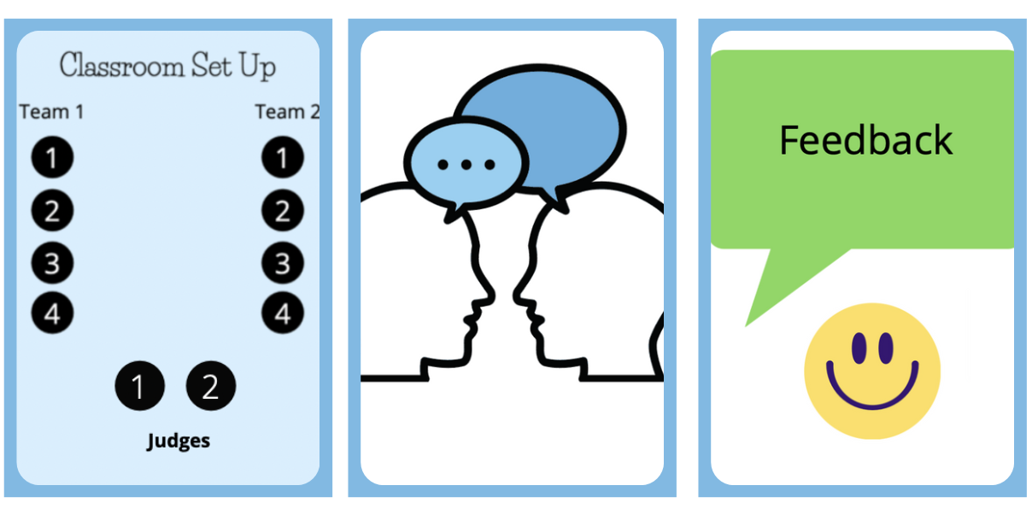
Activity 2:
Prepare, Debate and Reflect
In groups of four prepare arguments for either ‘The Israeli Government has been justified’ or ‘The Israeli Government has not been justified’ arguments.
Each student picks sources to support his/her argument.
Challenge students to look beyond a source’s content and make comments on a source’s provenance.
Students should have to speak for 90s-2mins.
Then run debates in groups of ten (two teams of four and two judges)
Reflection

