Slide 1
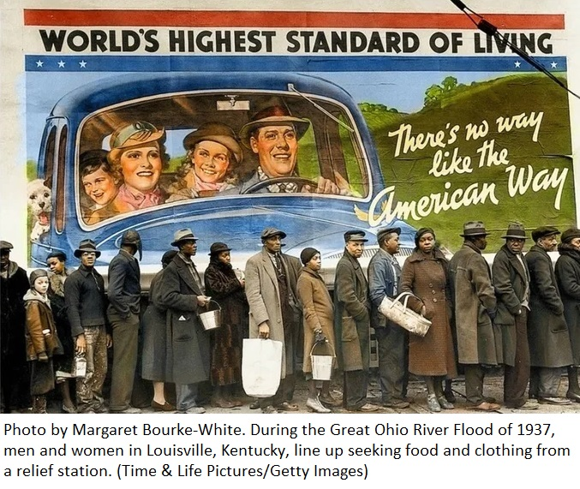
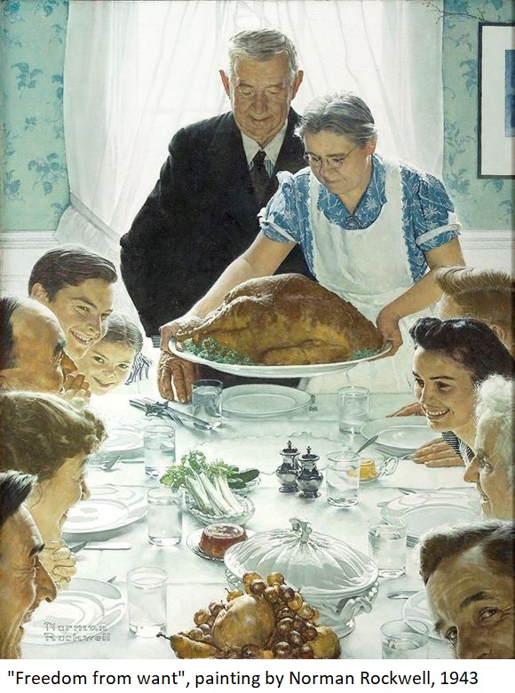
Activity 1: Compare and contrast two pieces of evidence from the USA in the last 1930s, early 1940s
How are these two pieces of evidence similar?
How are these two pieces of evidence different?
What might account for the similarities and differences? Consider the purpose for which each was made.

Slide 2
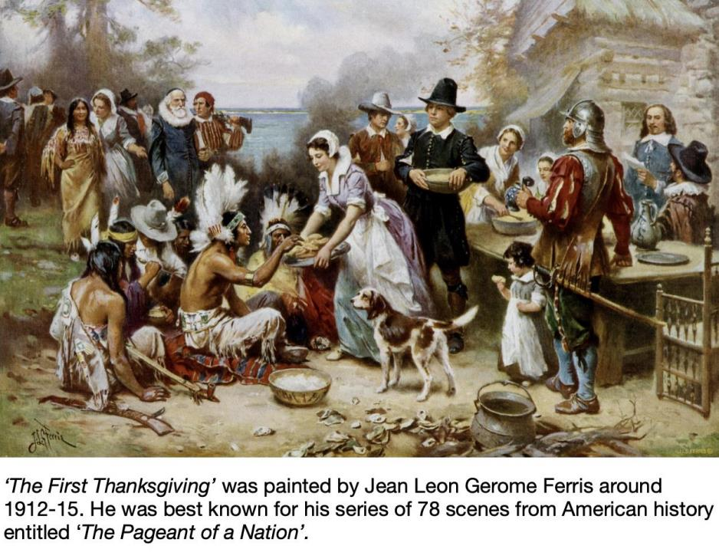
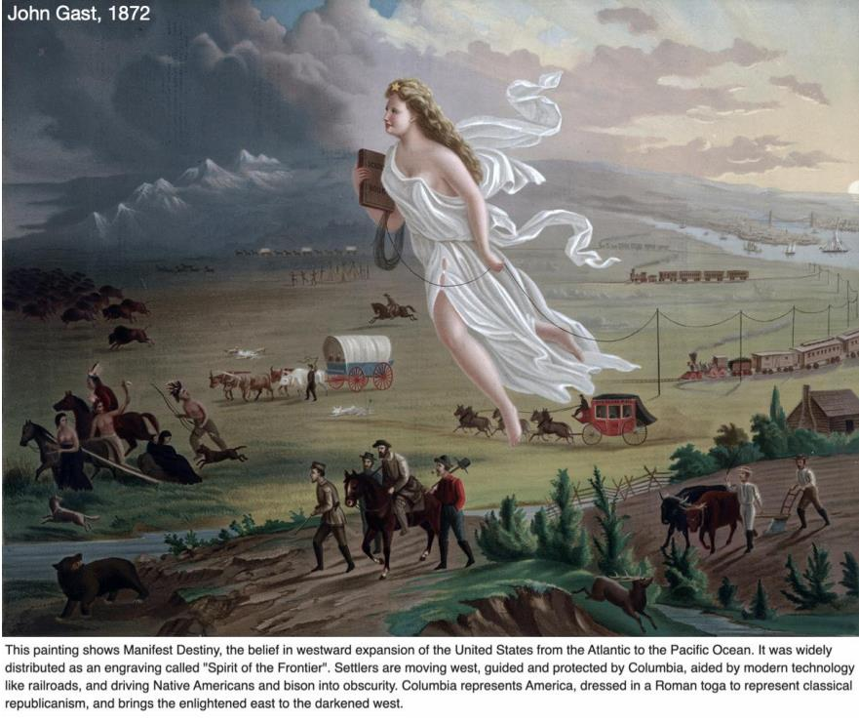
Activity 2: Compare and Contrast two paintings about historic events
How are these two paintings similar?
How are these two paintings different?
What might account for the similarities and differences? Consider the purpose and timing.

Slide 3
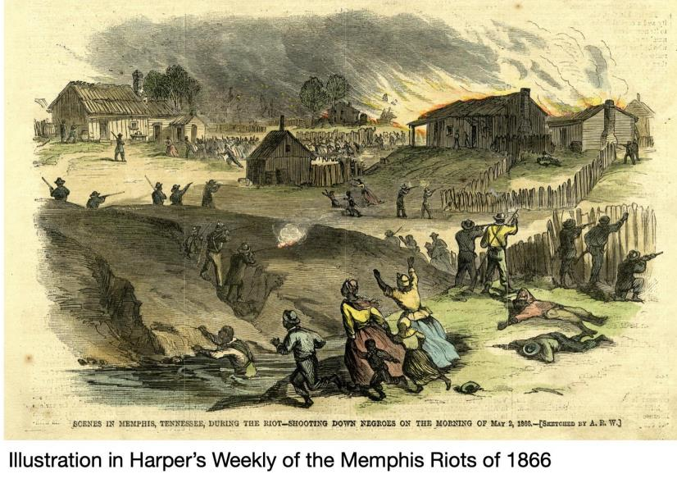
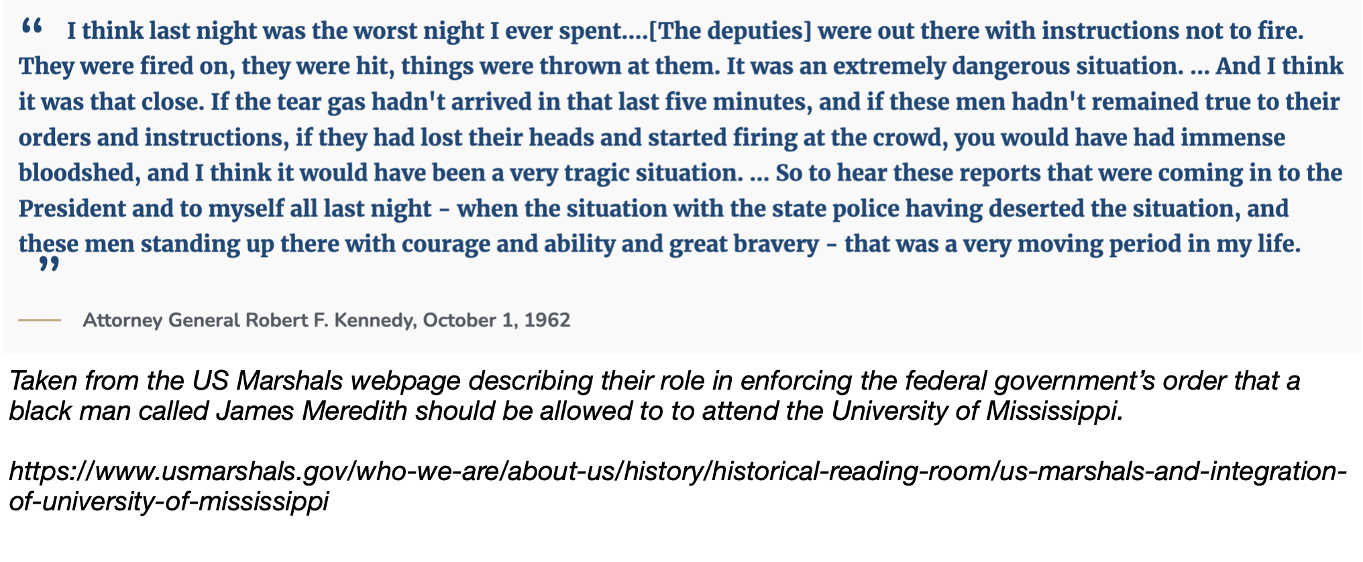
Activity 3: Using evidence to explore continuity and change over a century
How do these two pieces of evidence suggest a historical continuity between 1866 and 1962?
How do these two pieces of evidence suggest a historical change between 1866 and 1962?
If you were a historian in the future assessing the continuity and change in relations between European-Americans and African-Americans since the 1960s, what evidence would you look for?

Slide 4
Activity 4: Using evidence in a debate
Working in groups, examine all the sources to find evidence to argue for or against the proposition
“This house believe there has been more continuity than change in the history of race relations in the USA”

