Slide 1
Activity
Building the narrative
Put students into pairs or groups of four. Each pair watches either the Nationalist or Unionist perspective.
Ask the pairs ‘what would be the two most important historical event to commemorate if you were a Catholic/Protestant?’ (dependent on which video the pair watched)
In what ways has the British government caused conflict?
https://me.touchcast.com/s/jyn23v81sn

Slide 2
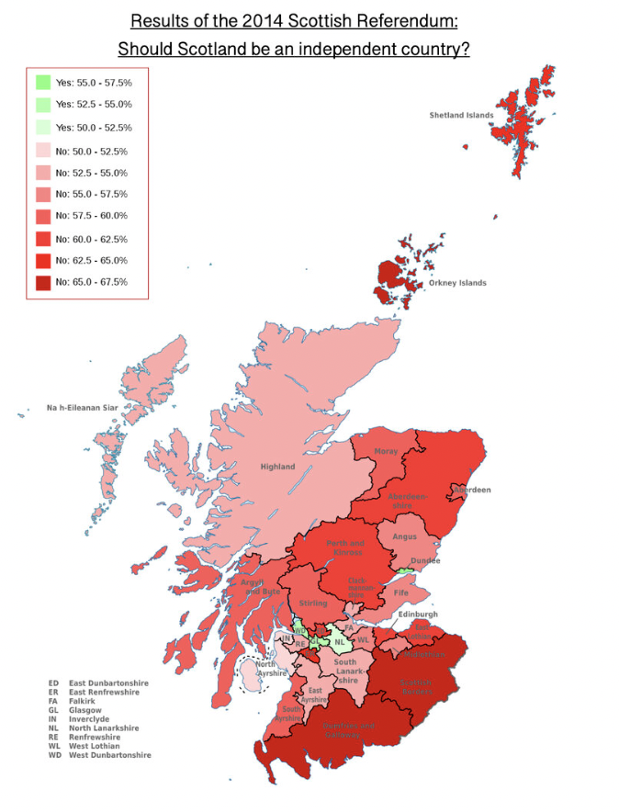
What can you learn from this source about Scottish national identity in 2014?
Key Enquiry:
Did the national identity of people living in Scotland after 1707 become more British?

Slide 3
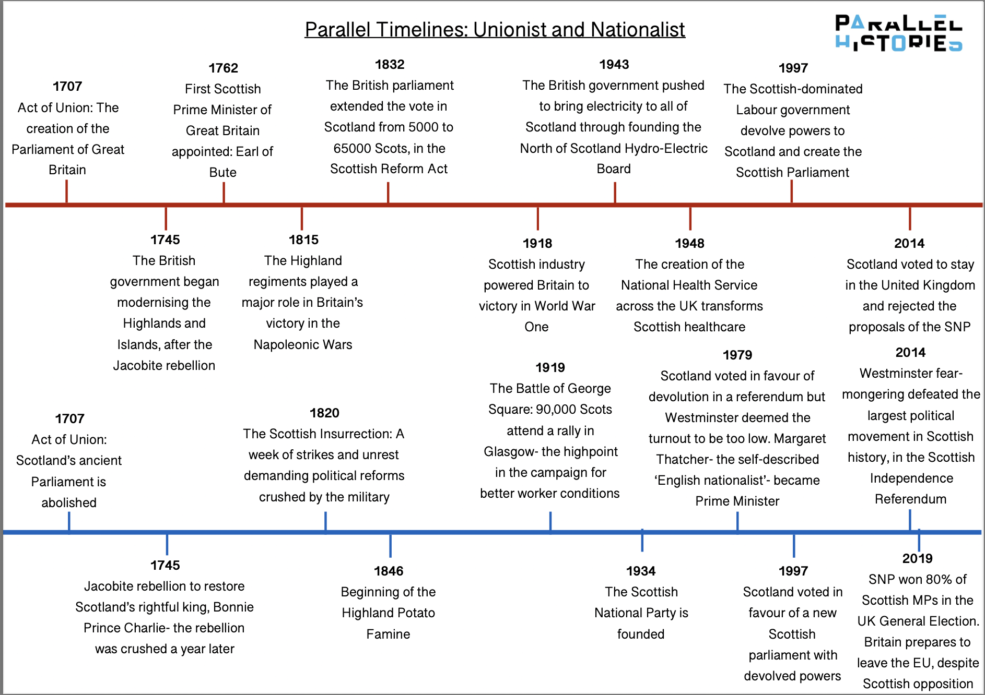
Exploring Parallel Timelines
Part 1: In small groups, ask students to memorize as much content as they can in 10minutes.
Red timeline = Unionist narrative
Blue timeline = Nationalist narrative

Slide 4
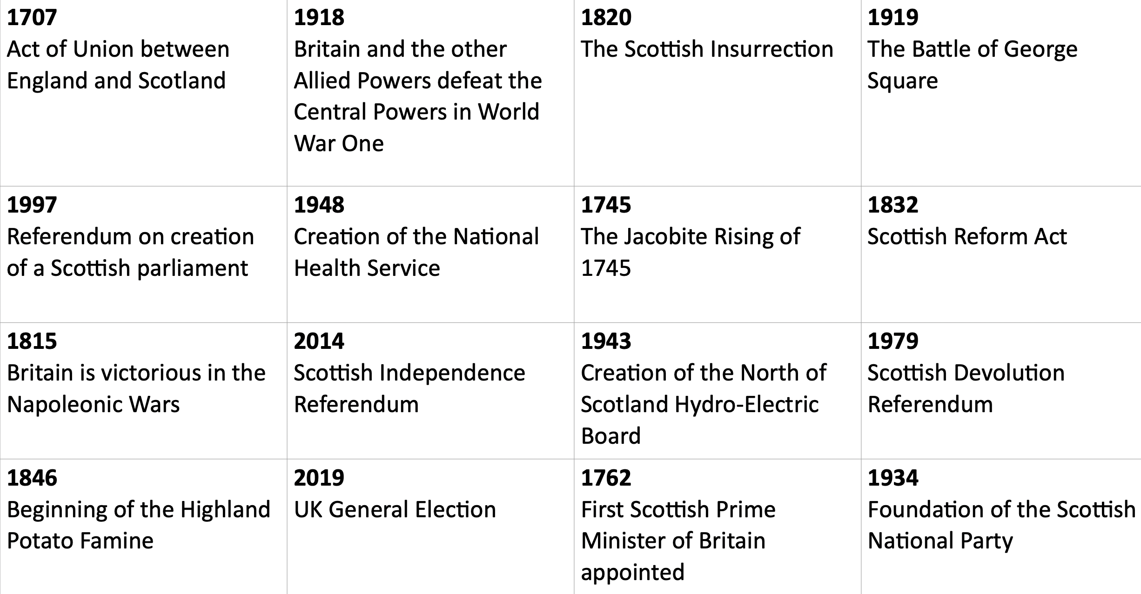
Exploring Parallel Timelines
Part 2: Ask students organise the cards and add some details to their parallel timelines:
One to use to tell the story that Scotland retained its Scottishness after Union
The other that Scotland became more British.
Discussion: Reviewing your timelines, ‘does our identity shape our study of history?’

Slide 5
Stage 1: Divide yourselves into two teams
Team 1: Yes, the national identity of people living in Scotland after 1707 became more British
Team 2: Not, the national identity of people living in Scotland after 1707 did not become more British
Activity
Prepare, Debate and Reflect
Create teams of 4
Provide each group with the source booklet
Students are to explore the sources and use them as evidence to support their arguments.
They are then to write a 60 second speech to use in a debate.
Stage 2: Your team’s arguments
From the video, agree as a team what four arguments you will use in a debate.
Stage 4: Writing your speech
Write a 60 second speech for your debate. You can use this format to help you:
S – State your argument
E – Evidence from the source
E - Factual Evidence
L – Link
Stage 3: Explore the sources
In groups explore all the sources:
Make inferences
Question its reliability
Question its utility
As a team choose the best source that would strengthen each argument

Slide 6
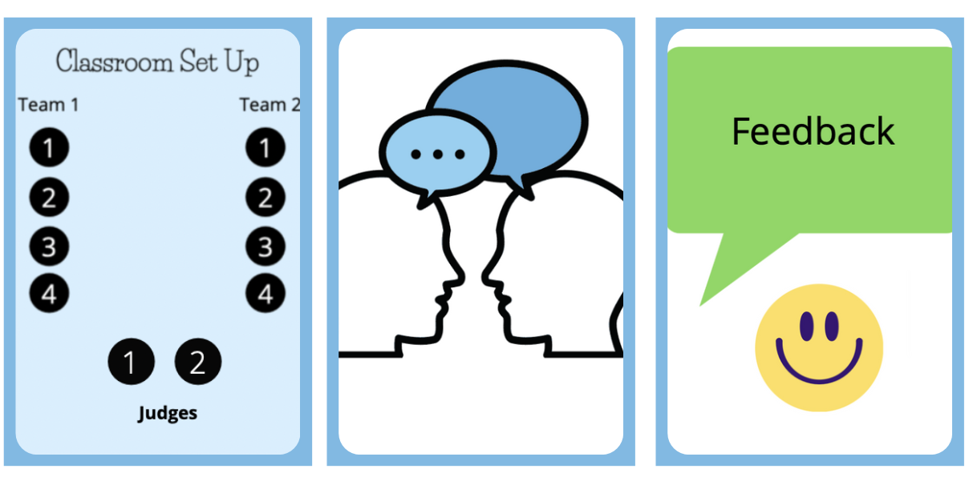
Activity
Prepare, Debate and Reflect
Run debates in groups of ten (two teams of four and two judges)
See guidance on debates and on how to judge debates.
The debates will run for 20 mins
Reflection for 5 mins

Slide 7
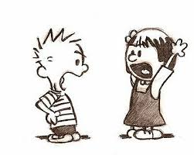
Homework
Short written answer - what was the strongest argument you heard against your side and why?

