Slide 1
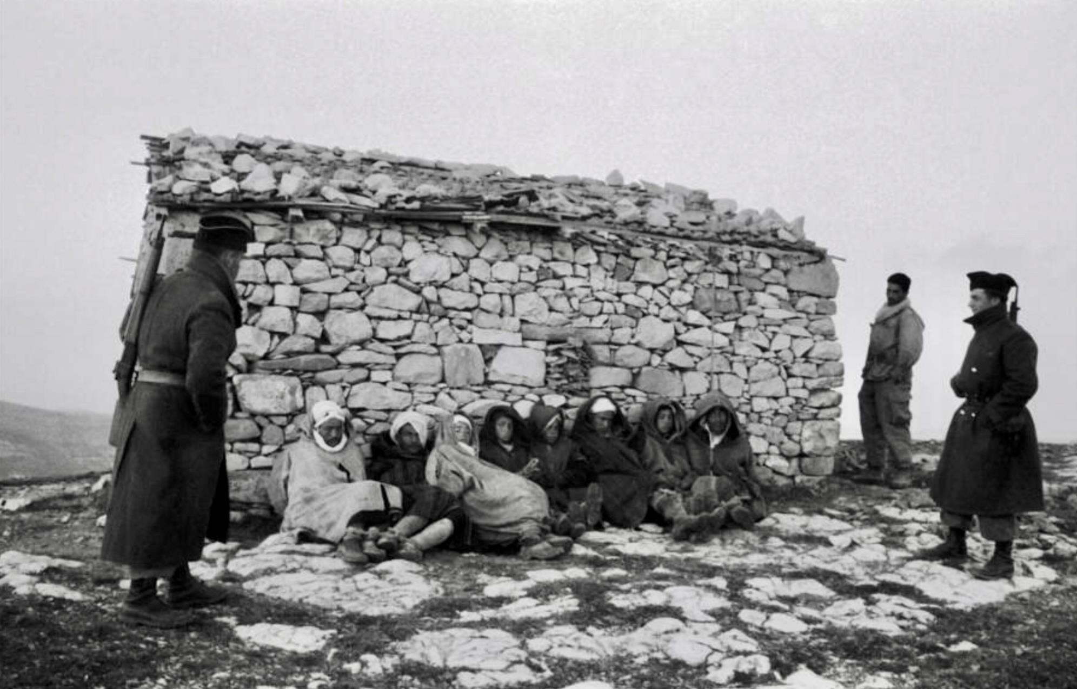
Key Inquiry
Why did war break out in Algeria in the 1950s?
French troops with Algerian prisoners

Slide 2
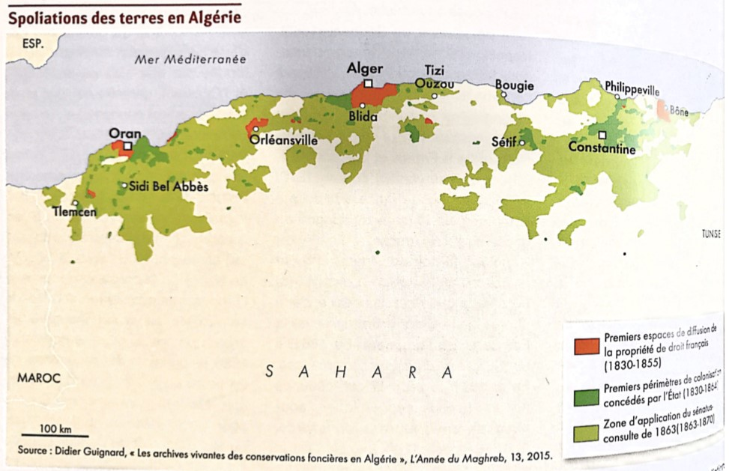
Both these sources are about European colonization of Algeria
How are the sources similar ?
How are the sources different?
What accounts for their difference?

Slide 3
1) Summarise in your own words the key points from the FLN’s ‘Call to the people’.
2) Do you think there are any internal contradictions in the document?
3) What did the FLN hope to gain from having ‘objectifs extérieurs’?
Appel au peuple algérien du FLN, 1er novembre 1954
“

Slide 4
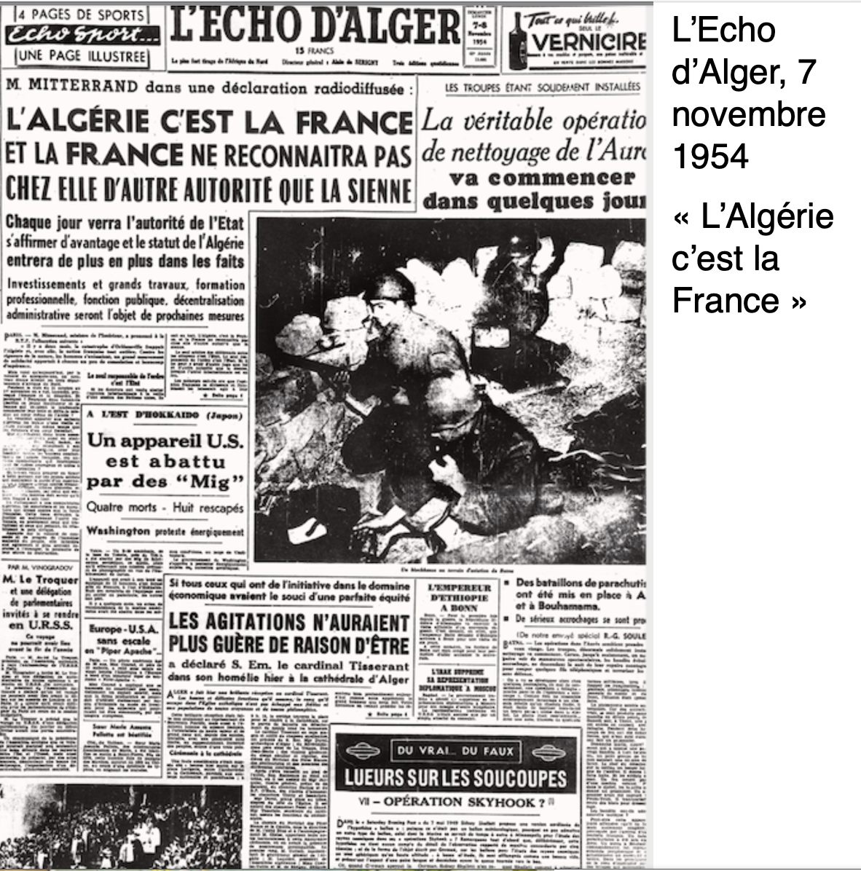
Summarise in your own words the key points from the newspaper report of Mitterrand’s radio announcement
Contrast this newspaper announcement with the previous ‘Appel au people’ from the FLN. How is it different?
And how is it similar?

Slide 5
Activity
Prepare, Debate and Reflect
In groups of four prepare either, ‘French leadership or Algerian leadership are more to blame for the war.
Each student picks sources to support his/her argument.
Then run debates in groups of ten (two teams of four and two judges)

Slide 6
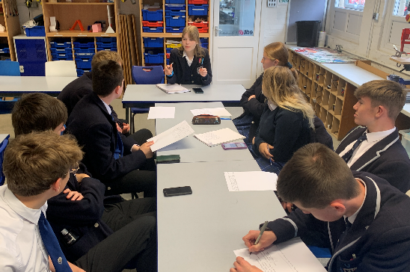
Using the assessment framework below, the judges will give feedback to EACH student using the criteria below.
The judges will give feedback using this format “What we really liked about your speech was (example), and what we’d like you to work on was (example).
Peer assessment and reflection
Assessment framework | Did the speech…
Structure | Follow a clear structure? Include linking sentences? Last 1-2 minutes, or whatever time you set? Link with the other speeches on the same team Include some counter arguments/rebuttal
Evidence | Include quotes/descriptions from the source? Include your own knowledge? Facts, statistics, dates Include critical analysis of why a source was credible evidence?
Language | Include persuasive language?
10mins

