Slide 1
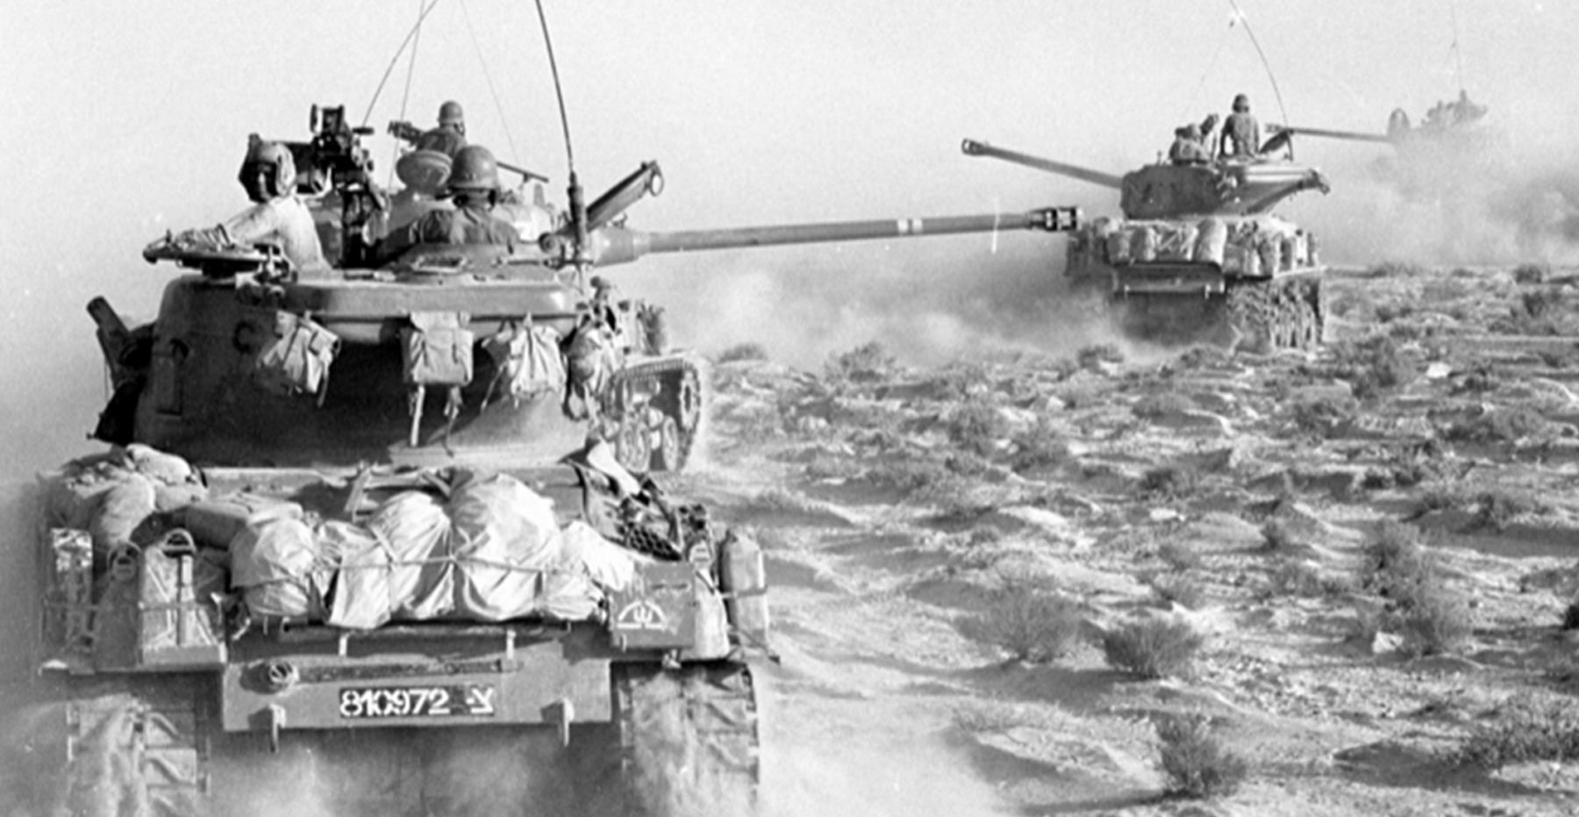
Was Israel forced to begin the Six-Day War to protect itself from Arab aggression?

Slide 2
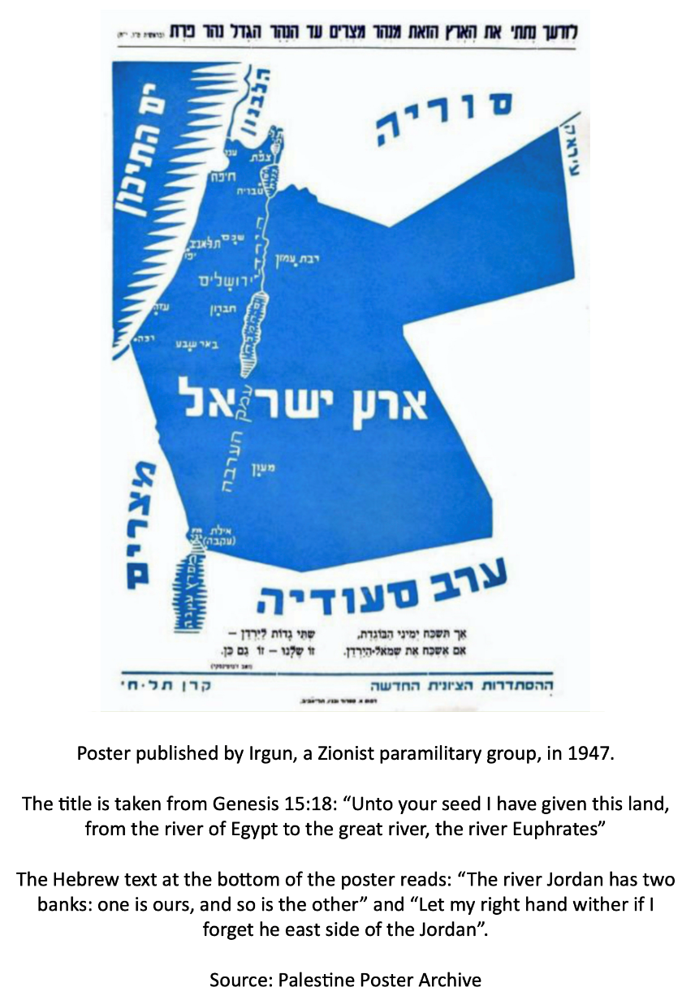
Activity 1: Compare and contrast these two posters about territory
Contrast these two visions for the future state of Israel or Palestine.
How realistic were they when created?
How would these maps create conflict?

Slide 3
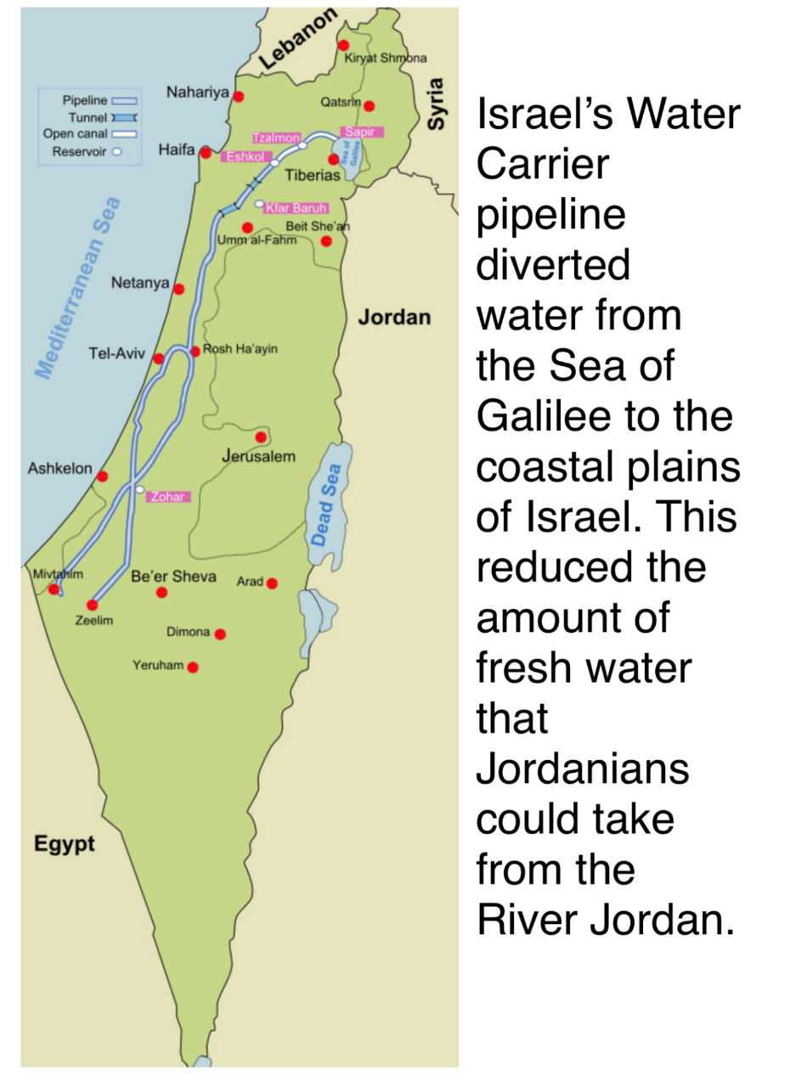
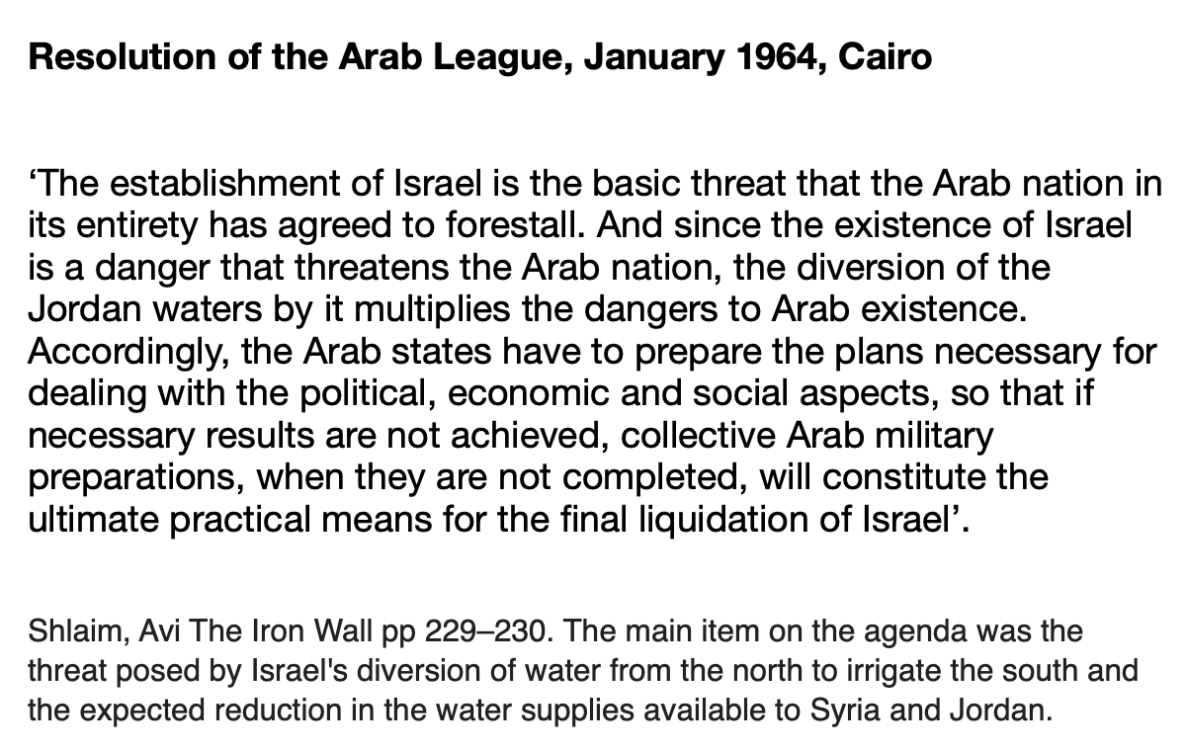
Activity 2: Compare this evidence about competition for water resources
1. To what extent do these two sources explain the hostility between Israel and its Arab neighbours in the 1960s?

Slide 4
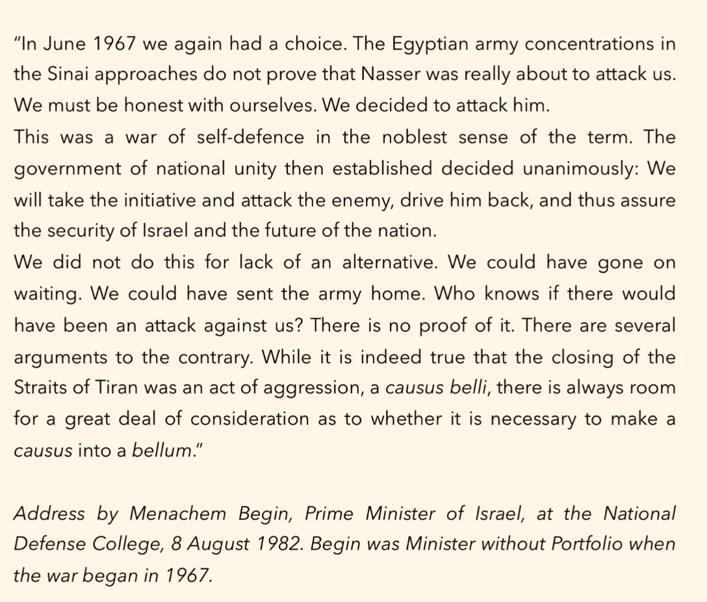
Activity 3: Examine this evidence about the causes of war
What can you tell from these two pieces of evidence about the causes of war in 1967?
Consider their timing. How does that affect the value of each as evidence?

Slide 5
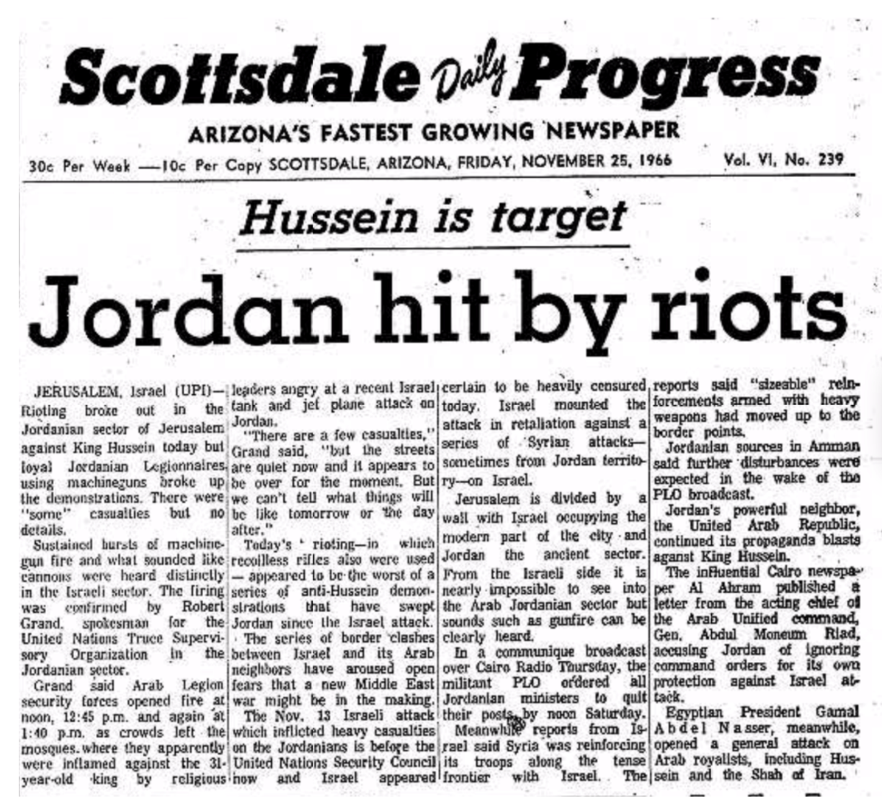
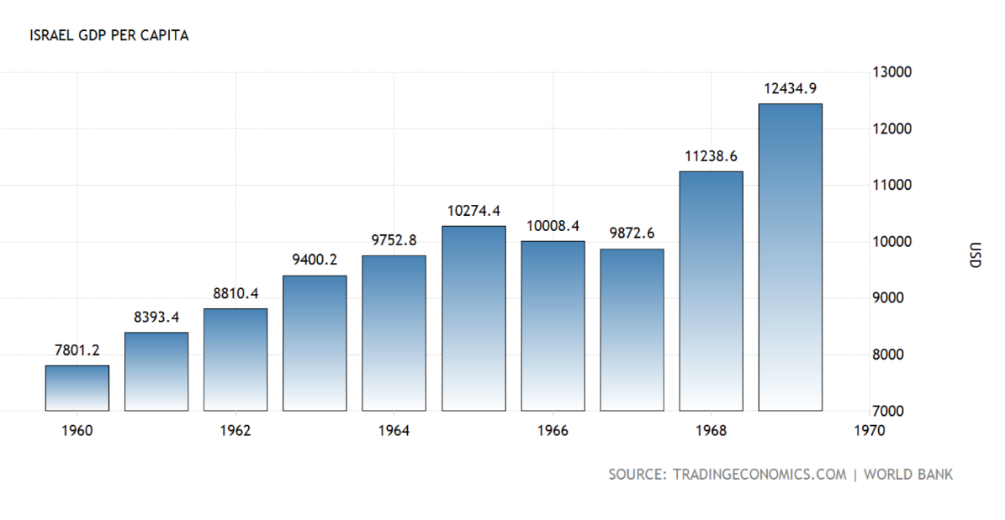
Activity 4: Compare this evidence about problems faced by Israeli and Jordanian governments
How are these two pieces of evidence different?
And how are they similar?
Why might internal weaknesses in both countries have made war more likely?

Slide 6
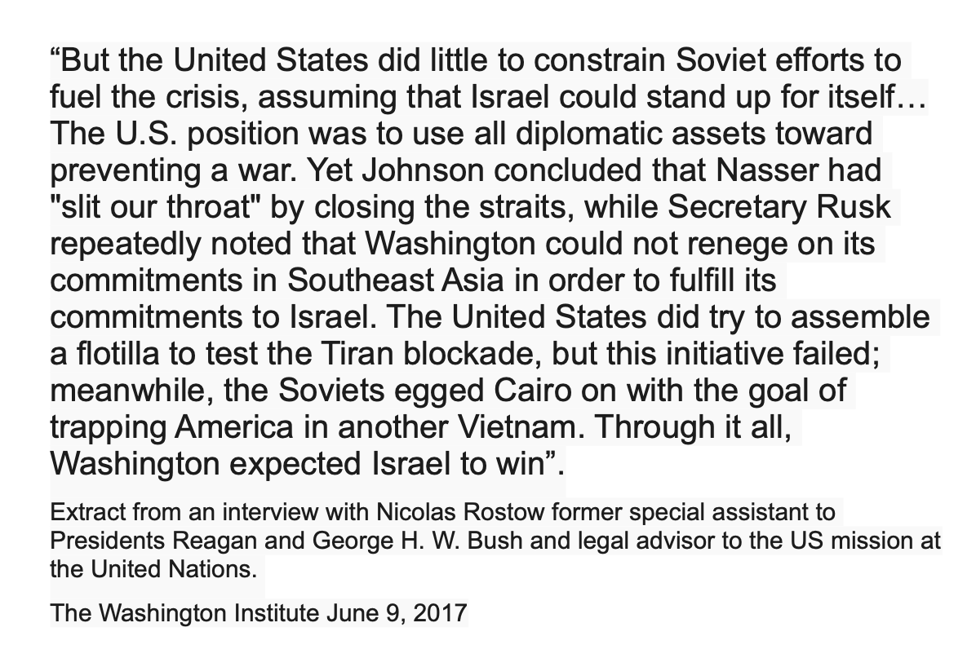
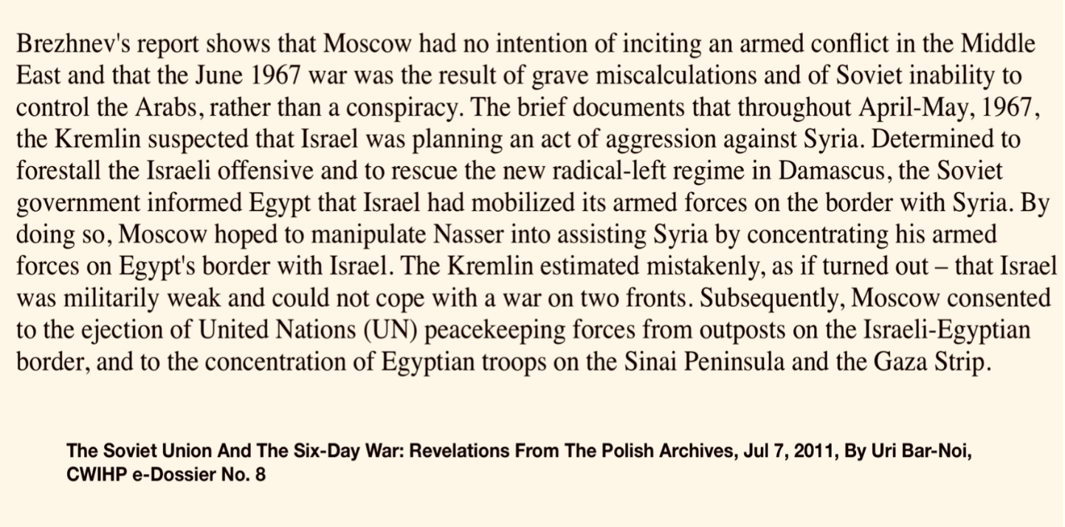
Activity 5: Compare and contrast these two pieces of evidence suggesting that the superpowers played a role in the war
How did the action or inaction of each superpower lead towards war?
What were the similarities in their approach?
What were the dissimilarities in their approach?

Slide 7
Activity 6: Using evidence in a debate
Working in groups prepare to debate the proposition
“This house believes that Israel did/did not begin the Six-Day War to protect itself from Arab aggression’’

