Slide 1
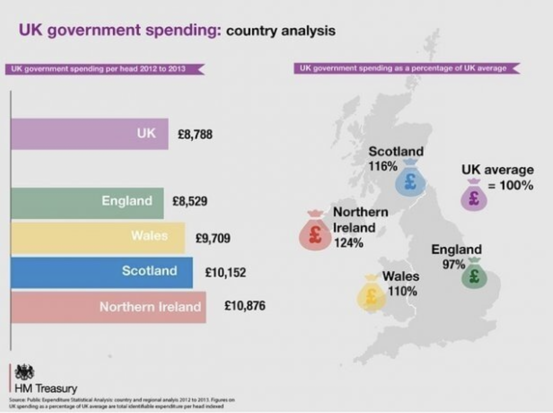
Key Enquiry:
Did people in Scotland after 1707 benefit from the Union with England?
What can you learn from this source about how Scotland benefitted from the Union with England?

Slide 2
Activity
Building the narrative
Put students in groups:
Group 1: The Union has been bad for Scotland / Nationalist argument
Group 2: The Union has been good for Scotland / Unionist argument
What are the lines of argument made?
https://me.touchcast.com/s/740zlftomh

Slide 3
Stage 1: Divide yourselves into two teams
Team 1: The Union has been bad for Scotland
Team 2: The Union has been good for Scotland
Activity
Prepare, Debate and Reflect
Create teams of 4
Provide each group with the source booklet
Students are to explore the sources and use them as evidence to support their arguments.
Discussion findings as a class before starting stage 4.
They are then to write a 60 second speech to use in a debate.
Stage 2: Your team’s arguments
From the video, agree as a team what four arguments you will use in a debate.
Stage 4: Writing your speech
Write a 60 second speech for your debate. You can use this format to help you:
S – State your argument
E – Evidence from the source
E - Factual Evidence
L – Link
Stage 3: Explore the sources
In groups explore all the sources:
Make inferences
Question its reliability
Question its utility
As a team choose the best source that would strengthen each argument
Class discussion: Are some sources stronger than others, and why?

Slide 4
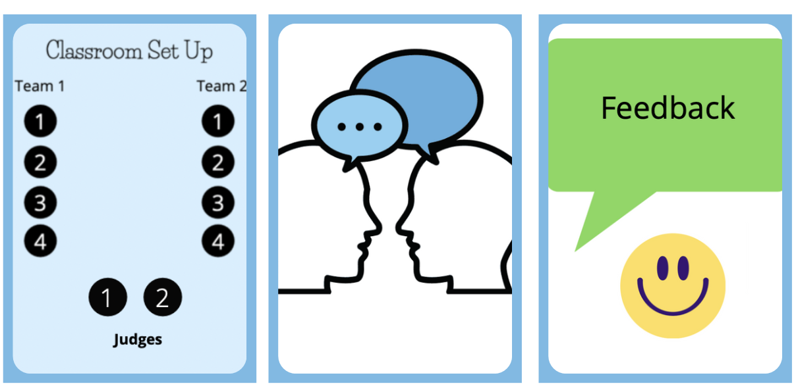
Activity
Prepare, Debate and Reflect
Run debates in groups of ten (two teams of four and two judges)
See guidance on debates and on how to judge debates.
The debates will run for 20 mins
Reflection for 5 mins

