Slide 1
Lesson Description
This lesson will examine the historical causes of conflict from the Indian, Hindu-centric perspective and the Pakistani, Muslim-centric perspective. Students will develop a series of arguments for the conflict from each perspective and critically evaluate evidence to shape their views. The lesson will also explore how this regional dispute has become international, in places such as Leicester in September 2022.
Lesson intentions | Lesson outcomes
Students will critically evaluate evidence and develop an Indian version and a Pakistani version of the cause of the conflict | Be able to explain the disputed historical causes of the conflict between Hindus and Muslims from India and Pakistan. Be able to critically evaluate evidence

Slide 2
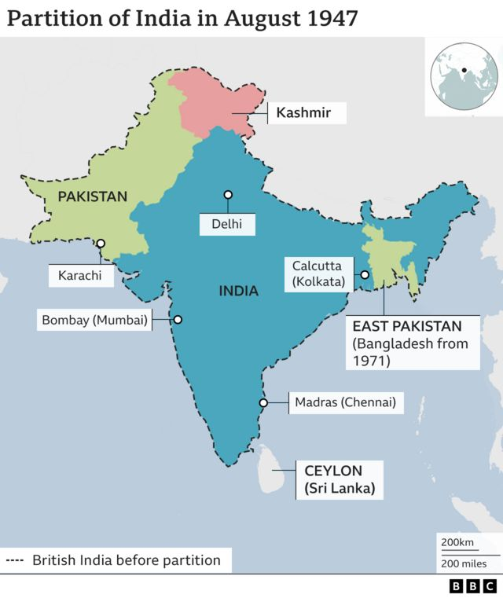
What are the historical causes of conflict between Hindus and Muslims from India and Pakistan?

Slide 3
Starter: Exploring identity
many factors shape our own cultural identity. These factors also influence how we view other people from other culture.
What factors influence our cultural identity?
In this lesson, you will be exploring the historical causes of conflict between Hindus and Muslims.
In pairs define what is a Hindu and what is a Muslim
Tap to reveal definition
Tap to reveal definition
A Hindu is a follower of Hinduism, and is the oldest world religion. Hinduism is a collection of religions and practices that originate from India. It has no founder, no single teacher or any prophets. There is over 800,00 Hindus living in the UK.
A Muslim is a follower of Islam, which is the second most practiced religion in the world. Muslims believe there is one true God, Allah and that Islam was revealed to the world by the Prophet Muhammad. There is over 3 million Muslims living I the UK.
Notes:
Some factors: Friends, family, religion, media, heritage and Race

Slide 4
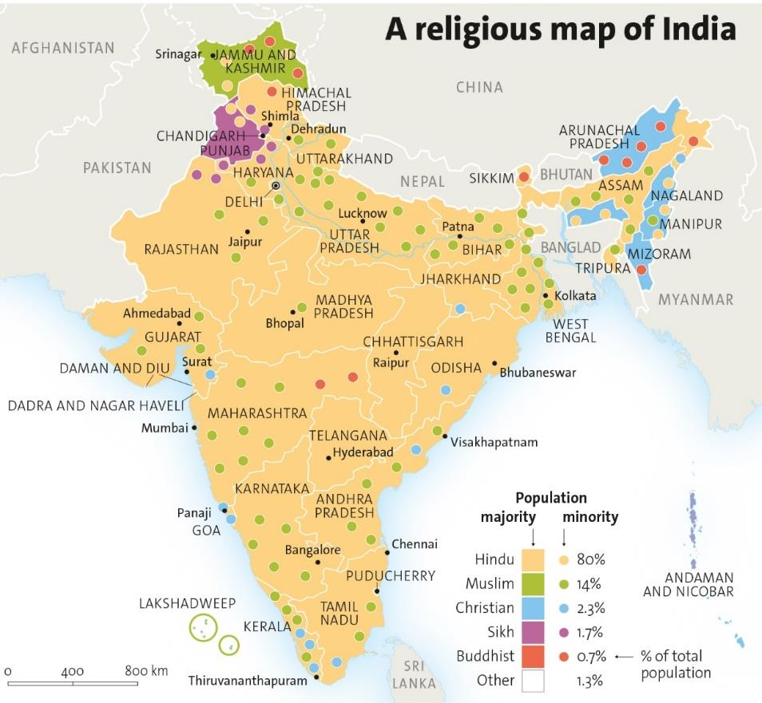
Activity: Study the maps below. Map 1 is the partition of India in 1947 and a religious map of India in 2011.
What are the similarities and differences between the two maps?
Study both maps, what can you learn about Kashmir?
What does map 2 tell you about religion in India?

Slide 5
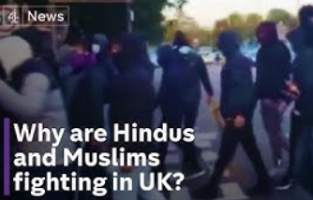
Activity: Why are Hindus and Muslims fighting in the UK today?
The news gives us a real insight into what happened at the time of the event.
Watch this clip from Channel 4 news and identify how far this report is useful to a historian exploring Hindu-Muslim conflict?

Slide 6
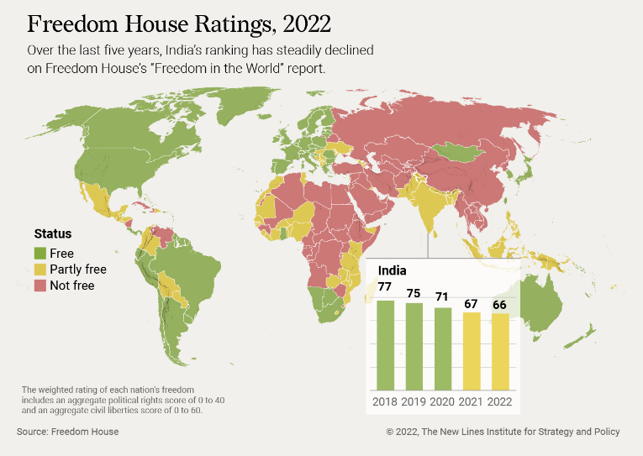
Source Pack A
Instructions:
Divide the class into two (Side A and Side B)
Organise each ‘side’ into pairs.
Give each pair either Source Pack A or Source Pack B.
Give students a suitable amount of time to read and discuss their sources.
Ask each pair to answer the following questions about each source
What can you learn from each source about Hindu-Muslim relations?
In what ways does each source suggest that there is conflict between Hindus and Muslims from India and Pakistan?
Choose representatives from each pair to share their ideas to the whole class.
Then, provide all students with a copy of both A and B sources. Ask them to read and discuss:
In what ways are Source 1 and Source 4 similar/ different?
In what ways are Source 2 and Source 5 similar/ different?
In what ways are Source 3 and Source 6 similar/ different?
Activity 1: Comparing sources
Source Pack B

Slide 7
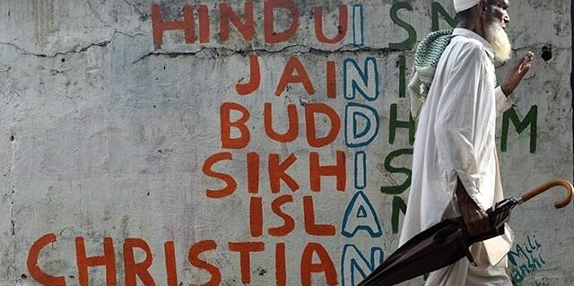
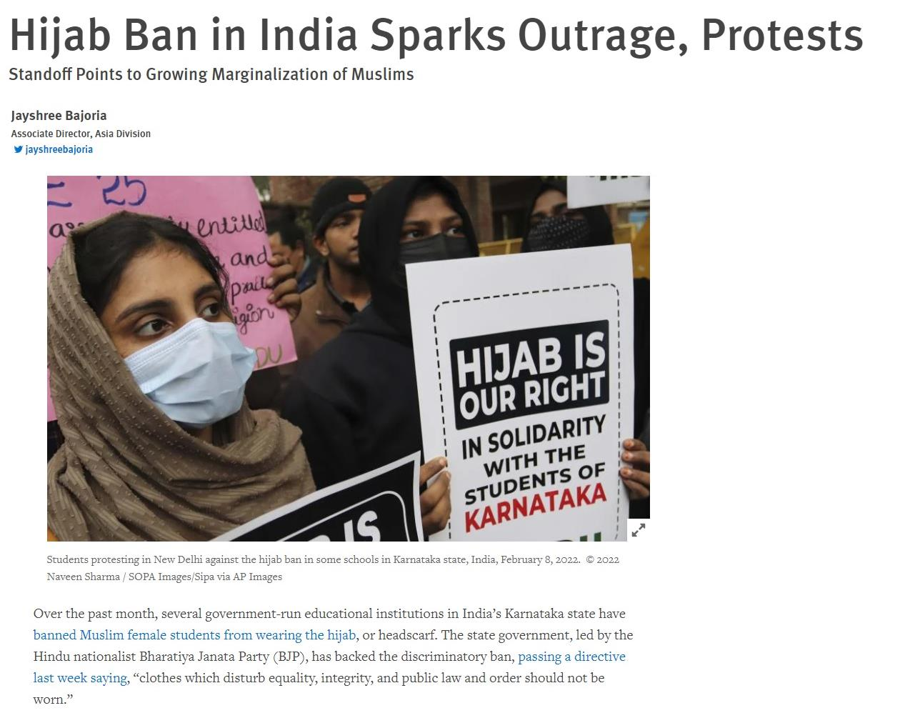
Activity: Compare these two pieces of evidence about religion in India
Source 1, a photograph of graffiti on a Mumbai wall
Source 2, a newspaper article from Human Rights Watch about the banning of the Hijab in India.
What can you learn from source 1 about religion in India?
What can you learn from source 2 about the treatment of Muslims in India?
In what ways are Source 1 and Source 2 different?

Slide 8
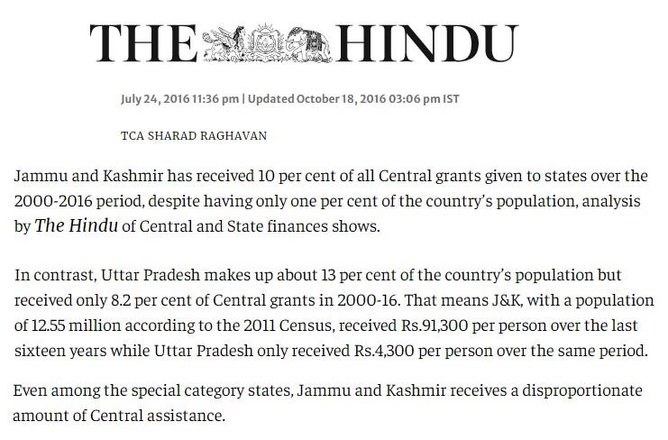
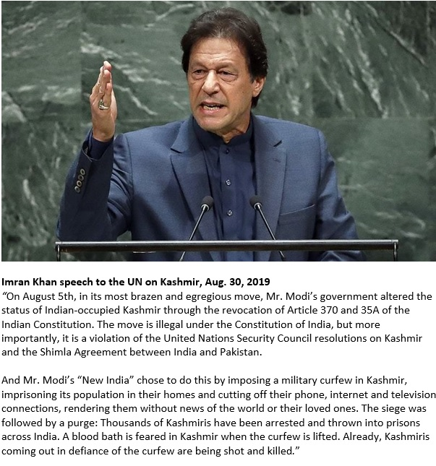
Activity: Compare these two pieces of evidence about Kashmir
Source 3, an article from The Hindu, July 2016
Source 4, a speech from Imran Khan to the UN, 2019
What is the message in the Hindu newspaper? Highlight a sentence to back up your answer.
‘what is the message in Imran Khan’s speech? Highlight a quotation to back up your answer.
In what ways are these messages different?
Which source is more reliable and why? (Comment on their origin and purpose)

Slide 9
Reflection: Working in groups examine all the sources to find evidence to argue for or against the question:
Is India the main cause of conflict between Hindus and Muslims?

