Slide 1
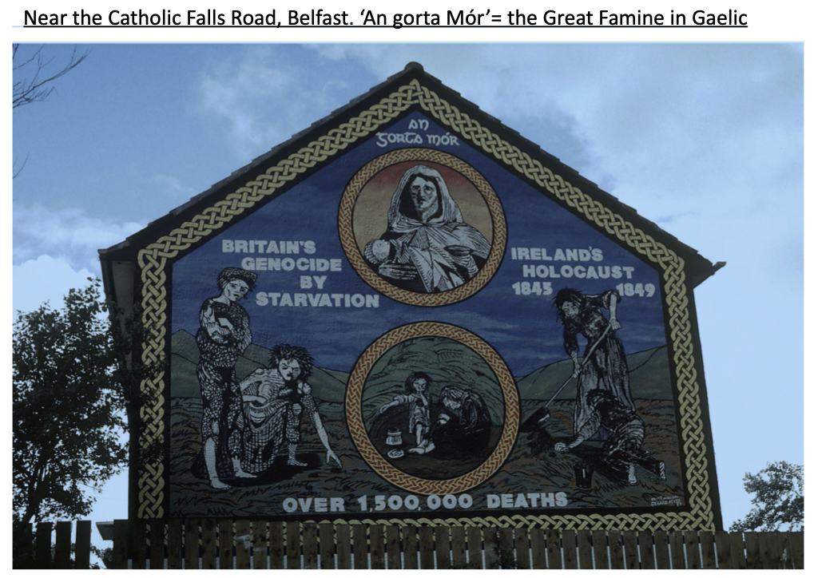
What is the message of these murals?
What historical event are they commemorating?
What is the tone of these murals?
What is the purpose of these murals?
Who is the target audience?
Starter: Comparing sources
Give students these two sources and ask them to deconstruct the sources by asking them these 5 questions

Slide 2
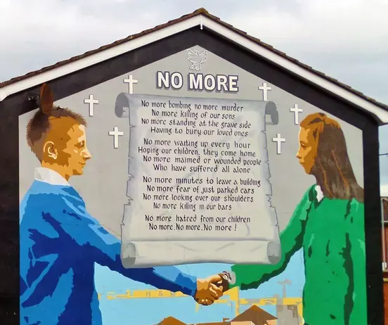
Key Enquiry:
Who is to blame for the slow progress of the Peace Process?
What are your first impressions of this mural?

Slide 3
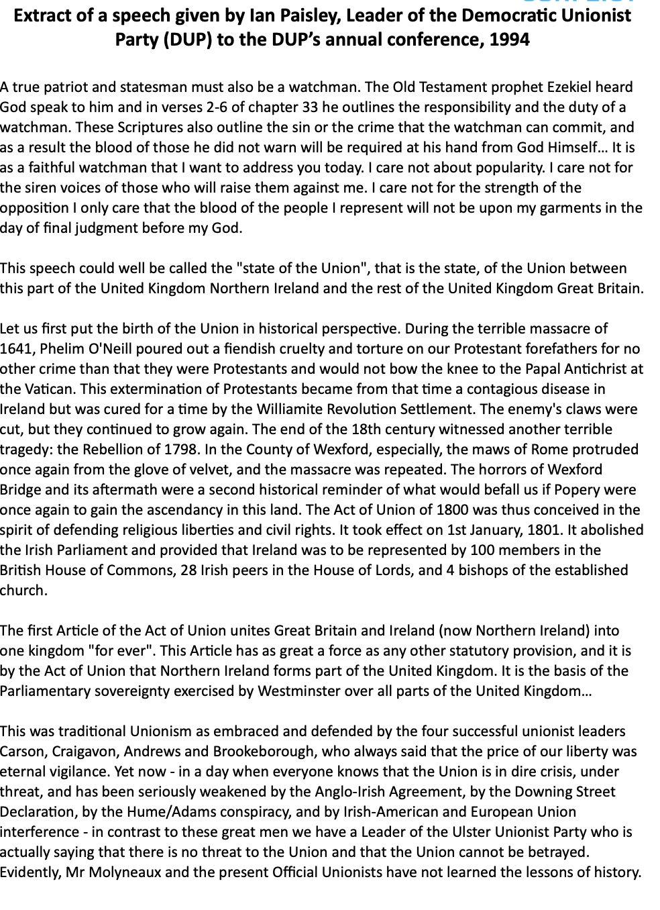
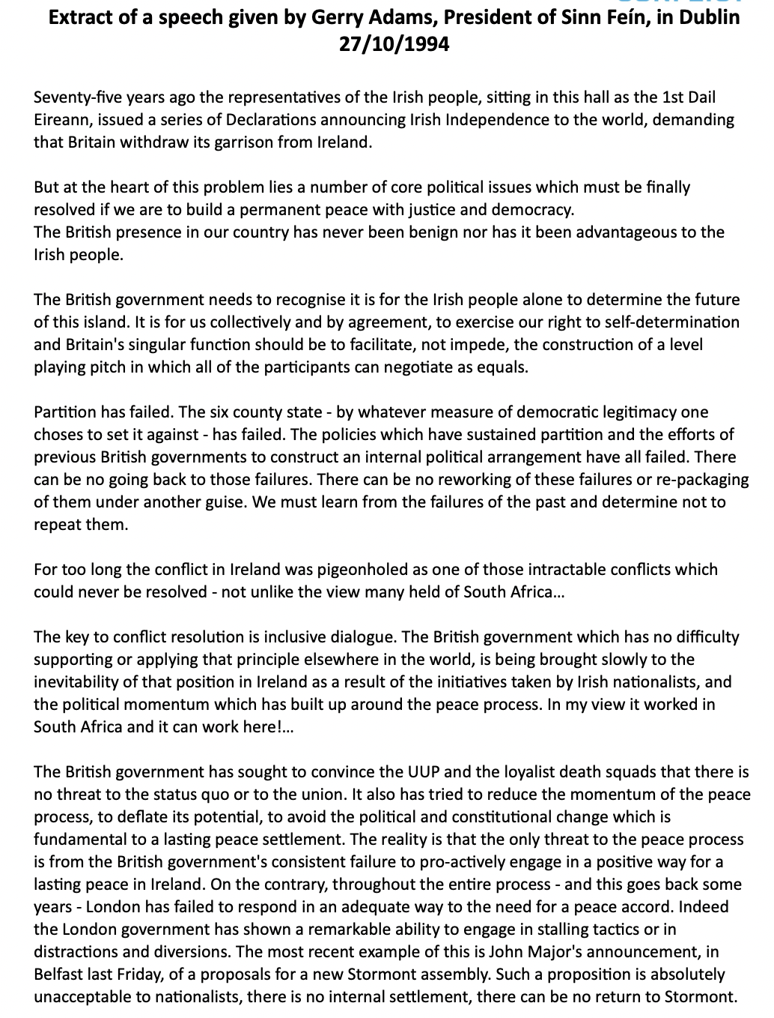
Activity
Exploring political speeches
Put students into pairs or groups of four. Give each pair (more challenging) the Ian Paisley and Gerry Adams speeches from 1994.
Ask pairs to analyse these sources and list the ways they are different and the same. Compare and contrast the following aspects:
What is the message?
What historical examples have they chosen?
What is the purpose of these speeches?
What is the tone of these speeches?
What is the target audience?
Discussion: To what extent are these speeches useful for an enquiry into the peace process?

Slide 4
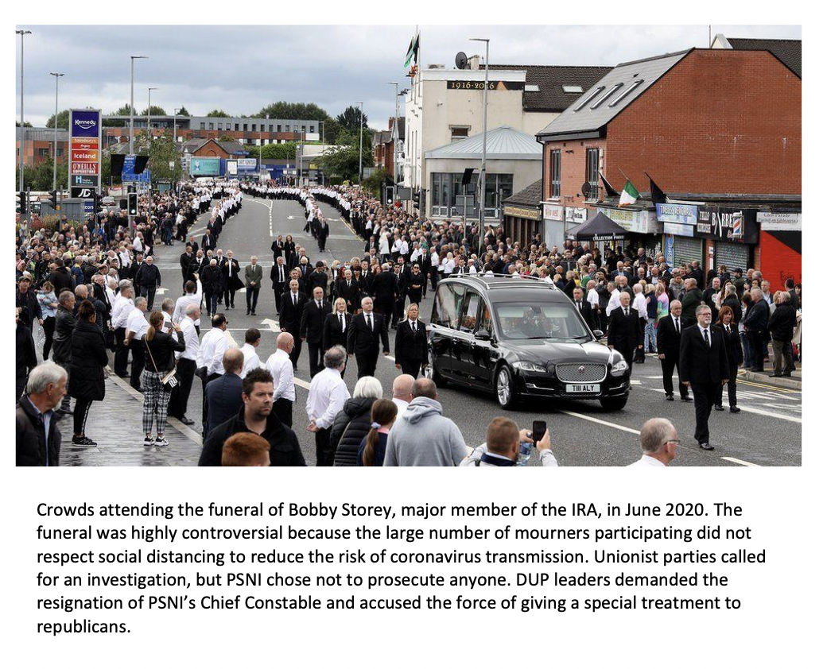
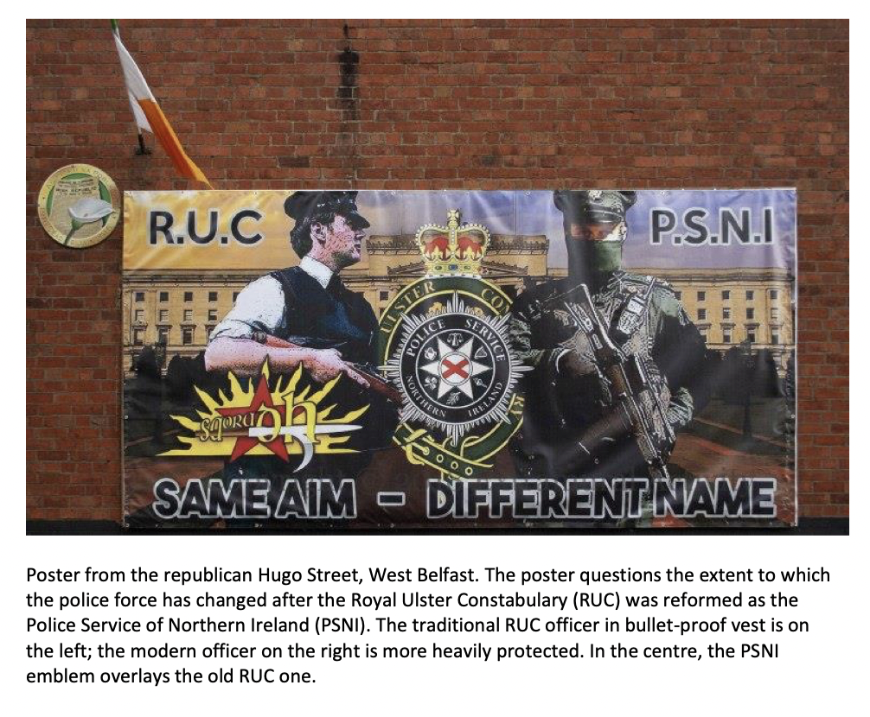
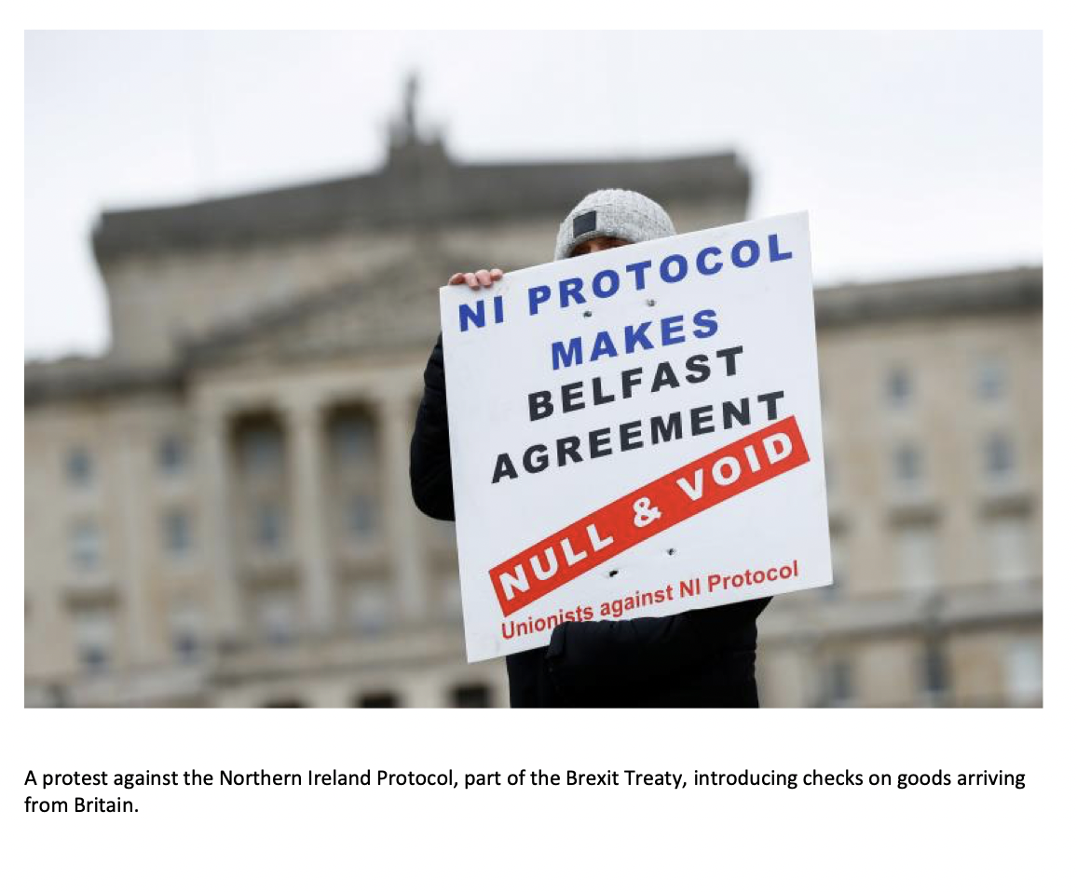
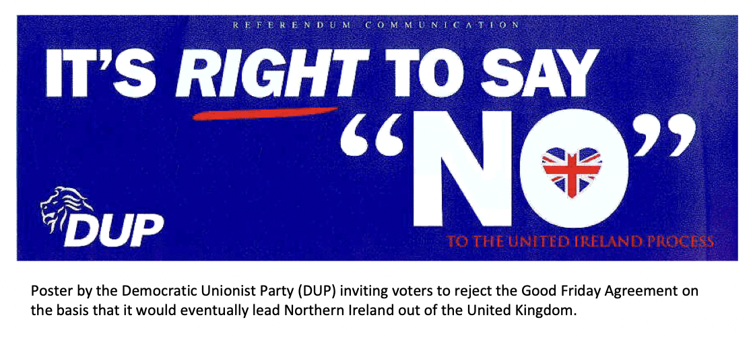
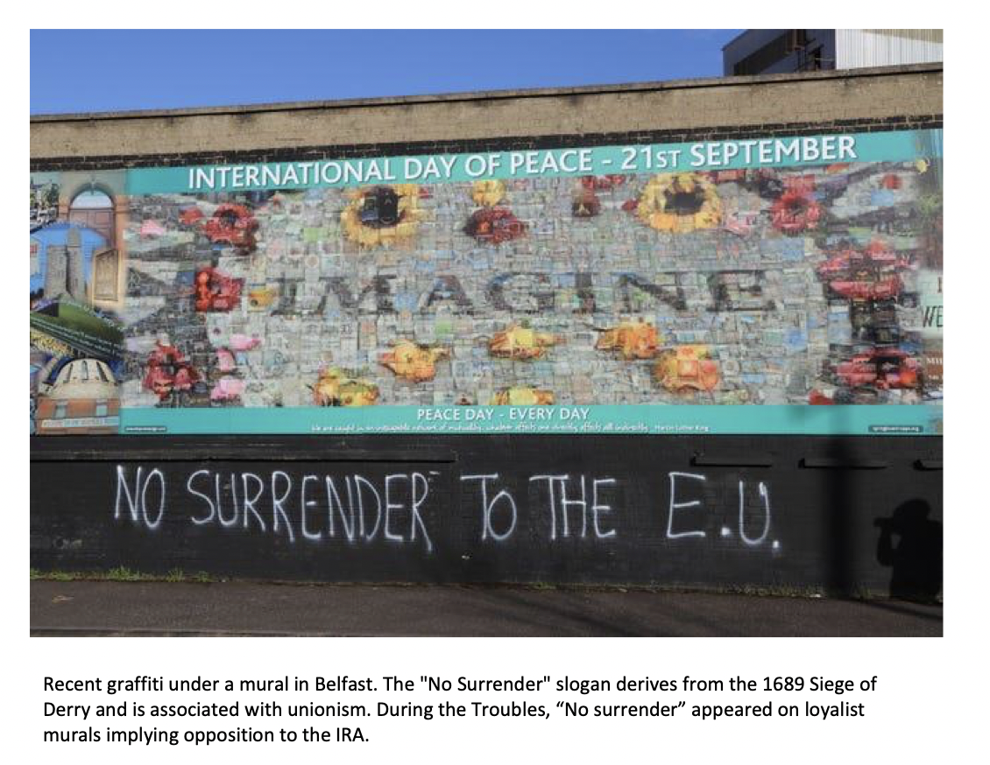
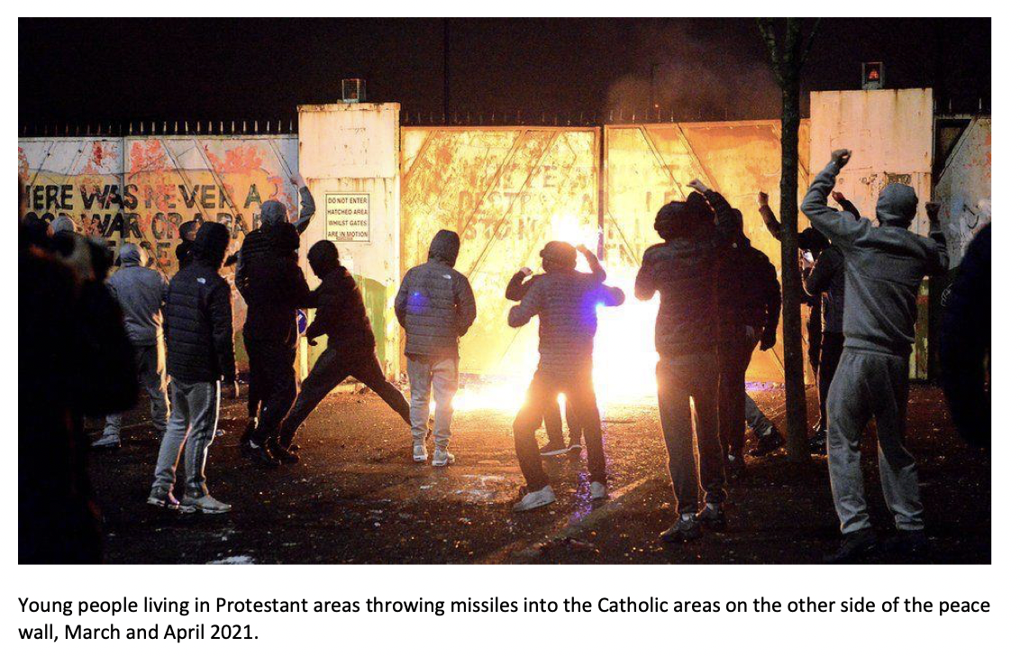
Activity
Preparing for a debate
Mix the groups so that they are different from the last debate:
In groups of 10:
Team 1: Nationalists are responsible
Team 2: Unionists are responsible
In teams, students are to explore the source packs (or selection of choices based on teacher’s judgement) and decide on 4 lines of argument they could use, based on the source’s content.

Slide 5
Homework
Split the class into two groups
Group 1 watch the ‘Nationalists are to blame’ side
Group 2: watch the ‘Unionists are to blame’ side
Make a note of some possible lines of argument you can use.
https://me.touchcast.com/s/qgn1oerxog

Slide 6
Gerry Adams: 'No assembly without Irish language act'
The Sinn Féin president has said there will not be an assembly without an Irish language act. Gerry Adams was speaking as his party, the SDLP, Alliance, the Green Party, and People before Profit joined forces to call for an act.
UUP leader Robin Swann said his party would not "give a blank cheque to Gerry Adams for discrimination against non-Irish speakers".
The language issue has been a sticking point in talks to restore devolution. Northern Ireland has been without a functioning devolved government since January, when the coalition, led by the two biggest parties, the DUP and Sinn Féin, collapsed over a green energy scandal. Talks aimed at getting the power-sharing institutions up and running again ended earlier this year without agreement.
Mr. Adams said society should respect everyone's rights. "There won't be an assembly without an Acht na Gaeilge (Irish language act). The DUP know that, the two governments know that. (...)
However, Mr. Swann said equality and respect needed to be shown to all communities. "No matter how many times he (Gerry Adams) says otherwise, obligations to the Irish Language made under the Belfast Agreement have been fulfilled," said Mr. Swann.
Abstract from an article published on the BBC website on 30th August 2017.
To what extent is the author useful in your enquiry?
Activity
Preparing for a debate
Ask a one or more pair(s) to model how to use a source to make an argument.
Discuss as a class.
What quotes could you use in an argument?
What can you learn from the content of the source? Is it based on facts, opinions or both?
What was happening at the time?

Slide 7
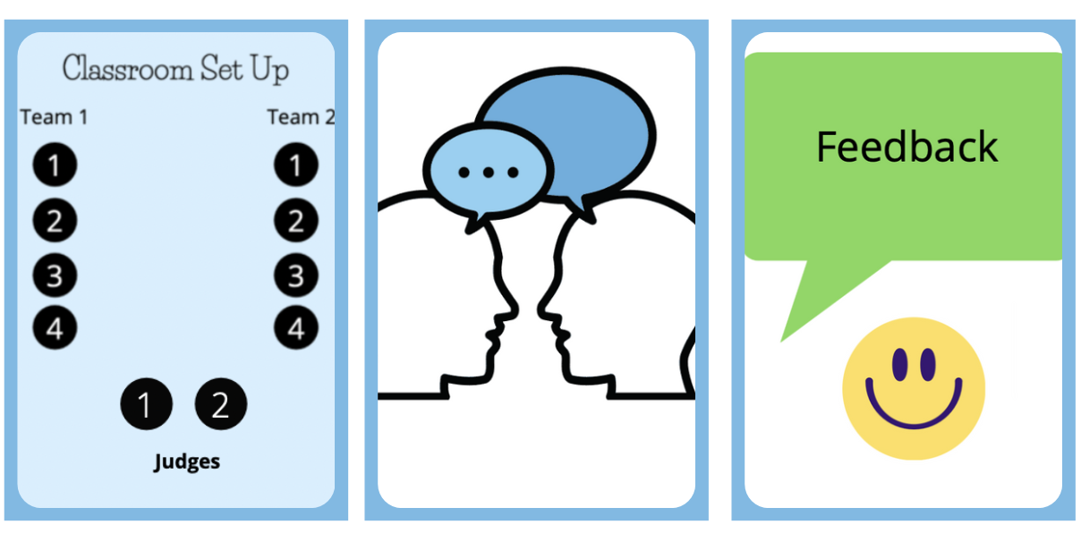
Activity:
Prepare, Debate and Reflect
In groups of four prepare either ‘Unionists are to blame’ or ‘Nationalists are to blame’ arguments.
Give students all the sources to explore
Each student picks sources to support his/her argument.
Challenge students to look beyond a source’s content and make comments on a source’s provenance.
Then run debates in groups of ten (two teams of four and two judges)
Reflection
Don’t forget you can use the content from a source AND comment on its provenance (i.e., author, type of source, date). You can also comment on its reliability and utility throughout your argument.
Remember, you are trying to persuade your audience that your argument is the most important one.

