Slide 1
Starter Activity
Ask students to annotate the source with the following information:
What can you learn from this source about Stalin’s rule?
What is the message?
Do you trust this source?
Source 12: A propaganda poster by Alexander Pavlovich Mogilevsky published in 1925.
The text reads "if you don't read books, you'll soon forget your grammar".
10mins

Slide 2
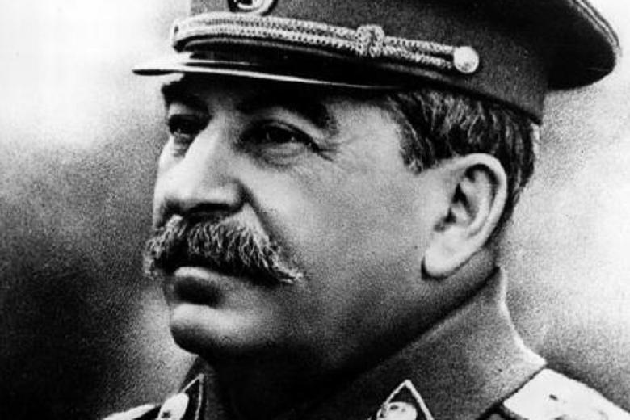
Key enquiry
Was Stalin a Great Leader?
For contextual knowledge you could use the timeline as an overview of Stalin’s rule from 1928-53.
Suggestions: card sort exercise into a dual narrative

Slide 3
Activity
Stalin’s Leadership
Put students into groups of four. Give group a source pack and in teams ask them to critical evaluate the sources they have:
Step 1: What can you learn from each source about Stalin?
Step 2: To what extent are these sources reliable?
Step 3: What are the similarities and differences between these sources?
You can use this question grid to help students evaluate each source

Slide 4
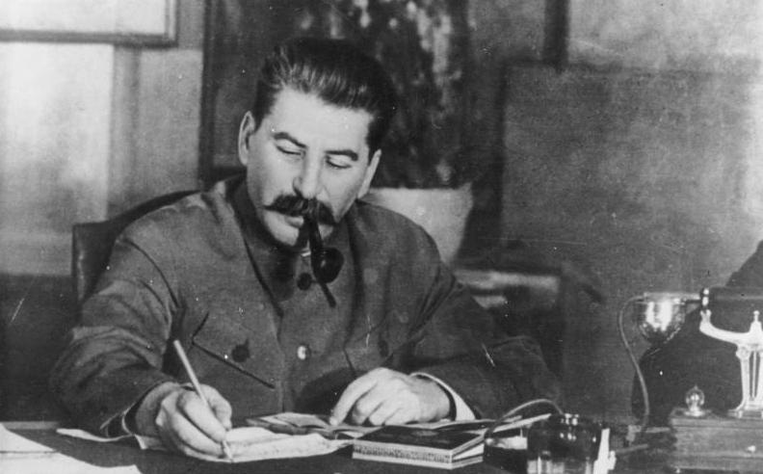
Homework
Getting ready to debate
Split the class into two groups.
Group 1 = Defends the view that Stalin was a great leader
Group 2 = Defends the view Stalin was not a great leader
Stalin was a great leader | Stalin was not a great leader
Watch the video for your side and write down 4 arguments for your chosen side.
https://me.touchcast.com/s/efeqjlw2ex
10mins

Slide 5
Activity
Prepare and Debate
In groups of four prepare either Stalin was a great leader or Stalin was not a great leader.
Each team member chooses an argument to defend and chooses a source to support their argument.
They are to write a 90 second speech to deliver in a debate.

Slide 6
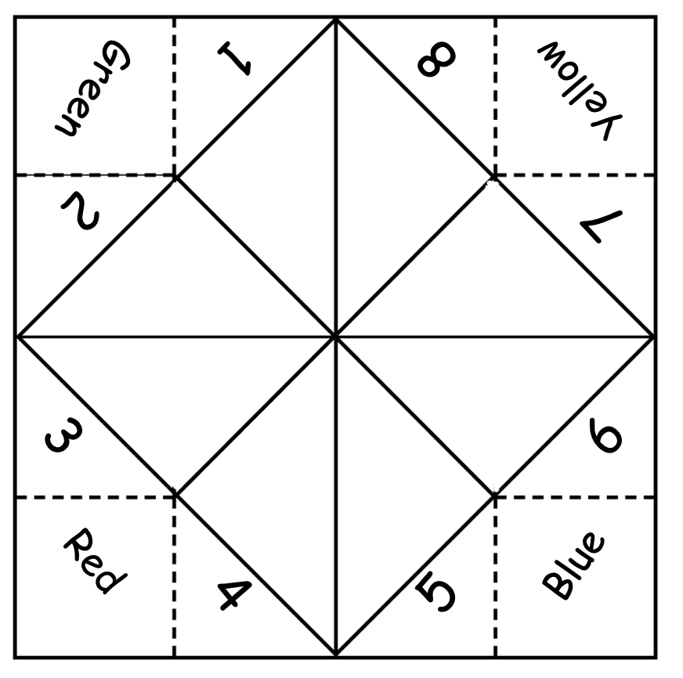
Activity
Planning for a rebuttal
Suggested activity – asking historical questions.
Ask students to create a fortune teller and in the blank triangles write questions they would like to ask each other related to the information on the timeline and some sources in the source pack.

Slide 7
In the blank triangles write in some questions
To build:
Cut out the square.
Fold diagonally so that the blank side is on the inside and the coloured area pictured above it on the outside.
Open it and fold the diagonally again from the other side so that, when you open it up, you have a cross which identifies the middle.
Fold the corners which have numbers on them into the middle to make a small square.
Turn the square over and fold the questions in to the middle to make a smaller square.
Turn it over and start to open it out like a fortune teller.‬

Slide 8
Activity
Run a debate
Run debates in groups of ten (two teams of four and two judges)
The judges will time the speakers and provide feedback using the grid on the left.
Using the mark scheme below, the judges will give you feedback using the criteria below:
 | Did the Speech…
Structure | Follow a clear structure? Include linking sentences? Last 1-2 minutes? Link with the other team’s speeches
Evidence | Include quotes/descriptions from the source? Include your own knowledge? Facts, statistics, dates
Language | Include persuasive language?
Tell them one thing you liked about their speech.
Tell them one thing they need to work on.

Slide 9
Homework:
Debate debrief
What was the strongest argument you heard against your side and why?
What criteria should we use when assessing historical figures

