Slide 1
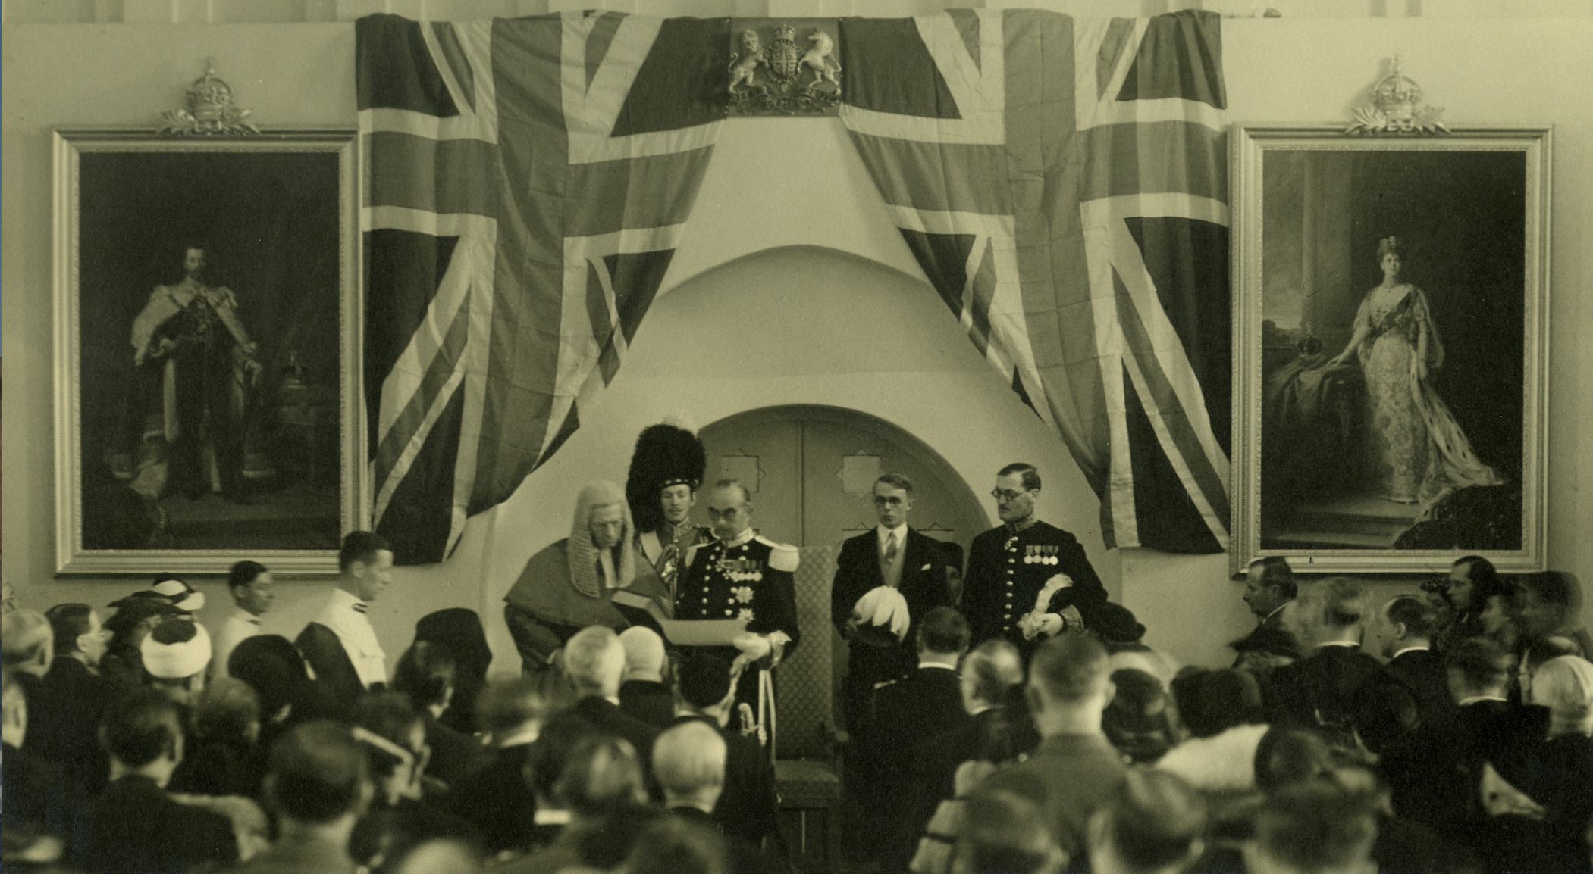
Should the British government be praised or blamed for its handling of the Mandate?
Incoming High Commissioner Sir Harold MacMichael taking the oath of office, Jerusalem 1938. Sir Harold MacMichael served as High Commissioner until 1944, where he was criticised for many policies that harmed the lives of both Arabs and Jews.

Slide 2
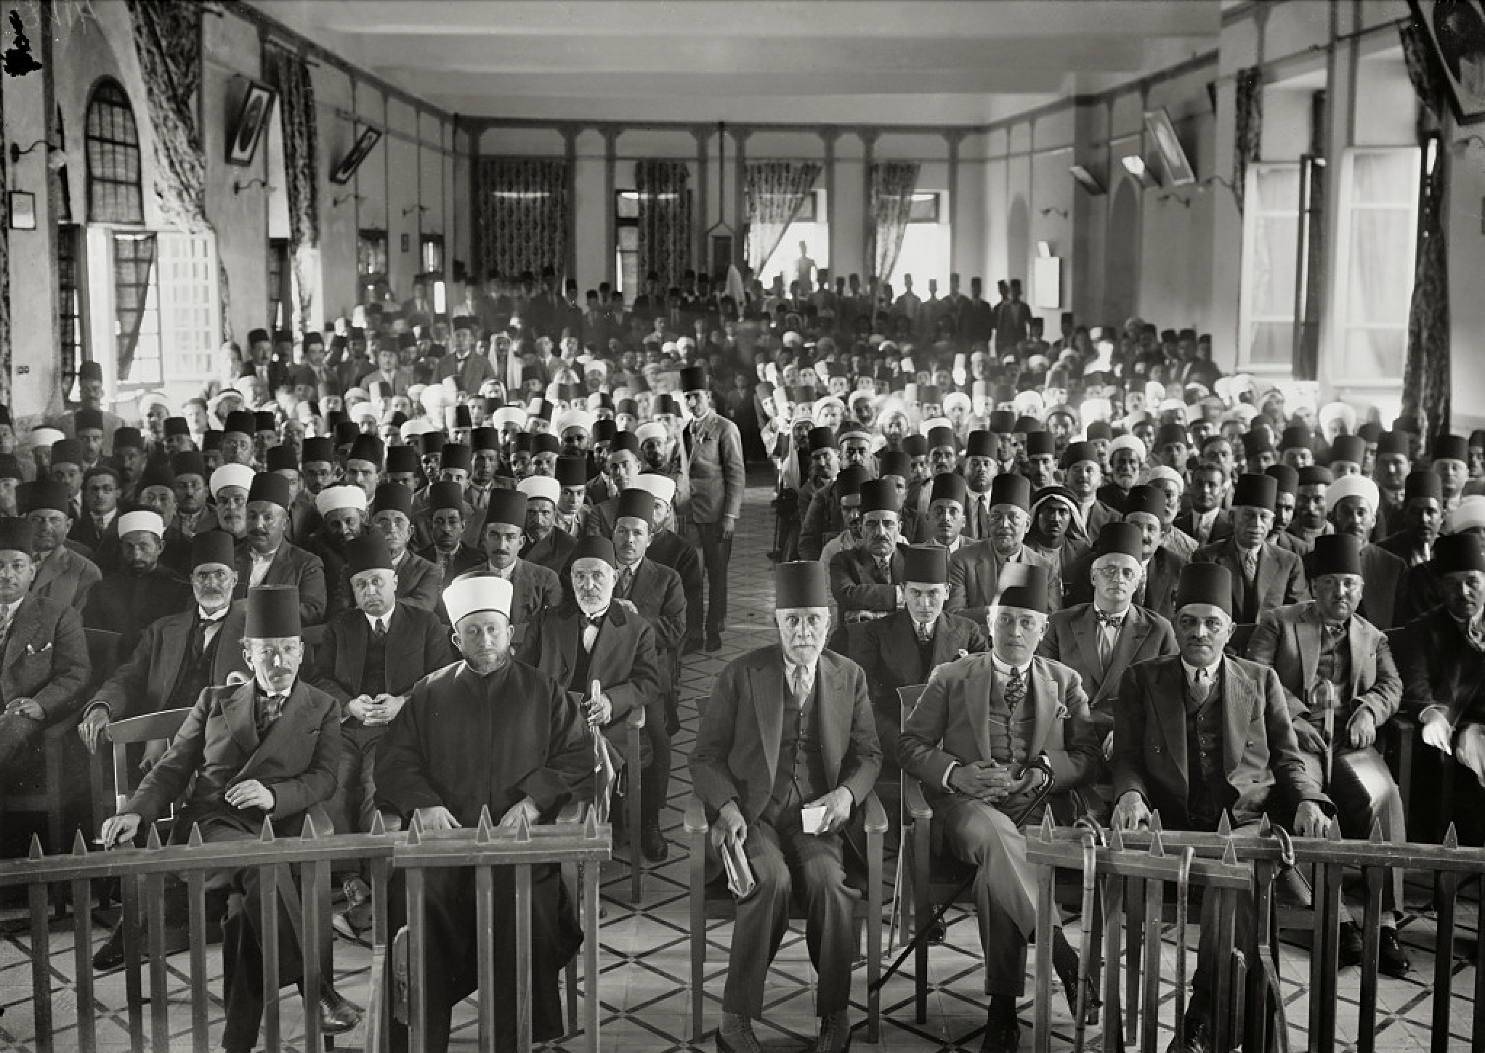
Starter: What can you tell about a society/culture/moment in the past from a photo?
Notes:
Students may notice the ordered and hierarchical nature of the seating plan and the absence of women or younger people. The hats are signifier; the fez is worn by the urban middle classes, the white turban by Muslim religious leaders and the few men wearing the keffiyeh (popularized by Yasser Arafat and which has now come to symbolize ‘Palestinian’) are leading men from the villages. The five men at the front include representatives are from important Palestinian families, the al-Husseinis on the left and the Nashashibis on the right. On the far right sits Alfred Roch a Palestinian Roman Catholic.

Slide 3
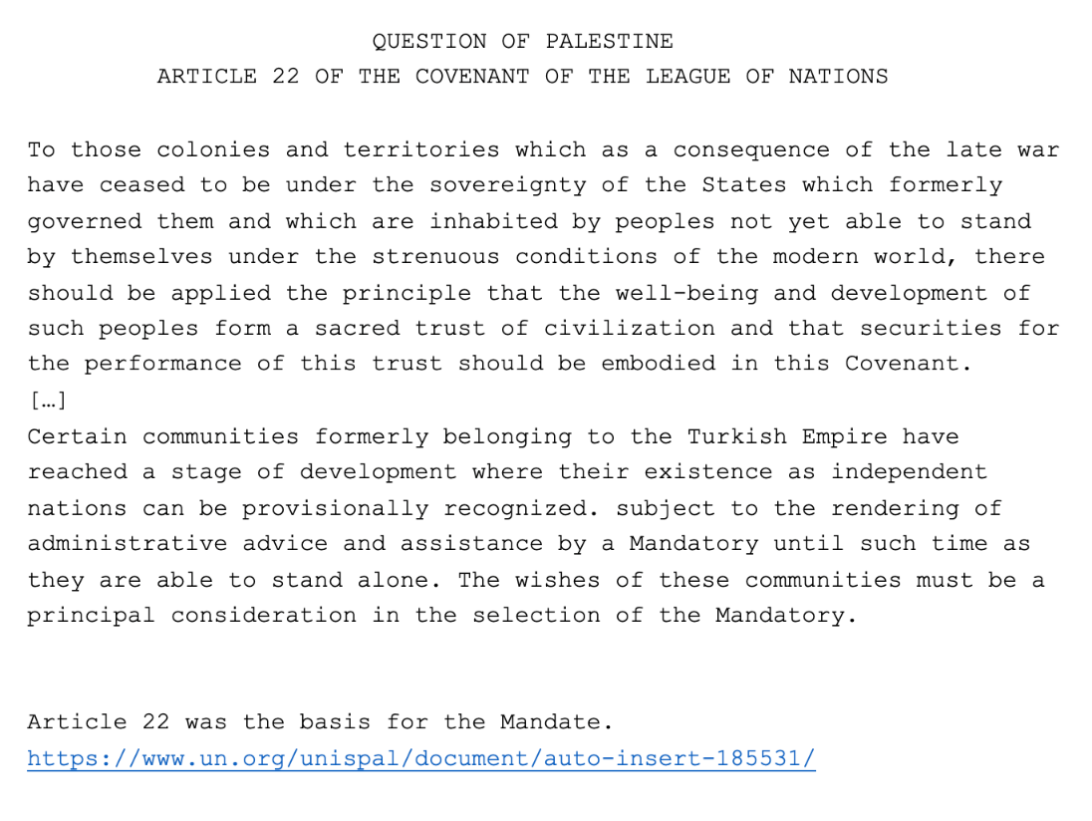
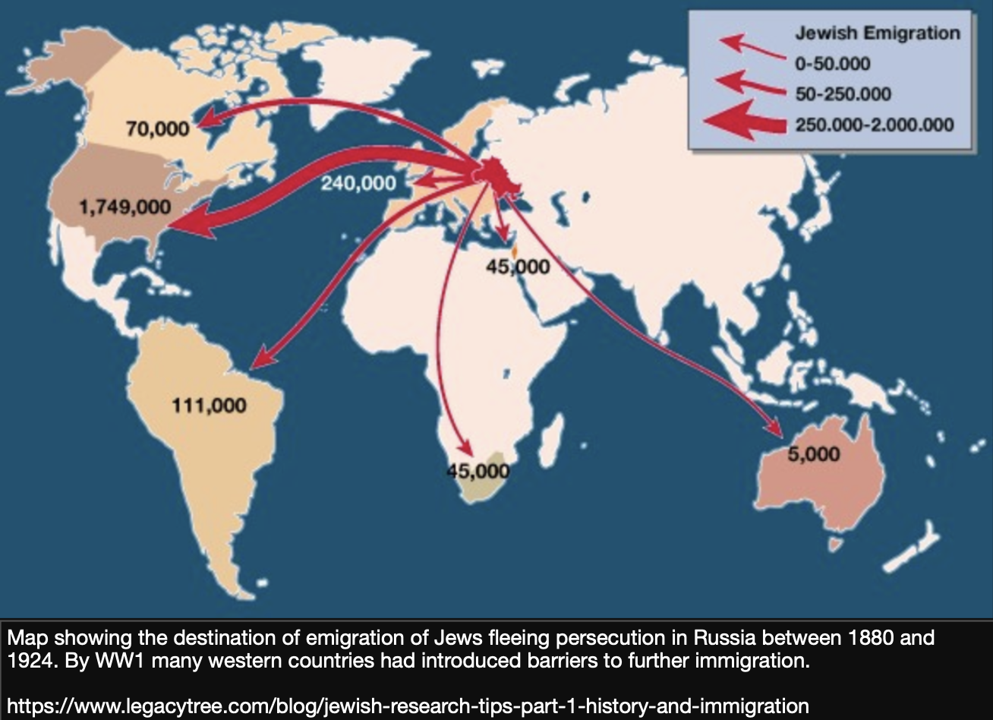
Activity 1: Consider these two pieces of evidence
1. Were the terms of the Mandate for Palestine flawed from the start? Use YOK as well as the sources.

Slide 4
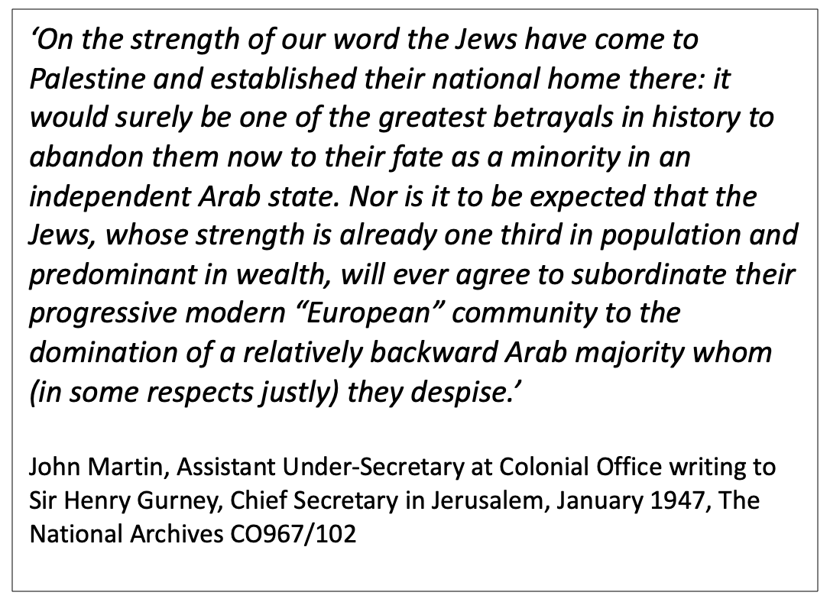
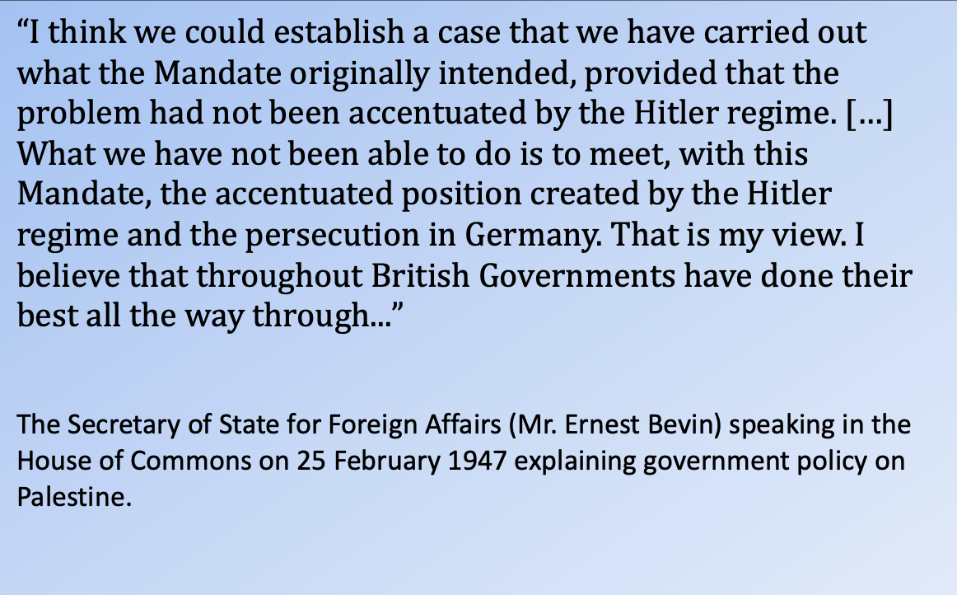
Activity 2: Contrast this evidence about the British government’s approach
How are these two sources both similar and different?
What might account for these similarities and differences?

Slide 5
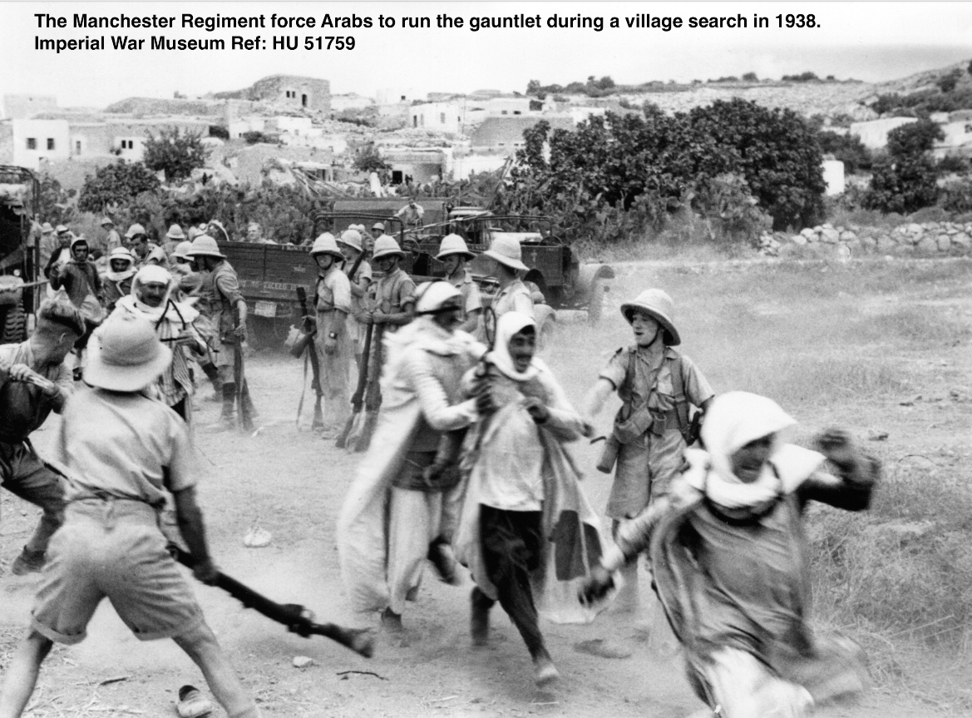
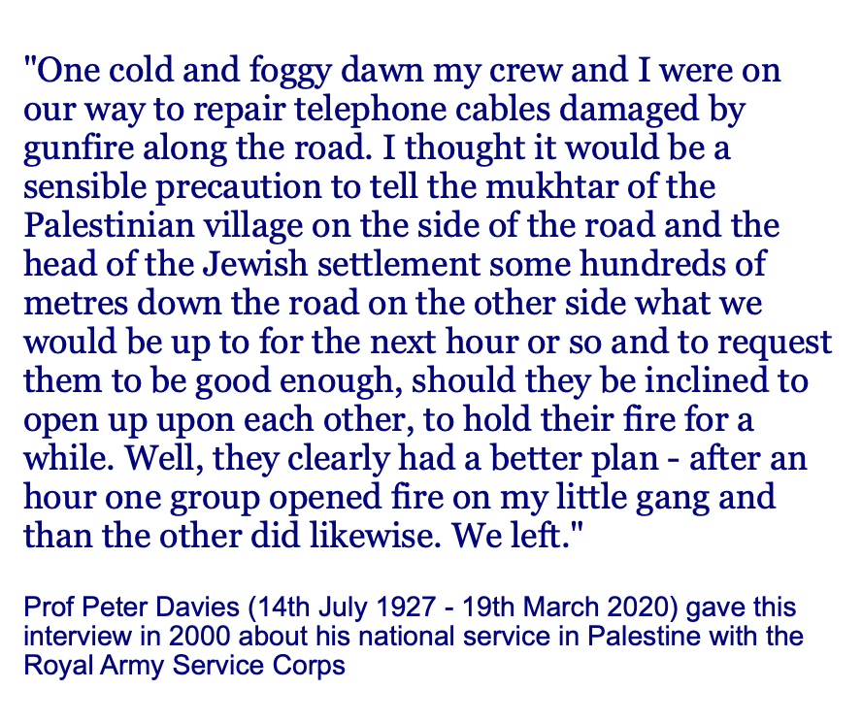
Activity 3: Compare these two pieces of evidence about the actions of British forces
What do these sources tell you about how British forces operated in Palestine?
What might explain the difference between the sources?

Slide 6
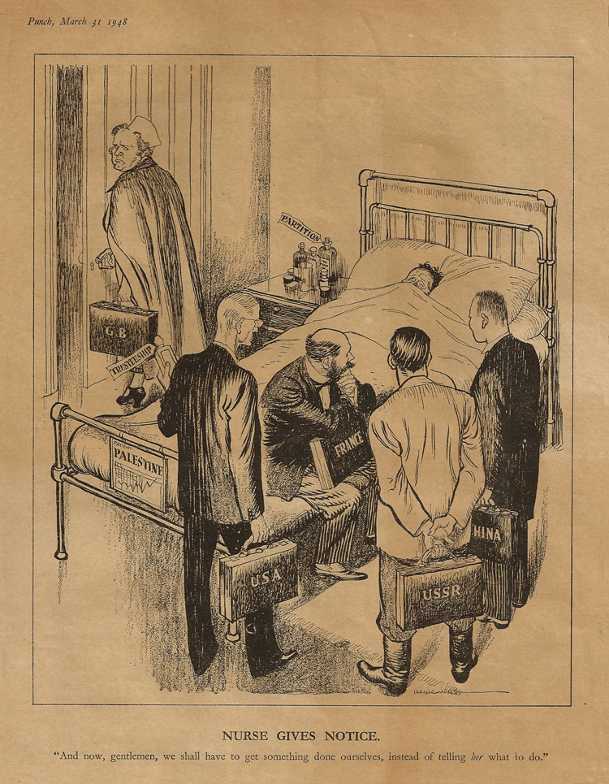
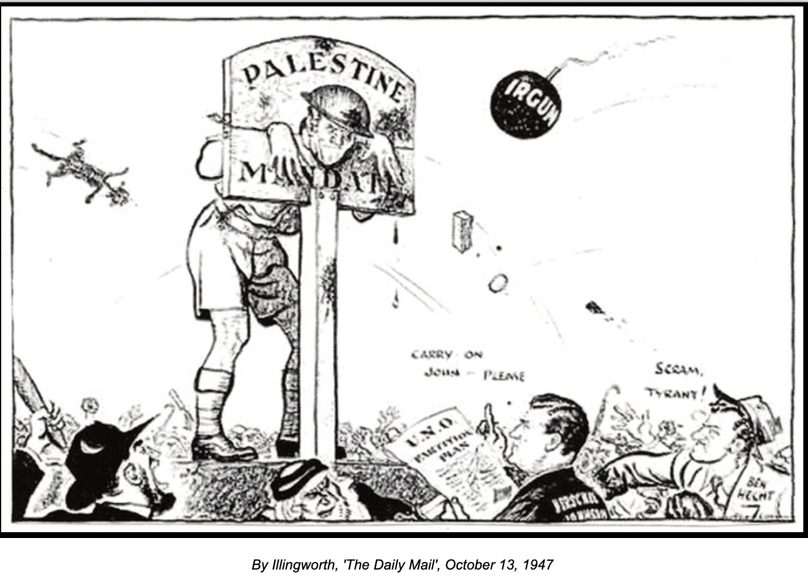
Activity 4: Compare this evidence about why Britain left Palestine
1. To what extent do these two cartoons agree or disagree about the causes of Britain’s departure?

Slide 7
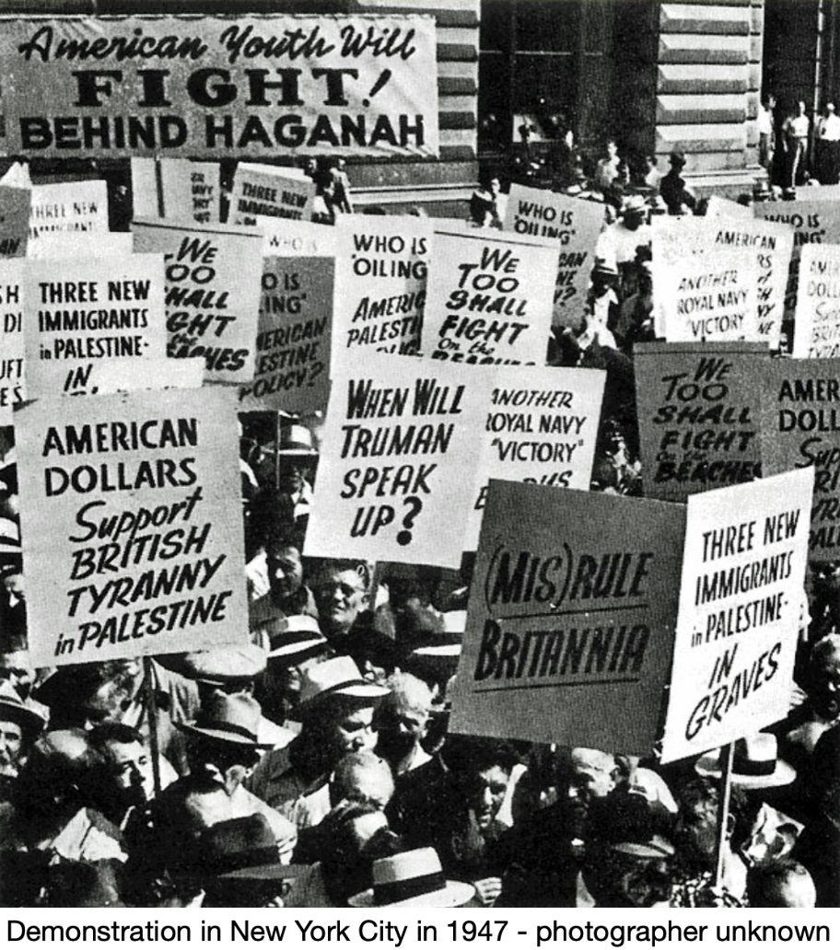
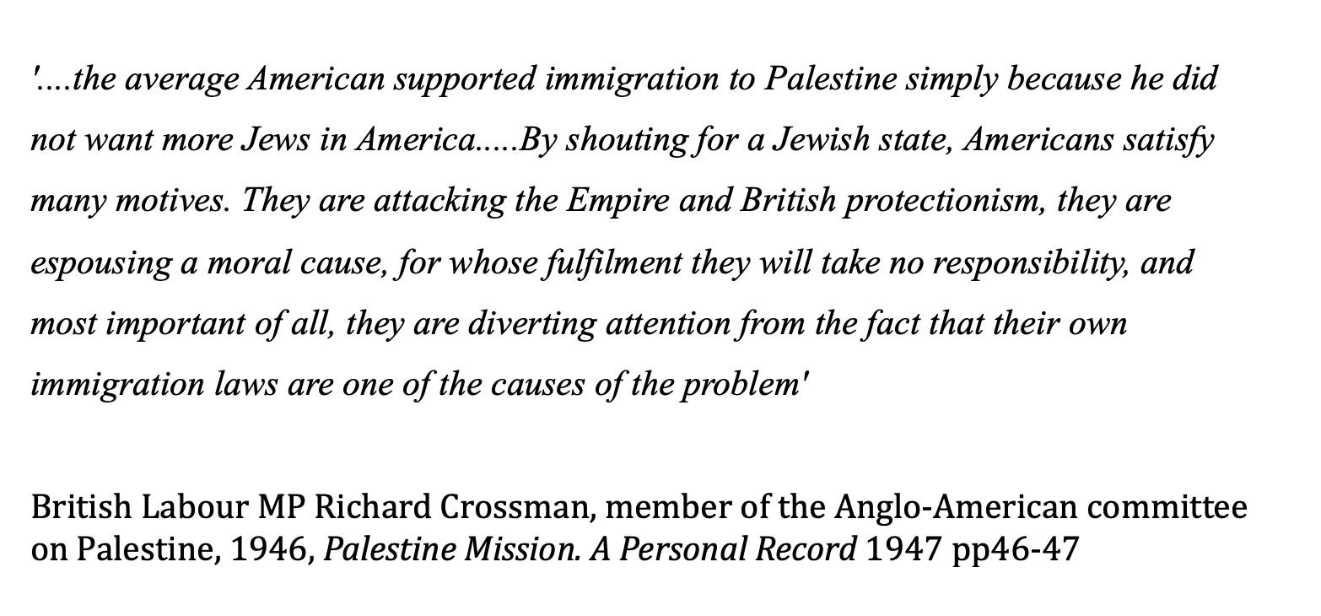
Activity 5: Compare these two pieces of evidence about attitudes to Jewish immigration
How do these two sources differ?
What might account for their difference?

Slide 8
Activity 6: Using evidence in a debate
Working in groups prepare to debate the proposition
“This house believes that Britain should be praised/blamed for its handling of the Mandate in Palestine”

