Slide 1
Nationalist perspective
Unionist perspective
Starter:
Historical Context
Students are encouraged to explore the thematic timeline and decide which perspective it is from.
They are to use the information on the timeline and from their own knowledge to create a dual narrative should the Catholic/Nationalist narrative and the Protestant/Unionist narrative.
Note – some events will feature in both narratives

Slide 2
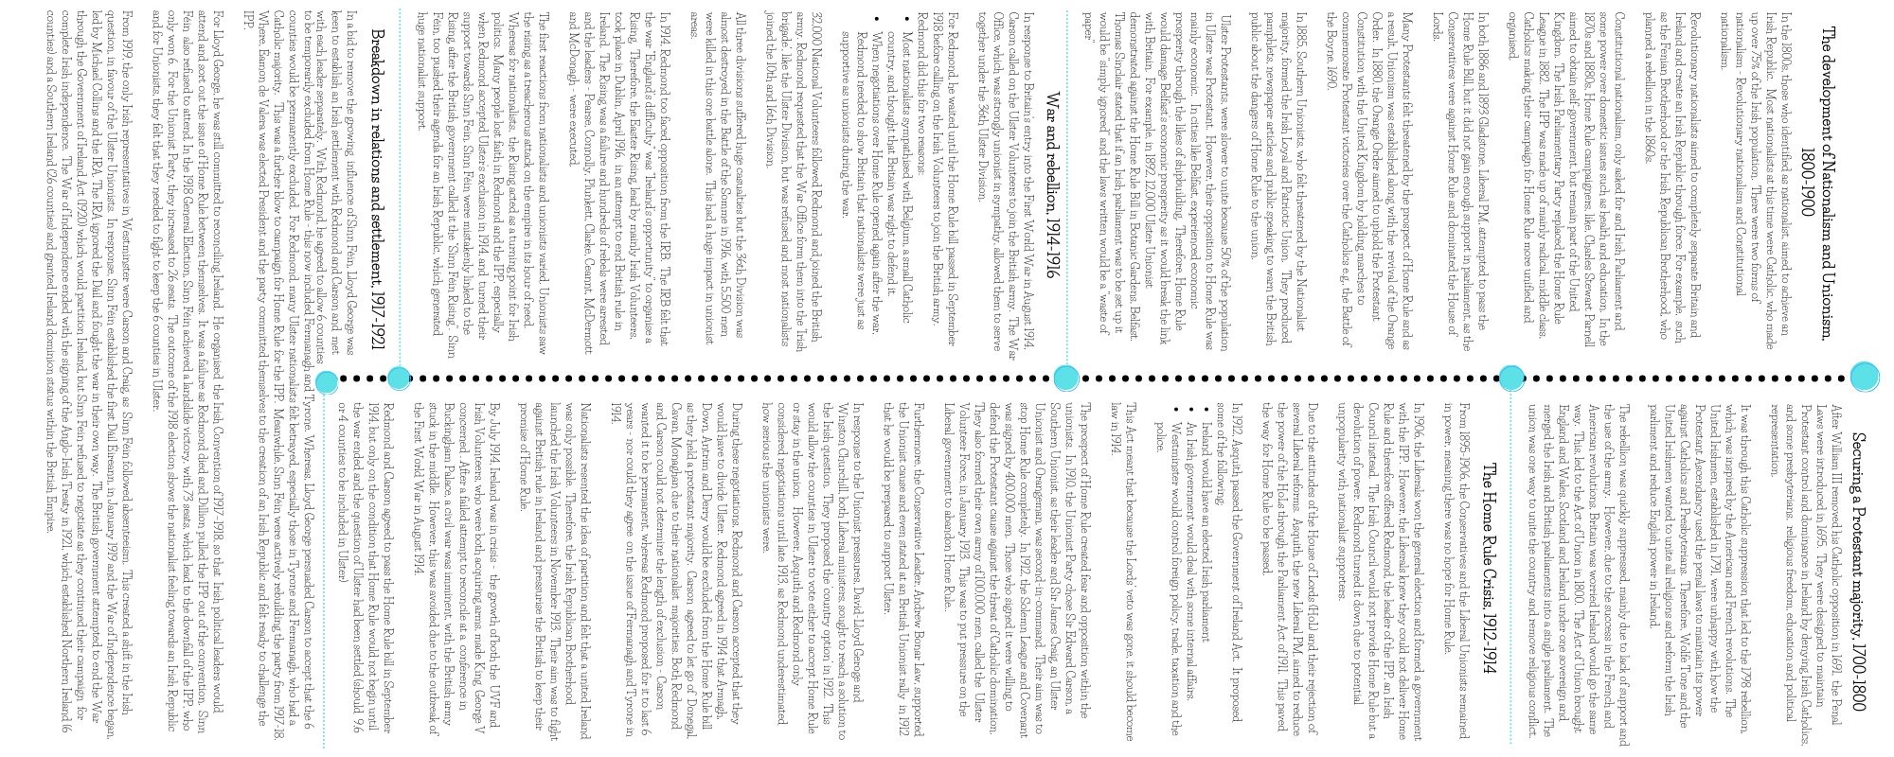

Slide 3
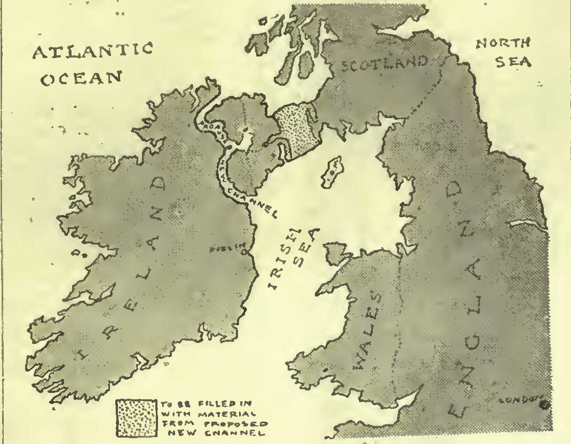
Key Enquiry:
Should the British government be praised or blamed for the partition of Ireland?
This source is from Punch Magazine.
How reliable is this source as evidence for an enquiry into the partition of Ireland?

Slide 4
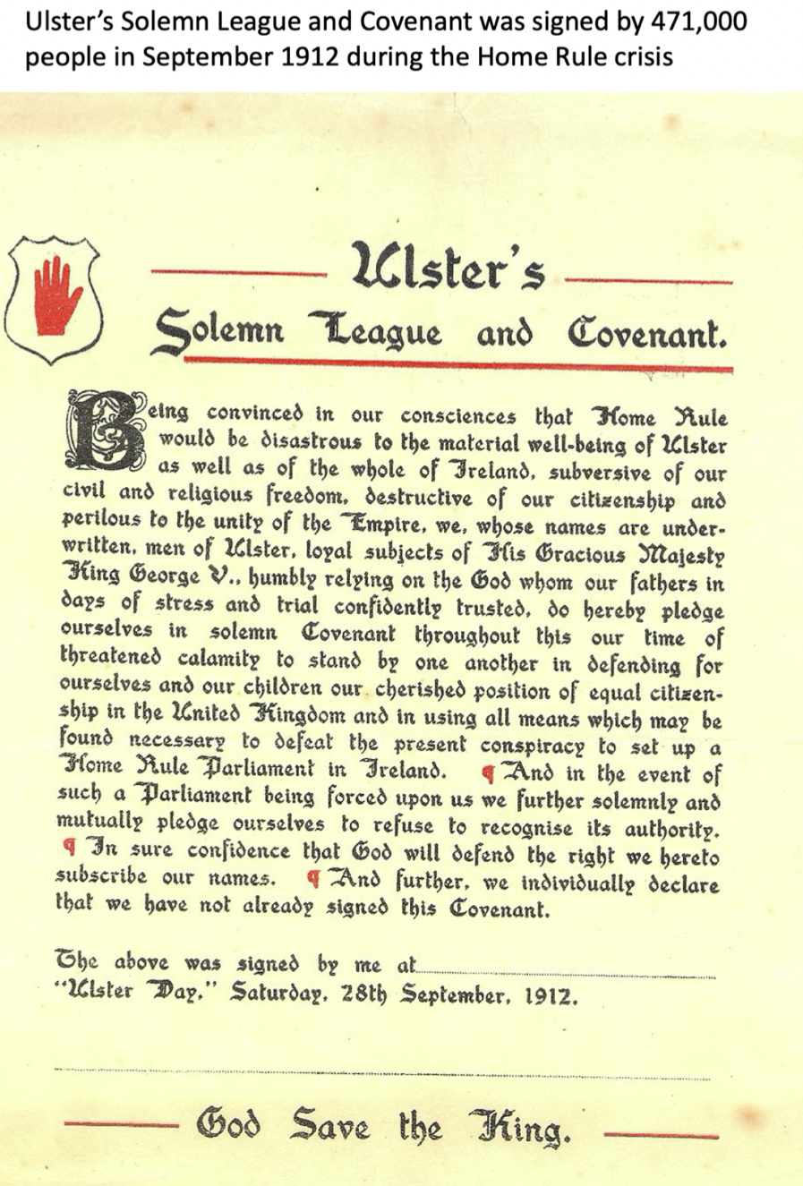
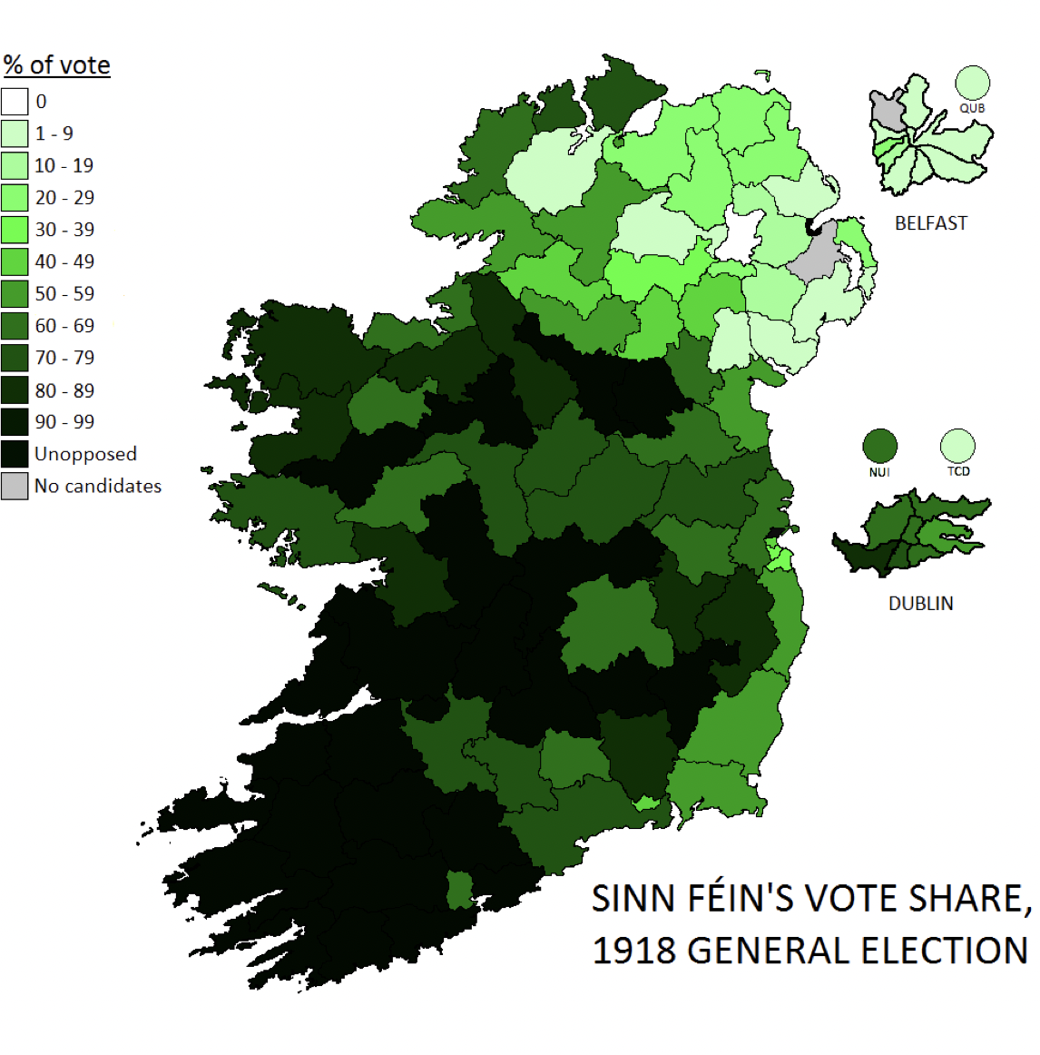
“The rebellion and its treasonable connection through the Clan-na-Gael with Germany, the harm it has done to the Empire, is forgotten, because they now think that Sinn Feinism and Irish patriotism are synonymous terms. The fact that the rebellion has brought Home Rule once again on a political platform induces them to think, with some reason, that rebellion pay better than constitutional methods. Hence there is a widespread opposition to Mr. Redmond and his party. We must now expect more extremist views to prevail.”
General John Maxwell in a letter to Herbert Asquith, British Prime Minister, 1916. Maxwell was sent as the military governor of Ireland following the Easter Rising broke out on 24 April 1916. Under his command, 3,400 people were arrested and 15 executed.
Activity
Exploring sources
In pairs explore these two sources:
The Solemn League and Covenant, 1912
A letter from Maxwell to Asquith in 1916
A map showing Sinn Fein’s vote share in the 1918 general election
What lines of argument can you create from these three sources on the question: Should the British government be praised or blamed for the partition of Ireland?
What can you learn from this source about how the British government responded to the Easter Rising in 1916?
What does this source tell you about public support towards Sinn Fein in the 1918 general election?
Extension task: Choose one source above.
Create a 20 second argument to use in a discussion on the key question.
What can you learn from this source about Unionist reactions to Irish Nationalists campaigning for Home Rule?

Slide 5
Activity
Exploring interpretations
Over the last 2 lessons students have explored evidence through making inferences and commenting on its reliability and utility.
The next stage is to bring in interpretations and how historians view the past differently and often, disagree with each other.
In pairs, they can try this interpretation and as a class discuss the questions in turn.
When exploring interpretations, you could ask these questions:

Slide 6
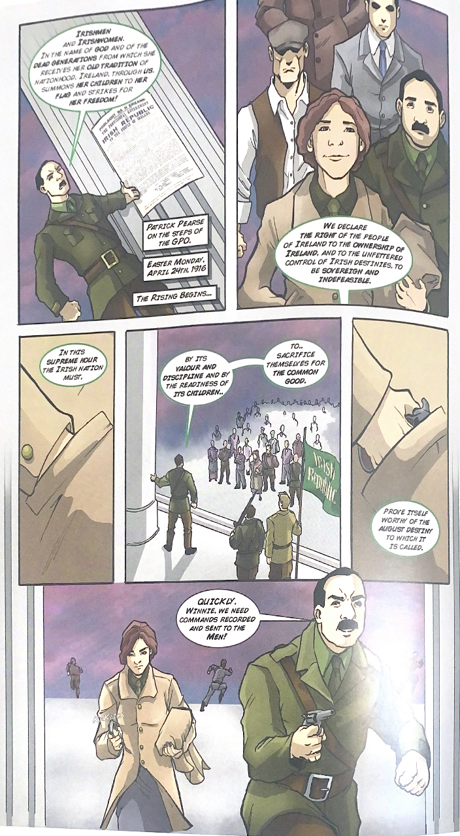
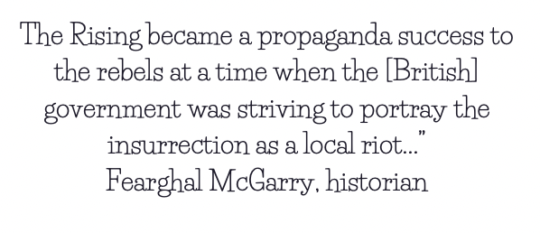
This is an extract from ‘The Easter Rising’ by Creative Centenaries, 2016. It is a comic aimed at primary school children.
It follows the story of Winifred Carney. Winifred was from Belfast and the first woman to enter the GPO, as a member of the Irish Citizen Army during the Easter Rising.
Activity
Exploring interpretations
In pairs, students are encouraged to explore two interpretations:
From a comic
From a historian
How can these interpretations be used together when discussing the key question?
Fearghal McGarry is an Irish historian, currently Professor of Modern Irish History at Queen's University, Belfast.

Slide 7
Homework
Split the class into two groups
Group 1 watch the ‘Britain should be blamed’ side
Group 2: watch the ‘Britain should be praised’ side
Make a note of some possible lines of argument you can use.
https://me.touchcast.com/s/87333ibddo

Slide 8
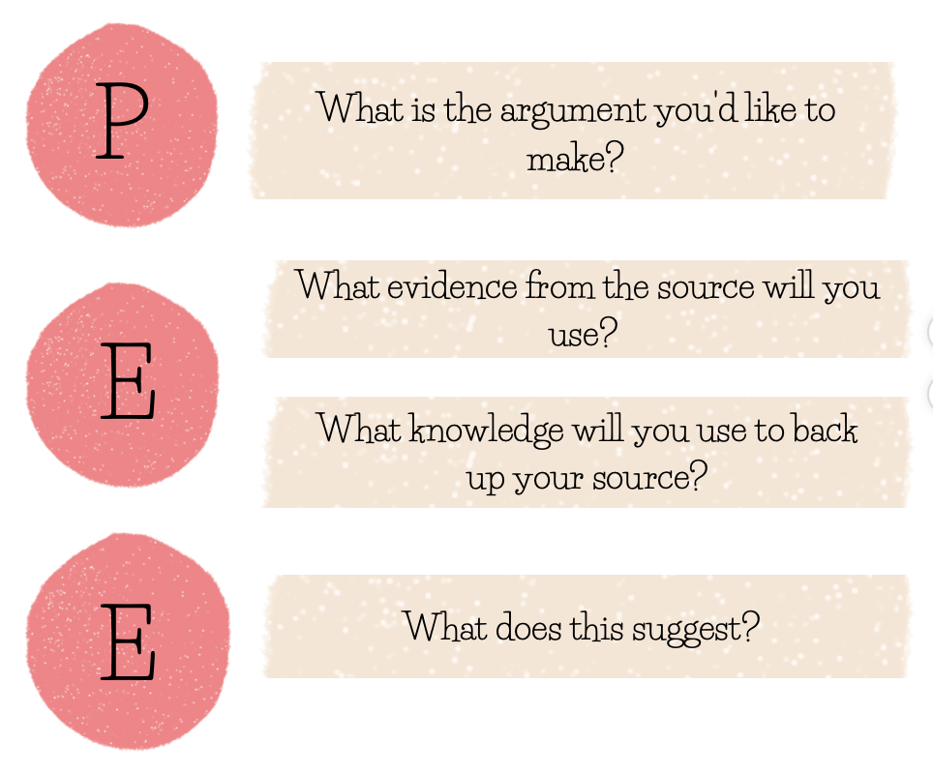
Activity
Preparing for a debate
In groups of 10:
Team 1: Responsible (5 students)
Team 2 : Not Responsible (5 students)
In teams, explore all the sources and select sources that matches their lines of argument.
Each student then prepares a 60-90second argument using sources to support his/her own argument.
You can use the structure to support your students or provide one of your own.
Don’t forget you can use the content from a source AND comment on its provenance (i.e., author, type of source, date). You can also comment on its reliability and utility throughout your argument.
Remember, you are trying to persuade your audience that your argument is the most important one.

Slide 9
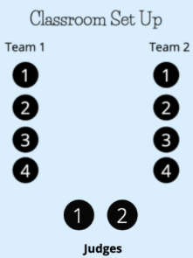
Activity
Run a debate, feedback and reflect
Run debates in groups of ten (two teams of four and two judges)
Each speaker has 90 seconds to deliver their speeches.
The judges will time the debates and provide feedback to each speaker.
Each student to write down their feedback in their debate logs or on their speeches

