Slide 1
Great Leaders:
Napoleon
Lesson:Napoleon’s Rise to Power

Slide 2
Length: 2x 50 minute class periods
Essential question:
To what extent was Napoleon Bonaparte’s ascension power a result of the French Revolution?
Lesson Objective:
Students will be able to explain how Napoleon Bonaparte rose to power and will be able to assess his approach to leadership.
Students will be introduced and familiarized with several primary sources which explore Napoleon’s leadership and the situation which enabled him to come to power.
Prior Knowledge:
Students should be familiar with the events and goals of the French Revolution from 1789-1799.
https://www.history.com/topics/france/french-revolution
https://www.youtube.com/watch?v=5fJl_ZX91l0

Slide 3
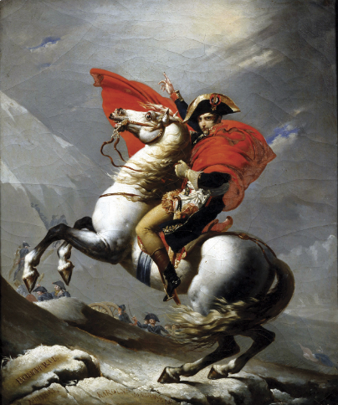
Bell ringer
What symbols and imagery do you see in this painting? What do you think they represent?
How does this painting portray Napoleon?
Napoleon Crossing the Alps by Jacques Louis David

Slide 4
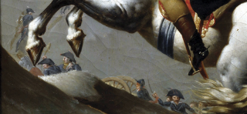
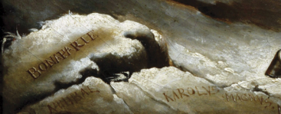
A closer look at a few details… What could these represent?
Arabian stallion
Elegant red cape
Soldiers in the background
Hannibal and Charlemagne’s names engraved into the stone. (two great leaders who also crossed the Alps)
Notes:
TEACHER NOTES FOR DISCUSSING THE BELL RINGER
This painting is a prime example of the way art was used as propaganda to glorify Napoleon’s image. Jacques Louis David was less concerned about accuracy and more about portraying a certain image.
Napoleon requested David to paint him “calm, on a fiery horse”. So…Napoleon is painted on an Arabian Stallion wearing and elegant red cloak. In reality he crossed the Alps on a mule in a simple grey coat to provide the necessary warmth and stability for the journey.
Napoleon was so pleased with the piece, he ordered three more versions to be painted and a fifth was eventually produced.
(Polit)
Ben Pollitt, "Jacques-Louis David, Napoleon Crossing the Alps," in Smarthistory, January 7, 2016, accessed November 29, 2022
For further reading on this painting, https://smarthistory.org/jacques-louis-david-napoleon-crossing-the-alps/

Slide 5
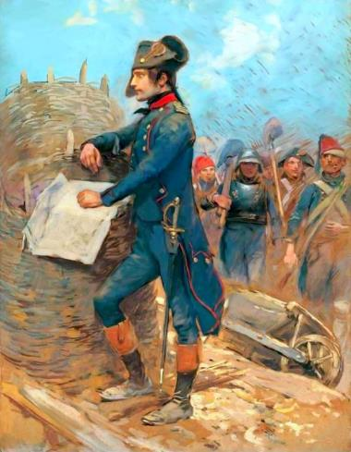
Early military success
In what ways were Napoleon Bonaparte’s early successes a result of the French Revolution?
In 1793, after retaking the key port city of Toulon from Royalist control, Napoleon Bonaparte was promoted to Brigadier General.
In 1795, after successfully suppressing a large Royalist insurrection, Napoleon was promoted by the Directory and given command of the army in Italy.
Napoleon at Toulon- Edouard Detaille
Notes:
Teacher notes:
In 1793, after retaking the key port city of Toulon from Royalist control, Napoleon Bonaparte a young Captain in the Republican Army, drew the attention of the Committee of Public Safety and was promoted to Brigadier General.
To avoid the unfortunate fate of Jacobin loyalist following the removal of the Committee of Public Safety, Napoleon needed to show his loyalty to the new government. He did this in 1795 by successfully suppressing a large Royalist insurrection. As a result he was promoted by the Directory and given command of the army in Italy.
https://commons.wikimedia.org/wiki/File:Napoleon_%C3%A0_Toulon_par_Edouard_Detaille.jpg

Slide 6
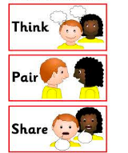
The Italian Campaign
Actively read this document on the note page
Napoleon’s Proclamation to His Troops in Italy (March-April 1796)
You have won battles without cannon, crossed rivers without bridges, made forced marches without shoes… Soldiers of liberty…the greatest obstacles have been overcome; but you still have battles to fight. Is there one among you whose courage is abating? No…all of you long to humiliate those arrogant kings who dare to contemplate placing us in chains…all of you wish to be able to say with pride as you return to your villages, "I was with the victorious army of Italy!"
Friends, I promise you this conquest; but there is one condition you must swear to fulfill—to respect the people whom you liberate…otherwise you would not be the liberators of the people; you would be their scourge.
Peoples of Italy, the French army comes to break your chains; your property, your religion, and your customs will be respected.
Discuss the questions with your neighbor
Share your ideas with the class and take notes on conclusions you make
What was the purpose/goal of this proclamation?
What does this proclamation show you about Napoleon and his approach to leadership?

Slide 7
The Italian Campaign
Napoleon’s Proclamation to His Troops in Italy (March-April 1796)
You have won battles without cannon, crossed rivers without bridges, made forced marches without shoes… Soldiers of liberty…the greatest obstacles have been overcome; but you still have battles to fight. Is there one among you whose courage is abating? No…all of you long to humiliate those arrogant kings who dare to contemplate placing us in chains…all of you wish to be able to say with pride as you return to your villages, "I was with the victorious army of Italy!"
Friends, I promise you this conquest; but there is one condition you must swear to fulfill—to respect the people whom you liberate…otherwise you would not be the liberators of the people; you would be their scourge.
Peoples of Italy, the French army comes to break your chains; your property, your religion, and your customs will be respected.
What do you think the purpose of this proclamation was?
Understanding
What does this proclamation show you about Napoleon and his approach to leadership?
Inspiring
Confident
The importance of image and public perception, wants to be seen as a liberator

Slide 8
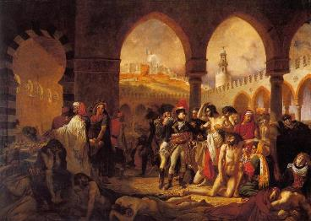
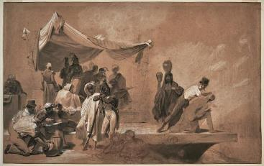
Bonaparte Visiting the Plague Victims of Jaffa by Antoine -Jean Gros 1804
The Egyptian Campaign
The Italian Campaign in 1797 was a tremendous success for the French.
In 1798, Napoleon was sent to Egypt by the Directory to disrupt British trade routes taking him out of the French Political scene.
Though the campaign led to the discovery of the Rosetta Stone, the defeat of the French Navy left Napoleon and 35,000 troops stranded.
Napoleon Bonaparte Surrounded by Scientists and Students in Egypt -Léon Cogniet 1821
Notes:
Teacher notes:
The Italian Campaign in 1799 was a tremendous success as the Peace of Campo Formio was signed between the Austrians and French essentially ending the first coalition war (except for the British who continued to fight)
.
https://en.wikipedia.org/wiki/Bonaparte_Visiting_the_Plague_Victims_of_Jaffa

Slide 9
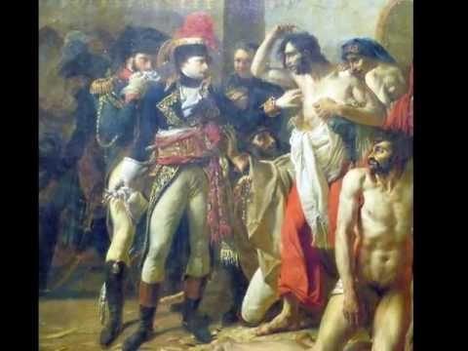
Watch: SmArt History’s analysis of: Bonaparte Visiting the Plague Victims of Jaffa
How is this painting an example of propaganda?
What does this painting (and the Egyptian Campaign) reveal about Napoleon and his intentions?

Slide 10
France 1799-1804
Memoirs of Madame de Remusat- Napoleon’s Appeal (1880)
I can understand how it was that men worn out by the turmoil of the Revolution, and afraid of that liberty which had long been associated with death, looked for repose under the dominion of an able ruler on whom fortune was seemingly revolved to smile… I may confidently assert that those persons believed quite sincerely that Bonaparte, whether as consul or emperor, would exert his authority to oppose the intrigue of faction and would save us from the perils of anarchy.
None dared to utter the word “republic,” so deeply had the Terror stained that name; and the government of the Directory had perished in the contempt with which its chiefs were regarded. The return of the Bourbons could only be brought about by the aid of a revolution; and the slightest disturbance terrified the French people, in whom enthusiasm of every kind seemed dead. Besides, the men in whom they had trusted had one after the other deceived them…
19 Brumaire Year Eight (10th November, 1799) Proclamation speech by Napoleon
On my return to Paris, I found a division reigning amongst all the constituted authorities. There was no agreement but on this single point — that the constitution was half destroyed, and could by no means effect the salvation of our liberties. All the parties came to me, confided to me their designs, unveiled their secrets, and demanded my support.
Highlight/Annotate
Highlight:
Evidence as to why people were drawn to Napoleon.
Evidence of situation in France upon Napoleon’s return from Egypt
Annotate:
What you’ve highlighted using the following sentences frame “This shows…”
NOTE: In 1799, the French government was The Directory which was created AFTER the National Convention was dissolved (the Committee of Public Safety (i.e. those responsible for the Reign of Terror) was created by the National Convention )
Notes:
https://www.napoleon.org/en/history-of-the-two-empires/articles/bonapartes-proclamation-to-the-french-people-on-19-brumaire/

Slide 11
Example of Highlight/Annotate
This shows …that the French Revolution was hard on people
Memoirs of Madame de Remusat- Napoleon’s Appeal (1880)
I can understand how it was that men worn out by the turmoil of the Revolution, and afraid of that liberty which had long been associated with death, looked for repose under the dominion of an able ruler on whom fortune was seemingly revolved to smile… I may confidently assert that those persons believed quite sincerely that Bonaparte, whether as consul or emperor, would exert his authority to oppose the intrigue of faction and would save us from the perils of anarchy.
None dared to utter the word “republic,” so deeply had the Terror stained that name; and the government of the Directory had perished in the contempt with which its chiefs were regarded. The return of the Bourbons could only be brought about by the aid of a revolution; and the slightest disturbance terrified the French people, in whom enthusiasm of every kind seemed dead. Besides, the men in whom they had trusted had one after the other deceived them…
…that people did not have a good experience with a government that promised liberty
Means “rest”-- so people wanted rest from Revolutionary turmoil
If you don’t know a word… look it up!
Notes:
Use this slide to explain “active reading” (highlighting and annotating )

Slide 12
Memoirs of Madame de Remusat- Napoleon’s Appeal (1880)
I can understand how it was that men worn out by the turmoil of the Revolution, and afraid of that liberty which had long been associated with death, looked for repose under the dominion of an able ruler on whom fortune was seemingly revolved to smile… I may confidently assert that those persons believed quite sincerely that Bonaparte, whether as consul or emperor, would exert his authority to oppose the intrigue of faction and would save us from the perils of anarchy.
None dared to utter the word “republic,” so deeply had the Terror stained that name; and the government of the Directory had perished in the contempt with which its chiefs were regarded. The return of the Bourbons could only be brought about by the aid of a revolution; and the slightest disturbance terrified the French people, in whom enthusiasm of every kind seemed dead. Besides, the men in whom they had trusted had one after the other deceived them…
Translation of 19 Brumaire Year Eight (10th November, 1799) Proclamation speech by Napoleon
On my return to Paris, I found a division reigning amongst all the constituted authorities. There was no agreement but on this single point — that the constitution was half destroyed, and could by no means effect the salvation of our liberties. All the parties came to me, confided to me their designs, unveiled their secrets, and demanded my support.
Notes:
Use this slide and the suggested highlights to have a class discussion about these documents as to why people were drawn to Napoleon and what the situation was in France upon Napoleon’s return from Egypt.

Slide 13
Homework
Using evidence from your highlighted sources write a paragraph answering the following question:
What was the situation in France following Napoleon’s return from Egypt in 1799?
Napoleon Bonaparte Surrounded by Scientists and Students in Egypt -Léon Cogniet 1821
Bonaparte Visiting the Plague Victims of Jaffa by Antoine -Jean Gros 1804

Slide 14
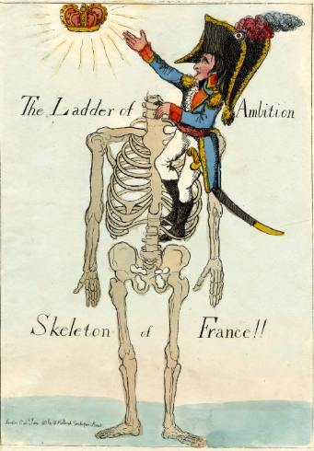
Bell ringer
What symbols and imagery do you see in this painting? What do you think they represent?
How does this painting portray Napoleon and his rise to power?
Notes:
Go over the homework from the previous night as you discuss this cartoon (there should be a lot of overlap!)

Slide 15
“Napoleon’s Account of the Internal Situation in France, 1804”
A plot conceived by an implacable government was about to plunge France into the abyss of civil war and anarchy. The discovery of this horrible crime stirred all France profoundly.
Experience has taught that a divided power in the state is impotent and at odds with itself…If power was delegated for short periods only it was so uncertain as to discourage any prolonged undertakings... If vested in an individual for life, it would lapse with him, and after him would prove a source of anarchy and discord. It was clearly seen that for a great nation the only salvation lies in hereditary power, which can alone assure a continuous political life.
Actively read this document on the note page
Discuss the questions with your neighbor
Share your ideas with the class and take notes on conclusions you make
According to Napoleon, what was the solution to the political turmoil that France faced in 1804? Why does he believe this?
implacable:used to describe strong opinions or feelings that are impossible to change

Slide 16
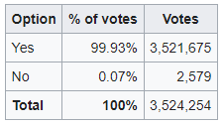
Napoleon becomes Emperor in 1804
A referendum (pleniscite) concerning the establishment of the French Empire, promoting Napoleon from's status from First Consul to Emperor of the French, was held in France in November 1804.
Why did people support Napoleon becoming Emperor?
What are some potential problems/concerns about this referendum ?
Total population in France in 1804: 7 million
Notes:
https://en.wikipedia.org/wiki/1804_French_constitutional_referendum

Slide 17
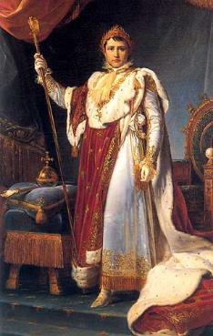
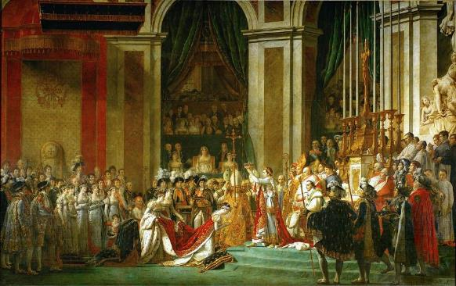
Napoleon I in his Coronation Robes- Francois Gerard, 1805
The Coronation of Napoleon- Jacques-Louis David 1805-1807
How was Napoleon becoming Emperor contrary to the goals of the French Revolution?
Notes:
https://en.wikipedia.org/wiki/The_Coronation_of_Napoleon#/media/File:Jacques-Louis_David_-_The_Coronation_of_Napoleon_(1805-1807).jpg

Slide 18
Summarize: Review the 8 documents that chronicle Napoleon’s rise to power. Citing specific evidence, answer the essential question: To what extent was Napoleon Bonaparte’s ascension to power a result of the French Revolution?

