Slide 1
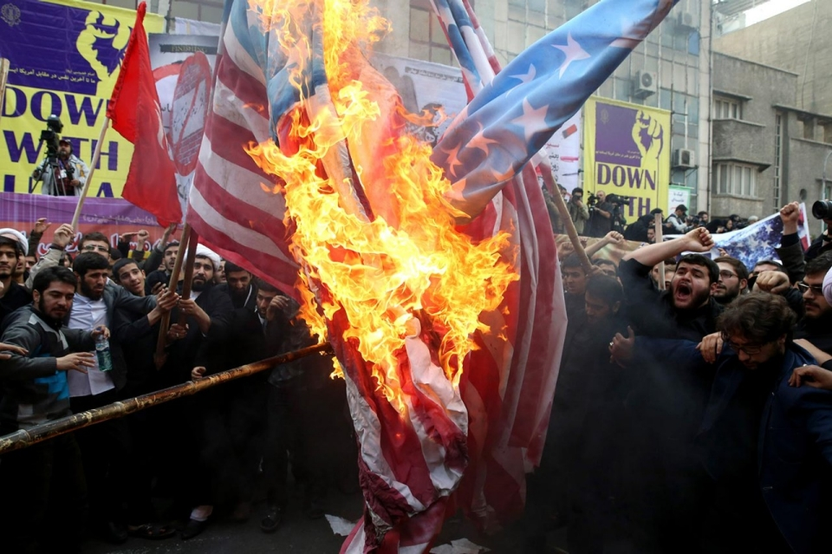
Starter Activity
Think, Pair, Share:
The image on the left was taken recently in Tehran, the Iranian capital.
In pairs, do the following:
What is happening in the picture?
What background or prior knowledge do you have that might help explain what is happening in the picture?
What more do you want to know about the picture?

Slide 2
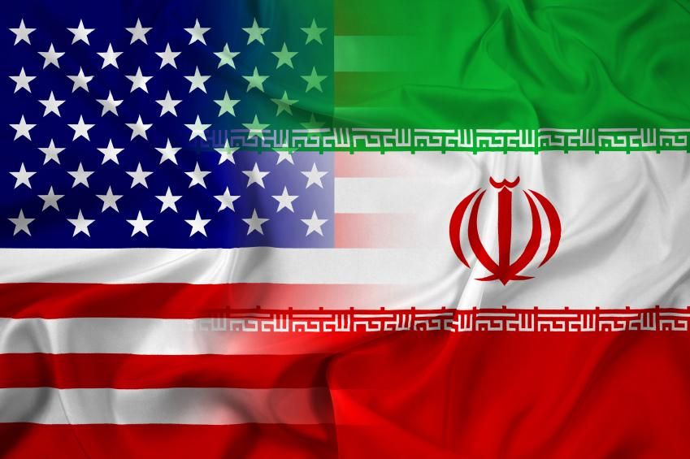
Key Inquiry
What explains the hostility and the current suspicion between Iran and the United States? Lesson 1

Slide 3
The Shah is overthrown
Iraq launched a full-scale invasion of Iran
USS Vincennes shoots down Iranian airliner
US diplomats held hostage
Anglo Soviet invasion of Iran
US withdraws from the Iran nuclear deal
Discovery of oil fields
Mosaddegh is overthrown
Signing of the Iran nuclear deal
Organize these events into the correct chronological order and add dates.
Notes:
1. Discovery of oil, 2. Anglo Soviet invasion of Iran 3. Mosaddegh is overthrown, 4. The Shah is overthrown, 5. US diplomats held hostage, 6. Iraq launched a full-scale invasion of Iran, 7. USS Vincennes shoots down Iranian airliner, 8. Signing of the Iran nuclear deal, 9. US withdraws from the Iran nuclear deal

Slide 4
"We cannot permit the existence, between the frontiers of our Indian Empire...and
those of our new Protectorate, of a hotbed of misrule, enemy intrigue, financial chaos and
political disorder. Further…we possess in the south-western corner of Persia great assets in the
shape of oilfields, which are worked for the British navy, and which give us a commanding
interest in that part of the world."
Lord Curzon, the British Foreign Secretary, writing in 1919
Both these sources are about oil fields in Iraq.
How are the sources similar ?
How are the sources different?
How does Lord Curzon’s letter help us understand Paris Mina’s memoir?
"I used to go to the city to buy something, I used to stop at the bus stop which was run by the
(Anglo-Persian Oil) company. In the heat of the summer, 50 degrees Celsius. I used to stand in
that bus stop for nearly half an hour, a number of buses would come but because they had the
red tape meant only the British staff, I could not use that bus, I had to wait for the buses which
(were) allowed to take Iranians. There was a famous club in Abadan which the British staff
used. And there was a sign outside that club which said Dogs and Iranians are not allowed”
Paris Mina, an employee of the Anglo-Persian Oil Company, the company established by
Britain that would become crucial to British oil interests in Iran, on life in Abadan in the early
20th century

Slide 5
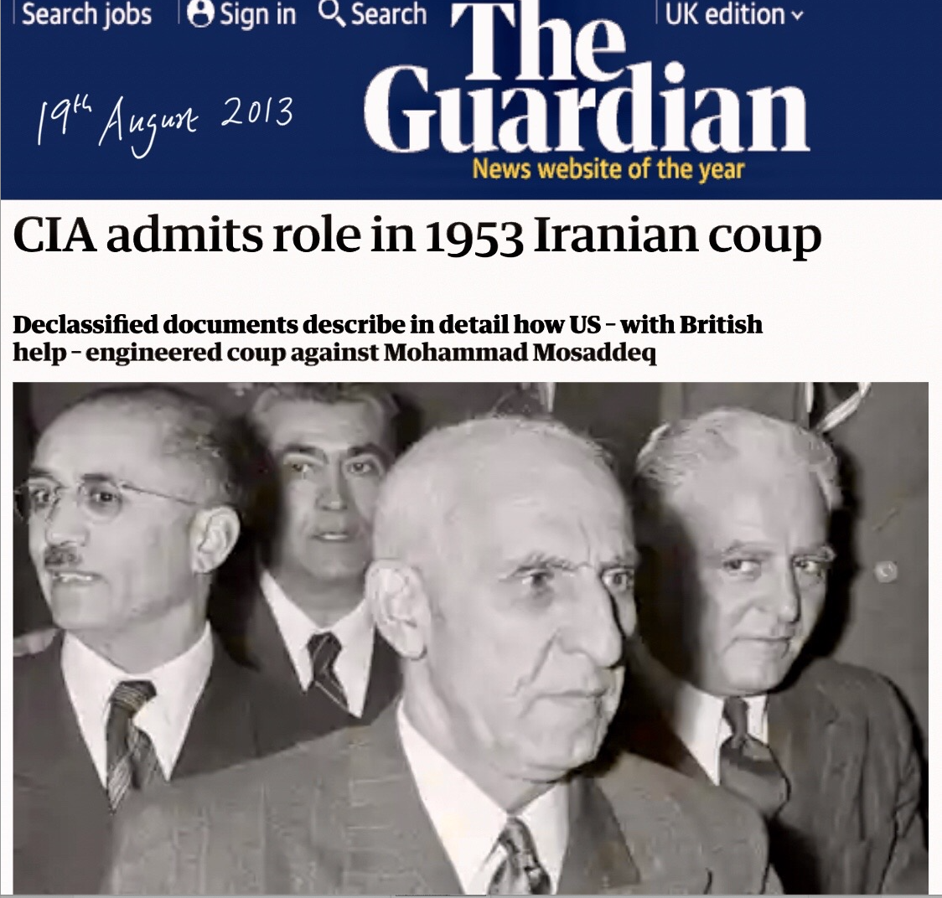
Compare and contrast these two pieces of evidence about outside intervention in Iran.
What are the similarities?
2) What are the differences?
3) How had the the world changed in between the Teheran Conference in December 1943 and the coup against Mosaddeq in August 1953?
Finally, the three leaders [Stalin USSR, Roosevelt USA, Churchill UK] issued a
"Declaration of the Three Powers Regarding Iran." Within it, they thanked the
Iranian Government for its assistance in the war against Germany and
promised to provide it with economic assistance both during and after the war.
Most importantly, the U.S., British, and Soviet Governments stated that they all
shared a "desire for the maintenance of the independence, sovereignty, and
territorial integrity of Iran.”
Office of the Historian, Foreign Service Institute
United States Department of State
https://history.state.gov/milestones/1937-1945/tehran-conf

Slide 6
Key Inquiry
What explains the hostility and the current suspicion between Iran and the United States? Lesson 2

Slide 7
Working in pairs, think about the key events which affected the relationship between Iran and the USA.
Ask yourselves, ‘did an event improve relations or make them worse?’
Draw this as a line on a chart and compare your chart with other students.

Slide 8
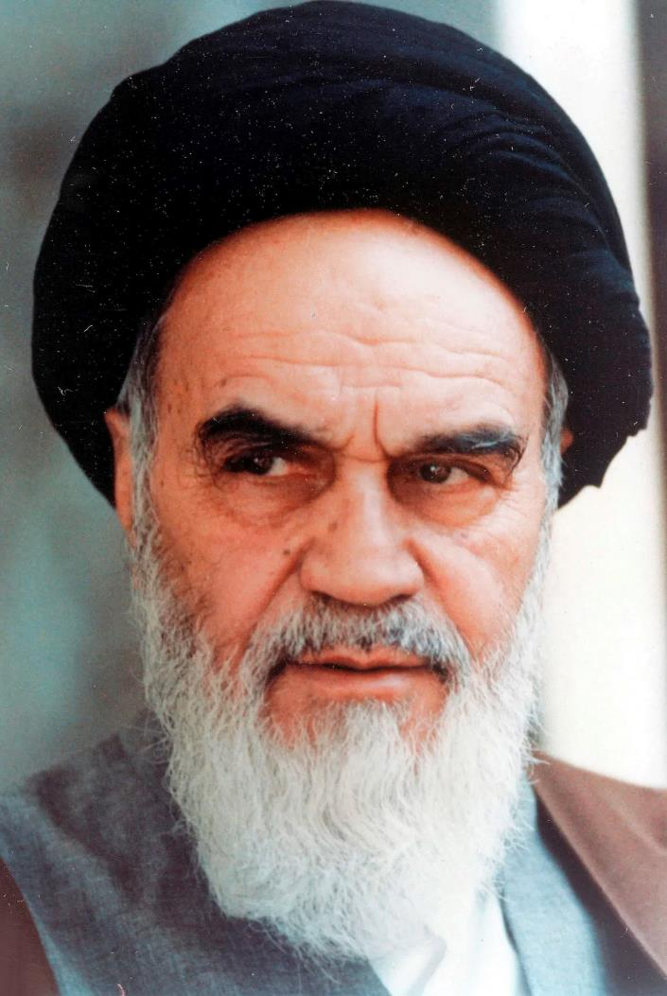
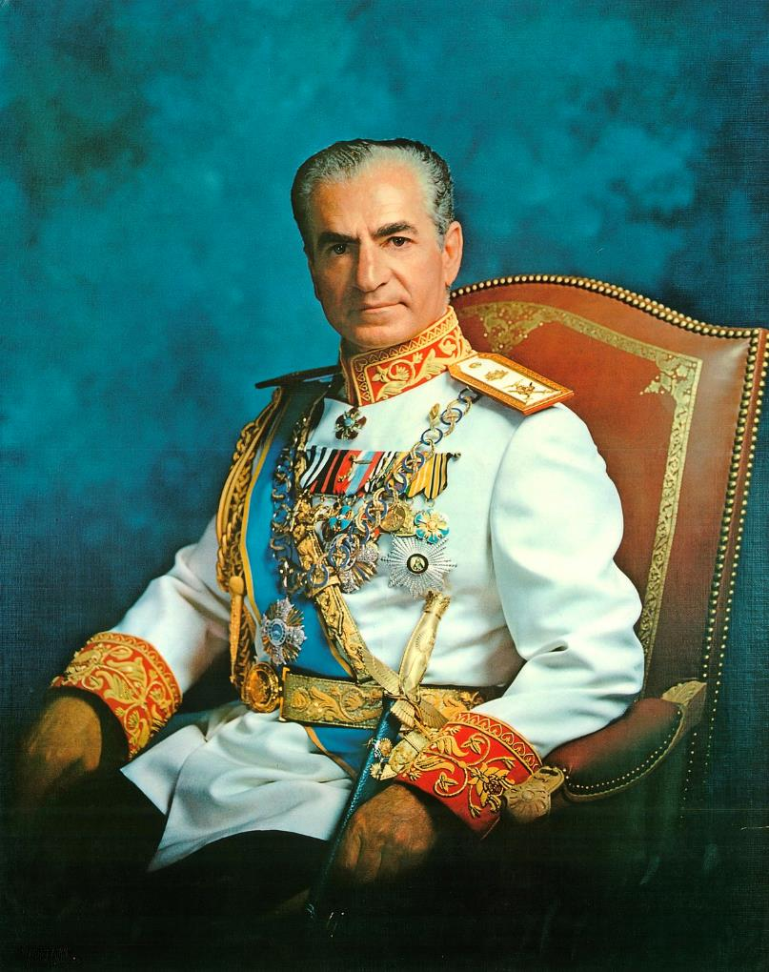
“The shameful so-called White Revolution which in a single day caused 15,000 Muslims to be killed by tanks and machine guns, has made the fate of our people even bleaker. In many of our cities and most of our villages, there are no doctors or medicine. {...}Most catastrophic of all, the 2,500th anniversary of the founding of the monarchy. Let the world know that these celebrations have nothing to do with the noble, Muslim people of Iran. All those who take part are traitors to Islam…”
Ayatollah Khomeini, right, to his followers in Iran following his exile in Nov 1964 https://www.youtube.com/watch?v=oXW9Q5HPzDA&t=308s
Activity 1:
These are two of the figures who defined Iran’s history in the 20th century.
1) What can you learn about their vision for how Iran should be governed?
2) What can you learn about Iran during the 1960s?
3) How are they similar?
4) How are they different?
I will frankly confess that I was convinced that God had ordained me to do certain things for the service of my nation, things that perhaps could not be done by anyone else. In whatever I have done and whatever I do in the future, I consider myself as an agent of the will of God.”
https://en.wikiquote.org/wiki/Mohammad_Reza_Pahlavi#On_Iranian_history
“
I will frankly confess that I was convinced that God had ordained me to do certain things for the service of my nation, things that perhaps could not be done by anyone else. In whatever I have done and whatever I do in the future, I consider myself as an agent of the will of God.”

Slide 9
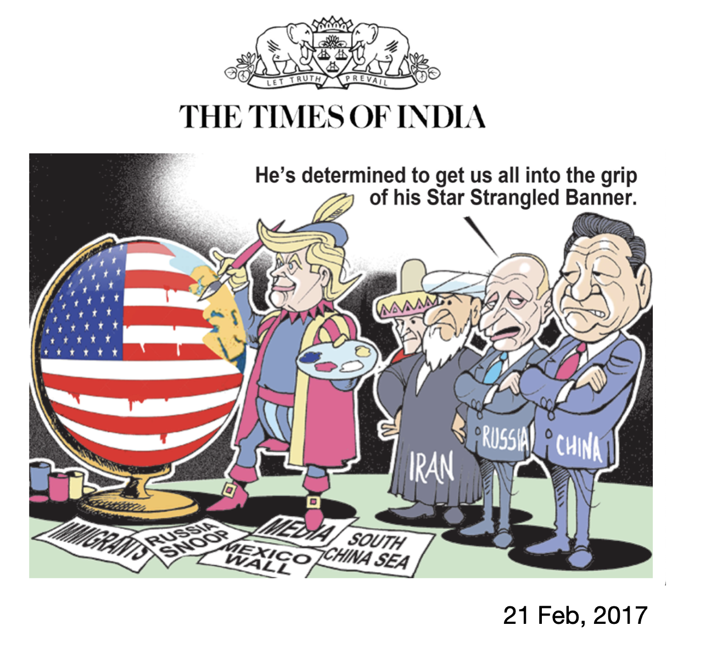
Here are two different views of Iranian and US ambitions to increase their influence over other countries.
How are the two sources different?
How are the two sources similar?
What might explain the different conclusion drawn by each source
Are cartoons credible and reliable sources of evidence?

Slide 10
Key Inquiry
What explains the hostility and the current suspicion between Iran and the United States? Lesson 3

Slide 11
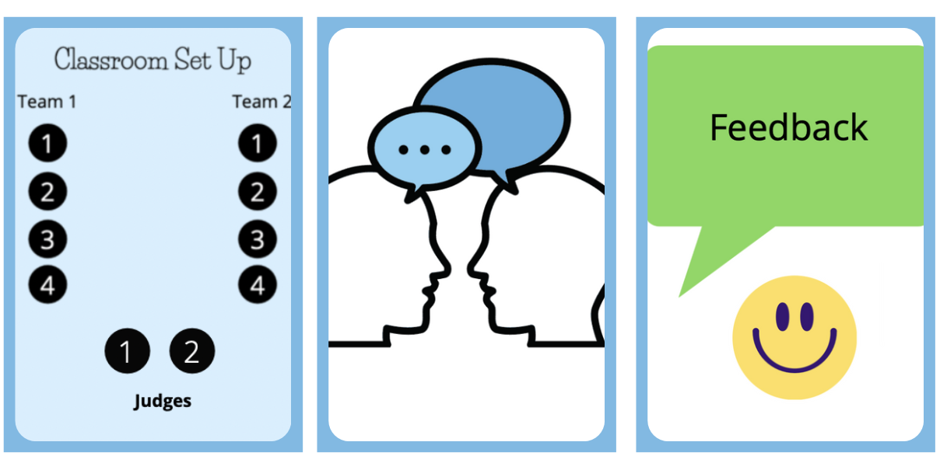
Activity
Prepare, Debate and Reflect
In groups of four prepare either, ‘Iran or USA is to blame for their poor relations.
Each student picks sources to support his/her argument.
Then run debates in groups of ten (two teams of four and two judges)

Slide 12
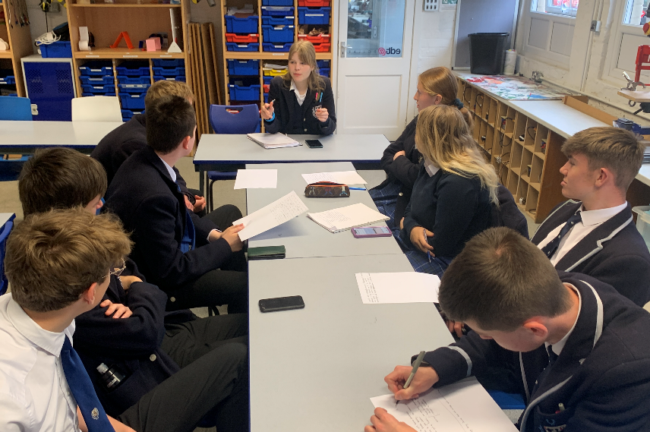
Using the assessment framework below, the judges will give feedback to EACH student using the criteria below.
The judges will give feedback using this format “What we really liked about your speech was (example), and what we’d like you to work on was (example).
Peer assessment and reflection
Assessment framework | Did the speech…
Structure | Follow a clear structure? Include linking sentences? Last 1-2 minutes, or whatever time you set? Link with the other speeches on the same team Include some counter arguments/rebuttal
Evidence | Include quotes/descriptions from the source? Include your own knowledge? Facts, statistics, dates Include critical analysis of why a source was credible evidence?
Language | Include persuasive language?
10mins

