Slide 1
Key Inquiry
What explains the current hostility between Sunni and Shi’a?

Slide 2
‘He (Shah Ismail) reforms our churches, destroys the houses of all
Moors who follow the Sunnah of Muhammad and never spares the
life of any Jew.'
The report of Tomé Pires, the Portuguese ambassador to China during
his visit to Iran in 1511-12.
Both these sources describe how attitudes of rulers to religious differences in their country
How are the sources similar ?
How are the sources different?
‘In Islamic law, the only allowable justification for the war of Muslim
against Muslim is a religious one, 'to enforce the sacred law or to check
transgressions against it'; Ottoman campaigns therefore required sanction
in the form of an opinion expressed by the religious authorities that the
proposed foe had departed from the path of true Islam…The struggle
with the Safavids was clearly going to be not only logistically taxing but,
without doctrinal sanction, illicit. The Ottoman quarrel was cloaked
accordingly in religious rhetoric, their claim to the be the repository of
'right religion’ - in distinction to the errant Safavids - duly emphasized.
The outright condemnation of the Safavids in Ottoman sources is in
surprising contrast to the respectful terms in which Safavid historians
referred to the Ottomans, seeing them as a bastion of Islam in the face of
European unbelief. The Ottomans needed to execrate the Safavids in the
harshest terms their religion could allow in order to justify the severity of
their repressive measures.'
C.Finkel, Osman's Dream: The Story of the Ottoman Empire 1300-1923

Slide 3
Both these sources are about Iraq in the years following the fall of Saddam Hussein.
How are the sources similar?
How are the sources different?
Discuss with your group whether sectarian violence causes religious division, or religious division causes sectarian violence.
"The problem of sectarianism increased after the religious Shiites took power in January 2005. The problem is that religious groups base their popularity on sectarian differences. Take the example of Ahmed Chalabi: In the run-up to the January 2005 elections, he changed overnight from a liberal politician to a religious man to obtain the support of the clerics. This is a dangerous political game.’
19 July 2005, Mijbel Sheikh Issa, one of the new Sunni Arab members of the Iraqi Constitutional Committee, half an hour before he was assassinated in an interview with the International Crisis Group. Quoted in 'Unmaking Iraq: A Constitutional Process Gone Awry' p.3 https://www.crisisgroup.org/middle-east-north-africa/gulf-and-arabian-peninsula/iraq/unmaking-iraq-constitutional-process-gone-awry
“

Slide 4
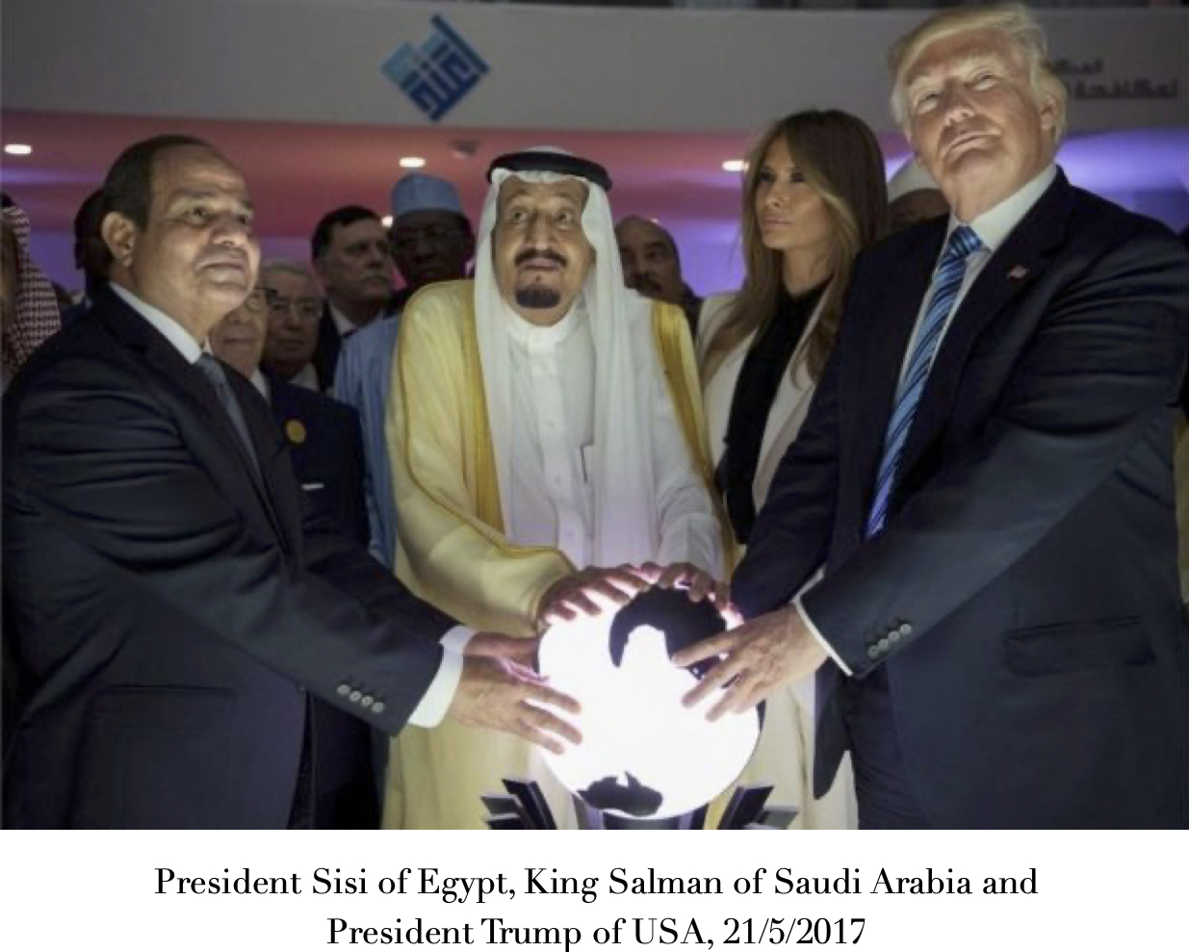
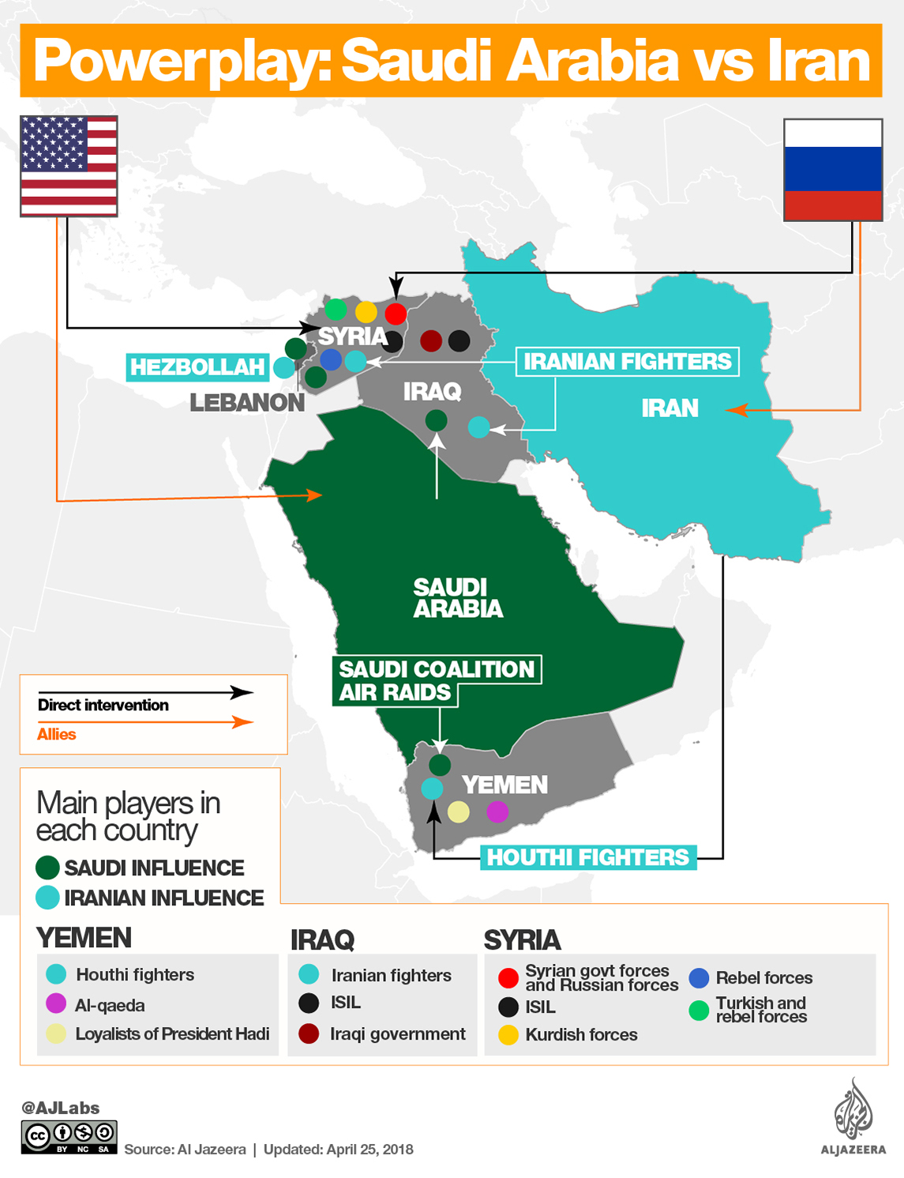
Here are two different views of Iranian and Saudi ambitions to increase their influence over other countries.
How are the two sources similar?
How are the two sources different?
How do these sources help us understand the impact of the rivalry between Russia and the USA on the Sunni Shi’a split?

Slide 5
Activity
Prepare, Debate and Reflect
In groups of four prepare either, ‘Shi’a leadership or Sunni leadership are more to blame for their poor relations.
Each student picks sources to support his/her argument.
Then run debates in groups of ten (two teams of four and two judges)

Slide 6
Using the assessment framework below, the judges will give feedback to EACH student using the criteria below.
The judges will give feedback using this format “What we really liked about your speech was (example), and what we’d like you to work on was (example).
Peer assessment and reflection
Assessment framework | Did the speech…
Structure | Follow a clear structure? Include linking sentences? Last 1-2 minutes, or whatever time you set? Link with the other speeches on the same team Include some counter arguments/rebuttal
Evidence | Include quotes/descriptions from the source? Include your own knowledge? Facts, statistics, dates Include critical analysis of why a source was credible evidence?
Language | Include persuasive language?
10mins

