Slide 1
Length: 2x50 minute classes
Essential question:
To what extent is our understanding of the Cold War impacted by pro-American and pro-Russian bias?
To what extent were actions that escalated the Cold War driven by ideology or fear?
Lesson Objective:
Students will be able to identify, describe and assess varying perspectives on the construction of the Berlin Wall (1961), U.S. Intervention in Vietnam (1955-1975) and the Prague Spring (1968).
Prior Knowledge:
Students should be familiar with the the political and social landscape following World War II, including the ideological differences between the Soviet Union and Western powers.

Slide 2
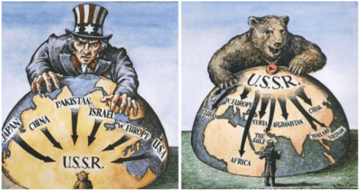
Cold War Perspectives

Slide 3
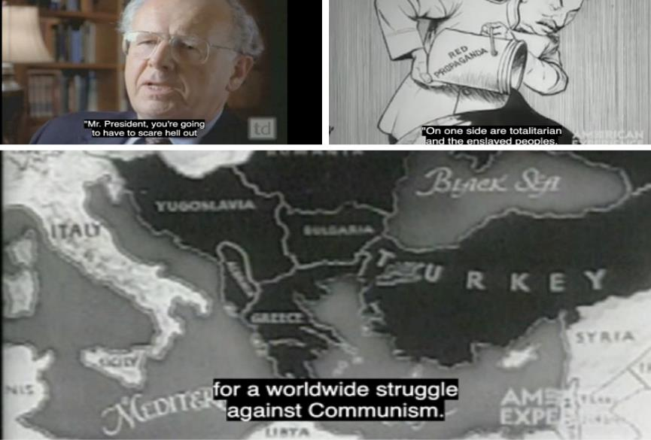
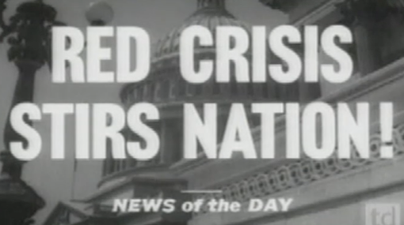
Bell Ringer
Use this QR code or click the image below to access the video needed to complete this bellringer.
Discussion questions:
According to this video, what was the American rationale for preventing the spread of communism?
What do you think the Soviet rationale was for involvement in Turkey and Greece?
What does this video foreshadow about the Cold War?
Notes:
Suggested response:
American involvement in Greece and Turkey (via aid money) was to prevent the spread of communism to ensure/ maintain European allies.
Soviet rationale might have included: Geopolitical: Dardanelles is an important access point to the Soviet Union by connecting the Black Sea to the Aegean/Mediterranean Seas, bolster the buffer between Soviet states and the West. Ideological: Dedication to support of Communist allies (the Greek Rebels)
That rhetoric and propaganda are going to be important in keeping American people willing to invest in the fight against the Communist

Slide 4
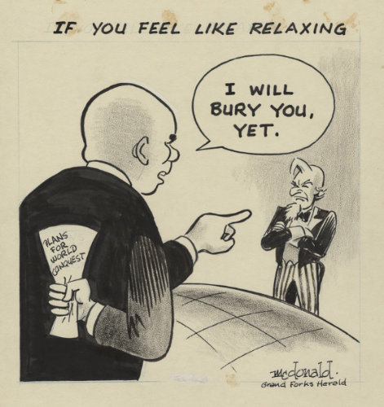
1) THINK
Activity: Study the cartoon and answer the questions below: What does this American political cartoon reveal about American attitudes towards the Soviet Union in 1962? What does this cartoon imply about American involvement in the Cold War? How would this cartoon shape the historical narrative of the Cold War?
Nikita Khrushchev
Doc 1: A cartoon by Stuart McDonald, 1962
2) PAIR
3) SHARE
Discuss the questions with your neighbor
Share out to and record as you listen to everyone

Slide 5
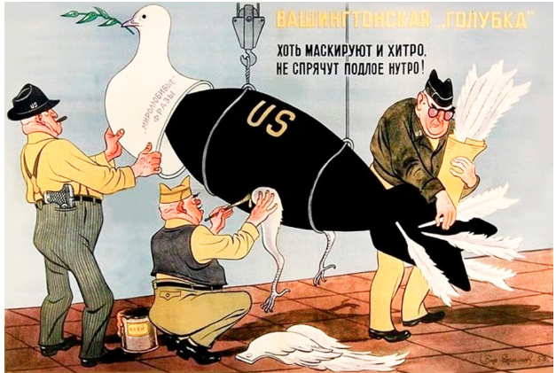
1) THINK
Activity: Study the cartoon and answer the questions below:
What does this Soviet cartoon reveal about Soviet attitudes towards the United States?
What does this cartoon imply about American involvement in the Cold War?
How would this cartoon challenge the American historical narrative of the Cold War
Doc 2: Soviet Poster, “Washington’s Dove of Peace”
“Washington’s dove of peace. Although they are sneakily disguising it, they will not hide its sleazy gut!”
2) PAIR
3) SHARE
Discuss the questions with your neighbor
Share out to and record as you listen to everyone

Slide 6
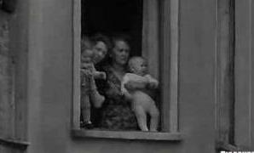
The Berlin Wall 1961
Activity: Click the image to watch the clip on the Berlin Wall from A day that shook the world, 20th August 1961.
Notes:
Use this video clip to introduce the building of the Berlin Wall. Ideally, students are already familiar with the partitioning of Germany and East/ West Berlin the Wall so this would be review,

Slide 7
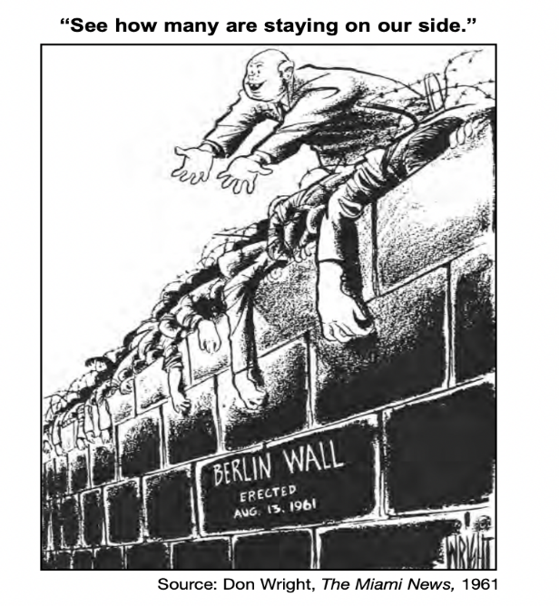
Western Perspective: The Berlin Wall
Activity: Turn to someone near you and use the prompt below to guide your discussion of the cartoon
Identify and describe aspects from this cartoon that shows what this American cartoonist believed was the impact of the Berlin Wall.
Doc 3:

Slide 8
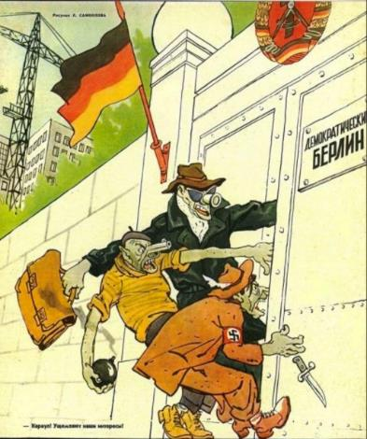
Soviet Perspective: The Berlin Wall August 13, 1961
East Germans referred to the Berlin Wall as “Antifascistischer Schutzwall,” or “antifascist bulwark,” between East and West Berlin.
The Soviets claimed its purpose was to keep Western “fascists” from entering East Germany and undermining the socialist state.
Soviet government claimed that workers from the East who were going to the West to work were being taken advantage of, justifying the wall’s ability to keep people from leaving the East.
“Western Fascists”
Doc 4:
Doc 5:
After the wall was built, the East German Communist party began justifying and celebrating the building of the wall:
“13 August was a victory for the forces of peace and socialism. The forces of war and reaction were defeated.
The victory was achieved by peace-loving Germans, by good Germans... The USA’s war policy failed. We say: “Ami go home!”
Notes:
https://research.calvin.edu/german-propaganda-archive/schlugs13.htm

Slide 9
Highlight/ Annotate
After the closing of the border, suddenly there was still present in the East German capital even in the evenings, enough meat of the best quality, while before, especially on weekends, it was already sold out by midday. We also do not have any more problems with bread or butter in the capital. Even the women are satisfied that they can now go to the hairdresser's, since until now the big hair dressing salons were occupied by West Berlin women. In West Germany, the defense measures of August 13 also led to a sobering up among a part of the bourgeoisie. … The strengthening of the workers-and-peasants state of East Germany and the victory of socialism is the basic condition to overcoming the imperialist past and present in all of Germany and to establishing a militarily neutral and flourishing Germany. We assess the situation such that East Germany will be strengthened further. In this we must see that also when the borders are closed the competition with West Germany will continue. Thus, we must overcome in the next years the losses which we have suffered because of West Berlin aggression; we must carry out economic cooperation with the USSR consistently, and reach the figures of the Seven-Year Plan again in 1963.
Activity
Highlight:
Evidence that shows what he believed was the impact of the Berlin Wall
Key words/phrases that reveal his view on the West
Annotate:
What you’ve highlighted using the following sentences frame “This shows…”
Doc 6: Letter from Walter Ulbricht, leader of East Germany to Khrushchev, 15 September 1961.
Walter Ulbricht was the First Secretary of the East German Communist Party from 1950 to 1971 giving him power as the chief decision-maker in East Germany
Nikita Khrushchev was the First Secretary of the Communist Party of the Soviet Union from 1953 to 1964
Notes:
This can be done in class or for homework
Full Letter: Letter from Ulbricht

Slide 10
Highlight/Annotate
After the closing of the border, suddenly there was still present in the East German capital even in the evenings, enough meat of the best quality, while before, especially on weekends, it was already sold out by midday. We also do not have any more problems with bread or butter in the capital. Even the women are satisfied that they can now go to the hairdresser's, since until now the big hair dressing salons were occupied by West Berlin women. In West Germany, the defense measures of August 13 also led to a sobering up among a part of the bourgeoisie. … The strengthening of the workers-and-peasants state of East Germany and the victory of socialism is the basic condition to overcoming the imperialist past and present in all of Germany and to establishing a militarily neutral and flourishing Germany. We assess the situation such that East Germany will be strengthened further. In this we must see that also when the borders are closed the competition with West Germany will continue. Thus, we must overcome in the next years the losses which we have suffered because of West Berlin aggression; we must carry out economic cooperation with the USSR consistently, and reach the figures of the Seven-Year Plan again in 1963.
This shows that he believed that the good food (resources) were taken by West Berliners and now with the wall East Berliners have more access.
This shows that he feels that West…
Doc 6: Letter from Walter Ulbricht, leader of East Germany to Khrushchev, 15 September 1961.
Notes:
This page can be used to give students a few examples of what they are being asked to do.

Slide 11
Bell ringer
After the closing of the border, suddenly there was still present in the East German capital even in the evenings, enough meat of the best quality, while before, especially on weekends, it was already sold out by midday. We also do not have any more problems with bread or butter in the capital. Even the women are satisfied that they can now go to the hairdresser's, since until now the big hair dressing salons were occupied by West Berlin women. In West Germany, the defense measures of August 13 also led to a sobering up among a part of the bourgeoisie. … The strengthening of the workers-and-peasants state of East Germany and the victory of socialism is the basic condition to overcoming the imperialist past and present in all of Germany and to establishing a militarily neutral and flourishing Germany. We assess the situation such that East Germany will be strengthened further. In this we must see that also when the borders are closed the competition with West Germany will continue. Thus, we must overcome in the next years the losses which we have suffered because of West Berlin aggression; we must carry out economic cooperation with the USSR consistently, and reach the figures of the Seven-Year Plan again in 1963.
Activity: Based on your annotations of the Ulbricht Letter add to your notes and answer the summative question
Did the East Germans build the Berlin Wall because of ideology or fear? Explain using examples
Doc 6: Letter from Walter Ulbricht, leader of East Germany to Khrushchev, 15 September 1961.
Notes:
Begin the second class by reviewing the annotations made on the Ulbricht letter and discussing with the class the idea of ideology vs. fear. This will complete handout #1

Slide 12
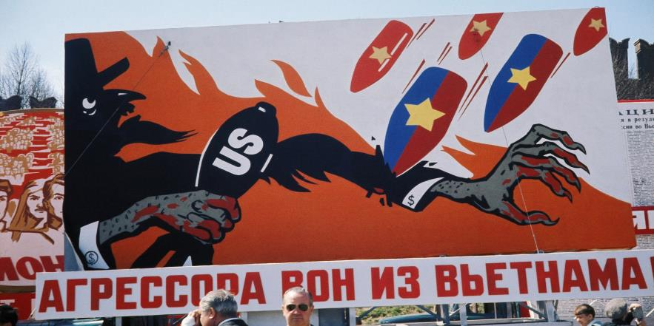
Perspectives on the Vietnam War
Thinking point: Identify and describe elements of this cartoon that shows what the Soviet government believed about the Vietnam war and the United States.
Doc 7: “Aggressors Out of Vietnam!’ reads a May Day billboard on a Moscow street in 1968. Getty Images
Notes:
Use handout #2
For more information regarding the U.S.S.R.s interests in Vietnam https://www.nytimes.com/2018/03/27/opinion/russians-vietnam-war.html
For more information regarding Soviet propaganda/information systems https://www.wilsoncenter.org/blog-post/the-soviet-side-the-cultural-cold-war

Slide 13
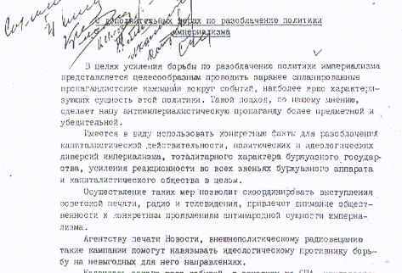
Discuss: What does this memo outlining Soviet Propaganda goals reveal about their views of the West?
CENTRAL COMMITTEE. COMMUNIST PARTY OF THE SOVIET UNION
Additional Measures To Expose Imperialist Policies
…
We intend to make use of concrete facts to expose capitalist reality, political and ideological diversions of imperialism, the totalitarian character of a bourgeois state, and the strengthening of reactionary thought in the bourgeois apparatus and in capitalistic society as a whole.
The realization of such measures will permit us to coordinate the Soviet press, radio and television in such a way that the public's attention will be directed to the concrete manifestations of the anti-popular nature of imperialism.
Such propaganda campaigns will help the press agency Novosti, and politically oriented radio programs transmitted abroad to force our ideological enemy onto disadvantageous paths in the ideological struggle.
A calendar of this type of events, mainly pertaining to the USA is attached. Similar plans pertaining to other imperialistic states could be developed in the course of work.
We request your review.
A. Iakovlev
Assistant Chief of the Propaganda Department, TsK KPSS January 21, 1971
Doc 8: A memo from the Central Committee Communist Party of the Soviet Union
Notes:
https://www.loc.gov/exhibits/archives/sovi.html

Slide 14
How might the Soviets have responded to President Johnson?
Doc 9: Lyndon B. Johnson, “Why Americans Fight in Vietnam” (1965)
“we are to live in a world where every country can shape its own destiny”
“The contest in Vietnam is part of a wider pattern of aggressive purposes.”
“Our objective is the independence of South Viet-Nam and its freedom from attack.”
“We are there …to strengthen world order”
“we fight for values and we fight for principle”

Slide 15
Highlight/ Annotate
We fight because we must fight if we are to live in a world where every country can shape its own destiny, and only in such a world will our own freedom be finally secure.
The world as it is in Asia is not a serene or peaceful place. The first reality is that North Viet-Nam has attacked the independent nation of South Viet-Nam. Its object is total conquest. . . And it is a war of unparalleled brutality.
The confused nature of this conflict cannot mask the fact that it is the new face of an old enemy. Over this war—and all Asia—is another reality: the deepening shadow of Communist China. The rulers in Hanoi are urged on by Peking. The contest in VietNam is part of a wider pattern of aggressive purposes.
Why are these realities our concern? Why are we in South Viet-Nam?
We are there …to strengthen world order. Around the globe from Berlin to Thailand are people whose well-being rests in part on the belief that they can count on us if they are attacked. To leave Viet-Nam to its fate would shake the confidence of all these people in the value of an American commitment and in the value of America’s word. The result would be increased instability, and even wider war.
Our objective is the independence of South Viet-Nam and its freedom from attack. We want nothing for ourselves—only that the people of South Viet-Nam be allowed to guide their own country in their own way.
We will not be defeated. Our resources are equal to any challenge because we fight for values and we fight for principle, rather than territory or colonies, our patience and our determination are unending.
Activity
Highlight:
Key words/phrases that reveal/allude to his bias favoring democracy and that U.S. involvement in Vietnam is ideological
Key words/phrases that reveal/allude that U.S. involvement in Vietnam is out of fear of a perceived threat
Annotate:
What you’ve highlighted using the following sentences frame “This shows…”
Doc 9: Lyndon B. Johnson, “Why Americans Fight in Vietnam” (1965) Speech delivered at Johns Hopkins University on April 7, 1965
Notes:
https://www.nytimes.com/2018/03/27/opinion/russians-vietnam-war.html “Why were the Russians in Vietnam?”

Slide 16
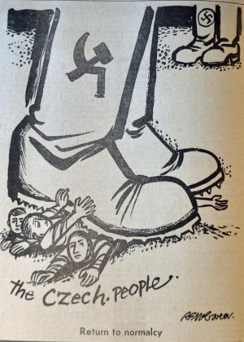
Perspectives on the Prague Spring
Activity: Compare and Contrast Soviet and U.S. perspectives on the Prague Spring and complete the Venn diagram on handout #2
The peoples of the socialist countries and Communist parties certainly do have and should have freedom for determining the ways of advance of their respective countries. However, none of their decisions should damage either socialism in their country or the fundamental interests of other socialist countries, and the whole working class movement, which is working for socialism. This means that each Communist party is responsible not only to its own people, but also to all the socialist countries, to the entire Communist movement. Whoever forget this, in stressing only the independence of the Communist party, becomes one sided. He deviates from his international duty….Czechoslovakia's detachment from the socialist community, would have come into conflict with its own vital interests and would have been detrimental to the other socialist states. Such "self determination," as a result of which NATO troops would have been able to come up to the Soviet border, while the community of European socialist countries would have been split, in effect encroaches upon the vital interests of the peoples of these countries and conflicts, as the very root of it, with the right of these people to socialist self determination. Discharging their internationalist duty toward the fraternal peoples of Czechoslovakia and defending their own socialist gains, the U.S.S.R. and the other socialist states had to act decisively and they did act against the antisocialist forces in Czechoslovakia.
Doc 10: The Brezhnev Doctrine, From Pravda, September 25, 1968
Doc 11: A US cartoon on the Prague Spring
Notes:
This can be done for homework or as an in class activity!

Slide 17
Summarize
Was the Cold War driven by fear of a perceived threat or the promotion of one ideology over another? Explain using examples.

